Slide 1
AAO-HNSF Clinical Practice Guideline: Nosebleed (Epistaxis)
Publication Date: January 7, 2020

Slide 2
Disclaimer
This clinical practice guideline is not intended as an exhaustive source of guidance for managing patients with epistaxis. Rather, it is designed to assist clinicians by providing an evidence-based framework for decision-making strategies. The guideline is not intended to replace clinical judgment or establish a protocol for all individuals with this condition and may not provide the only appropriate approach to diagnosing and managing this program of care. As medical knowledge expands, and technology advances, clinical indicators and guidelines are promoted as conditional and provisional proposals of what is recommended under specific conditions but are not absolute. Guidelines are not mandates. These do not and should not purport to be a legal standard of care. The responsible physician, with consideration of all circumstances presented by the individual patient, must determine the appropriate treatment. Adherence to these guidelines will not ensure successful patient outcomes in every situation. The AAO-HNSF emphasizes that these clinical guidelines should not be deemed to include all proper treatment decisions or methods of care, or to exclude other treatment decisions or methods of care reasonably directed to obtaining the same results.

Slide 3

AAO-HNSF Guideline Development Group
David E. Tunkel, MD Chair
Samantha Anne, MD, MS Assistant Chair
Spencer C. Payne, MD Assistant Chair
Stacey L. Ishman, MD, MPH Methodologist
Richard M. Rosenfeld, MD, MPH, MBA Methodologist
Peter J. Abramson, MD, AAO-HNSF Board of Directors (BOD)
Jacqueline D. Alikhaani, Consumers United for Evidence-based Healthcare (CUE)
Margo Mckenna Benoit, MD, AAO-HNSF Pediatric Otolaryngology Committee
Rachel S. Bercovitz, MD, MS, American Society of Hematology (ASH)
Michael D. Brown, MD, MSc, American College of Emergency Physicians (ACEP)
Boris Chernobilsky, MD, AAO-HNSF Board of Governors (BOG)
David A. Feldstein, MD, American College of Physicians (ACP)
Jesse M. Hackell, MD, American Academy of Pediatrics (AAP)
Eric H. Holbrook, MD, American Rhinologic Society (ARS)
Sarah M. Holdsworth, MSN, APRN, Society of Otorhinolaryngology Head and Neck Nurses (SOHN)
Kenneth W. Lin, MD, MPH, American Academy of Family Physicians (AAFP)
Meredith Merz Lind, MD, AAO-HNSF Pediatric Otolaryngology Education Committee
David M. Poetker, MD, MA, Hereditary Hemorrhagic Telangiectasia (HHT) (CUREHTT)
Charles A. Riley, MD, Section for Residents and Fellows (SRF)
John S. Schneider MD, MA, AAO-HNSF Rhinology Paranasal Sinus
Michael D. Seidman, MD, AAO-HNSF Medical Devices Committee
Venu Vadlamudi, MD, Society of Interventional Radiology (SIR)
Tulio A. Valdez, MD, American Society of Pediatric Otolaryngology (ASPO)
Lorraine C. Nnacheta, MPH, DrPH, AAO-HNSF Staff Liaison (AAOHNSF)
Taskin M. Monjur, AAO-HNSF Staff Liaison (AAOHNSF)

Slide 4
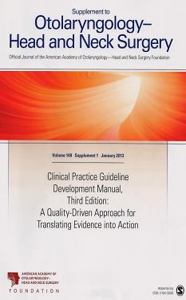
Clinical Practice Guideline Development Manual: Third Edition Rosenfeld, Shiffman, and Robertson
Pragmatic, transparent approach to creating guidelines for performance assessment
Evidence-based, multidisciplinary process leading to publication in 12-18 months
Emphasizes a focused set of key action statements to promote quality improvement
Uses action statement profiles to summarize decisions in recommendations

Slide 5

Clinical Practice Guidelines (CPG) Goals
Focus on quality improvement opportunities
Define actionable recommendations for clinicians regardless of discipline to improve care
The guideline is not intended to be comprehensive
The guideline is not intended to limit or restrict care provided by clinicians to individual patients

Slide 6
Nosebleed: Healthcare Burden
Nearly 60% of the population experience a nosebleed at least once.
One-tenth of these patients eventually seek medical advice/intervention and 0.16% will need hospitalization (Viehweg, Roberson, Hudson 2006).
Nosebleeds seem to affect the population in bimodal age distribution, with more nosebleeds seen in children and in the elderly (Schlosser 2009).

Slide 7
Nosebleed: Healthcare Burden
A study using the Nationwide Emergency Department Sample (NEDS) from 2009 to 2011 identified 1.2 million emergency department visits for epistaxis in the United States--0.32% of all emergency department encounters (Sethi, Kozin, Abt, Bergmark, Gray 2018)
While epistaxis is usually spontaneous without obvious cause, some nosebleeds can be associated with systemic hematologic, hepatic, renal, genetic, or cardiovascular diseases.
Nosebleeds are also a recognized problem for patients with known inherited bleeding disorders such as von Willebrand disease or hemophilia, as well as for patients with abnormal nasal vasculature such as that seen in hereditary hemorrhagic telangiectasia (HHT) syndrome (Eshghi, Jenabzade, Habibpanah 2014) (Halderman, Ryan, Clark et al 2018)

Slide 8
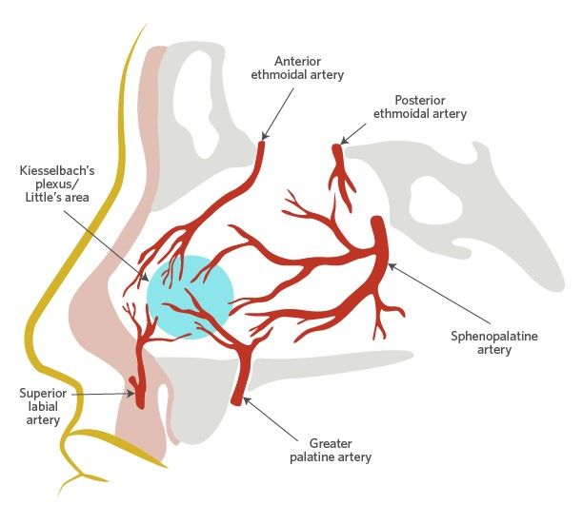
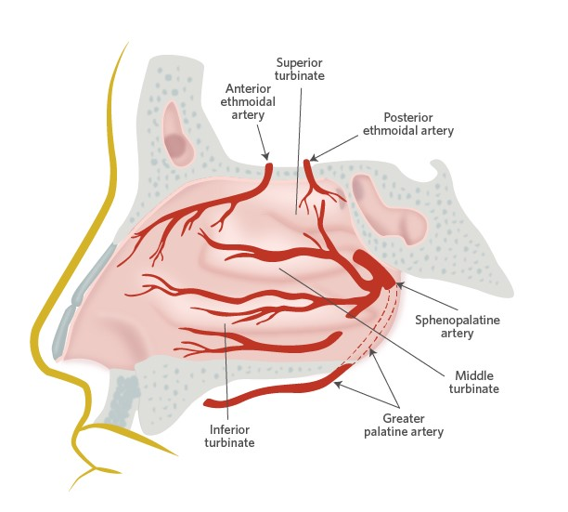
Most nosebleeds originate from the nasal septum, although the lateral nasal wall has a rich vascular supply as well
Vascular supply of the nasal septum
Vascular supply of the lateral nasal wall

Slide 9
Purpose and Target Audience
PURPOSE: to identify quality improvement opportunities in the management of nosebleeds and to create clear and actionable recommendations to implement these opportunities in clinical practice.
TARGET PATIENT: any individual aged three years and older with a nosebleed or history of nosebleed who needs medical treatment or seeks medical advice.
TARGET AUDIENCE: clinicians who evaluate and treat patients with nosebleed. This includes primary care providers such as family medicine physicians, internists, pediatricians, physician assistants, and nurse practitioners.
EXCLUSIONS: Does not apply to patients who have a diagnosed bleeding disorder, tumors of the nose or nasopharynx, vascular malformations of the head and neck, a history of recent facial trauma, or have undergone nasal and/or sinus surgery in the past 30 days.

Slide 10
Literature Search
Performed by an information specialist
Evidence included:
Clinical Practice Guidelines: 5
Systematic Reviews: 17
Randomized Control Trials: 16
163 references in the final CPG document

Slide 11
Strength of Action Terms/Implied Levels of Obligation
Strength | Definition | Implied Obligation
Strong Recommendation | The benefits of the recommended approach clearly exceed the harms (or that the harms clearly exceed the benefits in the case of a strong negative recommendation) and that the quality of the supporting evidence is excellent (Grade A or B) | In some clearly identified circumstances, strong recommendations may be made based on lesser evidence when high-quality evidence is impossible to obtain, and the anticipated benefits strongly outweigh the harms. Clinicians should follow a strong recommendation unless a clear and compelling rationale for an alternative approach is present.
Recommendation | A recommendation means the benefits exceed the harms (or that the harms exceed the benefits in the case of a negative recommendation), but the quality of evidence is not as strong (Grade B or C) | In some clearly identified circumstances, recommendations may be made based on lesser evidence when high-quality evidence is impossible to obtain and the anticipated benefits outweigh the harms. Clinicians should also generally follow a recommendation but should remain alert to new information and sensitive to patient preferences.
Option | An option means that either the quality of evidence that exists is suspect (Grade D) or that well-done studies (Grade A, B, or C) show little clear advantage to one approach versus another. | Clinicians should be flexible in their decision making regarding appropriate practice, although they may set bounds on alternatives. Patient preference should have a substantial influencing role.

Slide 12
CPG Nosebleed: Action Statements
Recommendations: 15
Prompt treatment, nasal compression, packing (3), risk factors, anterior rhinoscopy, nasal endoscopy, treatment of identified bleeding site, nasal cautery, surgery/embolization, patients on anticoag/anti-platelet meds, HHT, patient education, outcomes assessment
Options:1
Nasal endoscopy
Strong Recommendations: NONE

Slide 13
STATEMENT 1. PROMPT MANAGEMENT
STATEMENT 1: PROMPT MANAGEMENT: At the time of initial contact, the clinician should distinguish the nosebleed patient who requires prompt management from the patient who does not. Recommendation based on observational studies and a preponderance of benefit over harm.
Benefit: Prevention of morbidity and in rare cases mortality; increased likelihood of timely treatment; more efficient allocation of resources to patients in greatest need of treatment; reduction of patient and family stress; avoidance of unnecessary interventions in patients who are not actively bleeding.
Risks, harms, costs: Delayed treatment of patients who may actually need intervention, overtreatment of patients who are not actively bleeding, increased patient anxiety. No costs are associated with this recommendation

Slide 14
STATEMENT 1. PROMPT MANAGEMENT
Action Statement Profile
Quality improvement opportunity: To identify those patients who need immediate diagnosis and treatment. (National Quality Strategy: Patient safety)
Level of Confidence in Evidence: Medium, as available evidence only addresses nosebleed patients who actually seek and receive medical intervention
Aggregate Evidence Quality: Grade C, based on observational studies on the effectiveness of interventions
Benefit-Harm Assessment: Preponderance of benefit over harm
Value Judgments: None
Intentional Vagueness: The actual appropriate timing for “prompt” management is not specified, as it may vary with different clinical situations; assessment of bleeding severity may occur during telephone/electronic communications or during face-to-face patient encounter.
Role of Patient Preferences: None
Exclusions: None
Policy Level: Recommendation
Differences of Opinion: None

Slide 15
STATEMENT 2. NASAL COMPRESSION
STATEMENT 2: NASAL COMPRESSION: The clinician should treat active bleeding for patients in need of prompt management with firm sustained compression to the lower third of the nose, with or without the assistance of the patient or caregiver, for five minutes or longer. Recommendation based on observational studies and a preponderance of benefit over harm.
Benefit: Use of the simplest method to stop nosebleeds, reduce morbidity, protect airway, reduce need for blood products, improve patient satisfaction, allow for further assessment and management
Risks, harms, costs: May delay more definitive management if needed; patient discomfort

Slide 16
STATEMENT 2. NASAL COMPRESSION
Action Statement Profile
Quality improvement opportunity: To promote effective treatment for nosebleed patients. (National Quality Strategy Domain: Patient and family engagement, Clinical processes/effectiveness)
Level of Confidence in Evidence: Medium
Aggregate Evidence Quality: Grade C, observational studies and control group of 1 randomized controlled trial
Benefit-Harm Assessment: Preponderance of benefit over harm
Value Judgments: The GDG felt the least invasive, most readily available, and lowest-cost management method should be used first in patients with nosebleeds
Intentional Vagueness: Patients or caregivers may choose to perform sustained digital compression under the direction of the clinician if willing and able. A nose clip is an alternative to digital compression if available and tolerated by the patient. The precise duration of compression is not stated, although the GDG felt a minimum of 5 minutes was necessary to control bleeding. We agreed that longer periods of compression and repeated compression may be helpful for persistent bleeding. Vasoconstrictors can be applied by clinician or patient in conjunction with compression.
Role of Patient Preferences: None
Exclusions: None
Policy Level: Recommendation
Differences of Opinion: None

Slide 17
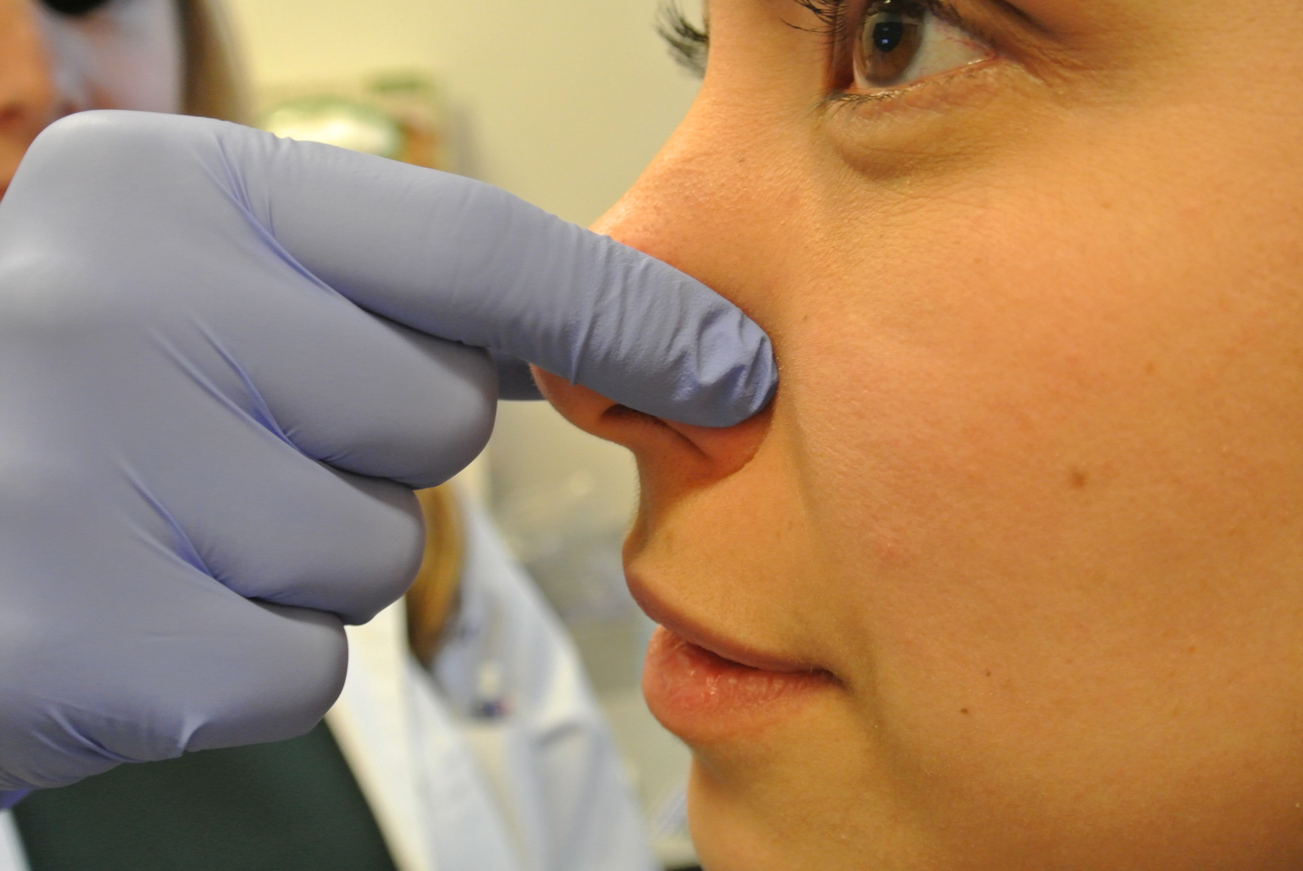
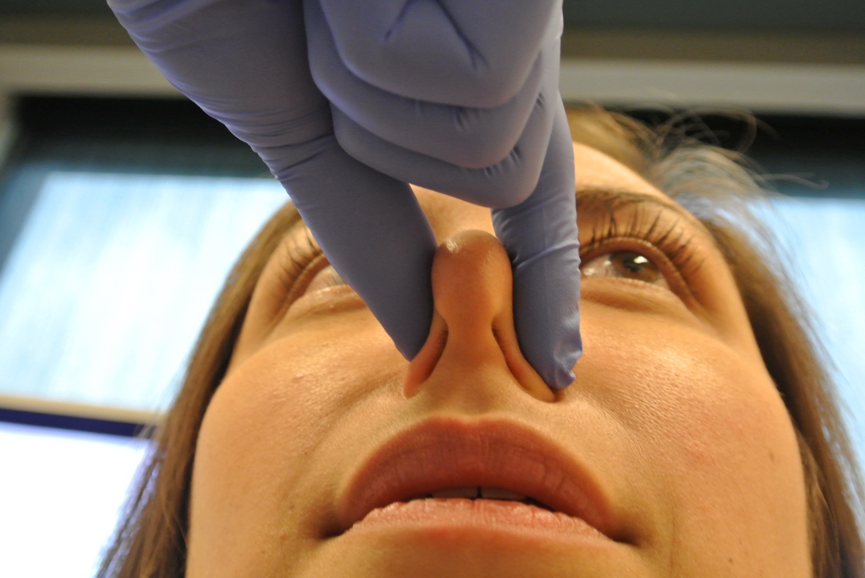
Digital Compression of the Lower Third of the Nose

Slide 18
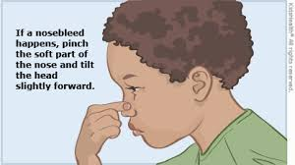
Digital Compression of the Lower Third of the Nose

Slide 19
STATEMENT 3A. NASAL PACKING
STATEMENT 3A: NASAL PACKING: For patients in whom bleeding precludes identification of a bleeding site despite nasal compression, the clinician should treat ongoing active bleeding with nasal packing. Recommendation based on observational studies and a preponderance of benefit over harm.
Benefit: Effective and prompt control of nasal bleeding, reduce morbidity, protect airway, reduce need for blood products, allow for additional assessment and management to control bleeding
Risks, harms, costs: Failure to control bleeding, delay in care, can make subsequent examination more difficult, patient discomfort, mucosal damage from packing insertion/removal, damage to intranasal structures, possible infection, possible antibiotic exposure, adverse respiratory effects of nasal obstruction, cost of packing materials and procedure

Slide 20
STATEMENT 3A. NASAL PACKING
Action Statement Profile
Quality improvement opportunity: Promote effective treatment for nosebleed patients. (National Quality Strategy Domains: Patient and family engagement, clinical processes/effectiveness)
Level of Confidence in Evidence: Medium
Aggregate Evidence Quality: Grade C, based on observational studies and 2 randomized controlled trials
Benefit-Harm Assessment: Preponderance of benefit over harm
Value Judgments: None
Intentional Vagueness: The duration of packing is not specified, but the GDG felt that long durations of packing should be avoided.
Role of Patient Preferences: Small to moderate, as some may decline packing and instead elect to try more or less aggressive treatments
Exclusions: None
Policy Level: Recommendation
Differences of Opinion: None

Slide 21
STATEMENT 3B. NASAL PACKING IN PATIENTS WITH SUSPECTED INCREASED BLEEDING RISK
STATEMENT 3B: NASAL PACKING IN PATIENTS WITH SUSPECTED INCREASED BLEEDING RISK: The clinician should use resorbable packing for patients with a suspected bleeding disorder or for patients who are using anticoagulation or antiplatelet medications. Recommendation based on observational studies and 2 randomized controlled trials, and a preponderance of benefit over harm.
Benefit: Reduce likelihood of additional bleeding when non-resorbable packing is removed, reduce morbidity, protect airway, reduce need for blood products, allow for proper further assessment and management, reduce the need for future visits, improve patient comfort as compared to non-resorbable packing
Risks, harms, costs: Scarring, failure to control the bleed, can make subsequent exam more difficult, patient discomfort, cost for resorbable packing materials, possible infection, possible antibiotic exposure, adverse respiratory effects of nasal obstruction, delay of care if resorbable packing not available

Slide 22
STATEMENT 3B. NASAL PACKING IN PATIENTS WITH SUSPECTED INCREASED BLEEDING RISK
Action Statement Profile
Quality improvement opportunity: Promote effective treatment for nosebleed patients. (National Quality Strategy Domains: Patient and family engagement, clinical processes/effectiveness)
Level of Confidence in Evidence: Medium
Aggregate Evidence Quality: Grade C, based on observational studies and 2 randomized controlled trials
Benefit-Harm Assessment: Preponderance of benefit over harm
Value Judgments: None
Intentional Vagueness: The specific type of resorbable packing is not addressed as there are a variety of materials, with limited evidence to support use of any one specific material. Experience and local availability may dictate the specific type of packing material used
Role of Patient Preferences: None
Exclusions: Patients who take “low dose” daily aspirin and do not take other anti-platelet and/or anticoagulation medications
Policy Level: Recommendation
Differences of Opinion: The use of the term resorbable versus other terms (absorbable, dissolvable, degradable) was debated by the GDG, as multiple terms are used in the literature. The vote was 0 for degradable, 1 for absorbable, 10 for resorbable and 8 for dissolvable. One panel member was recused from these statements regarding nasal packing, as this member was concerned about potential conflict of interest with a role as a US Food and Drug Administration (FDA) patient representative

Slide 23
STATEMENT 4. NASAL PACKING EDUCATION
STATEMENT 4: NASAL PACKING EDUCATION: The clinician should educate the patient who undergoes nasal packing about the type of packing placed, timing of and plan for removal of packing (if not resorbable), postprocedure care and any signs or symptoms that would warrant prompt reassessment. Recommendation based on observational studies and one systematic review with a preponderance of benefit over harm.
Benefit: Reduce complications of packing, prompt recognition of complications, avoid prolonged packing duration, decrease patient anxiety, improve patient satisfaction, allow shared decision making regarding the decision to use prophylactic systemic antibiotics, improve timing of appropriate follow-up
Risks, harms, costs: Time for education, increase patient anxiety regarding potential complications

Slide 24
Statement 4. Nasal Packing Education
Action Statement Profile
Quality improvement opportunity: To improve patient education regarding care after nasal packing; (National Quality Strategy Domains: Patient Safety, Person and Family Centered Care, Health and Well-being of Communities)
Level of Confidence in Evidence: Medium
Aggregate Evidence Quality: Grade C, based on observational studies and one systematic review
Benefit-Harm Assessment: Preponderance of benefit over harm
Value Judgments: Although evidence regarding education specifically about nasal packing is not available, the GDG made this recommendation based on indirect evidence regarding the benefits of education about medical interventions in general; GDG expressed concern that plans for removal of packing may not be clear for some patients, leading to prolonged packing duration and perhaps complications.
Intentional Vagueness: None
Role of Patient Preferences: None
Exclusions: None
Policy Level: Recommendation
Differences of Opinion: None

Slide 25
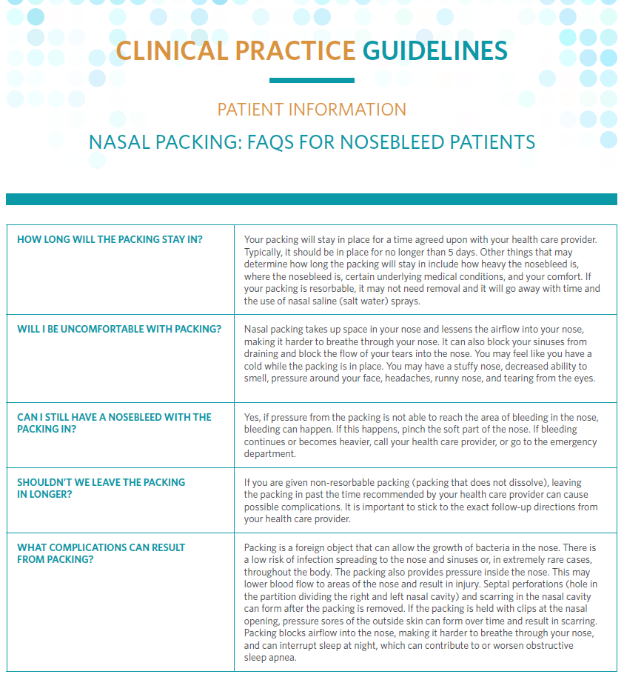
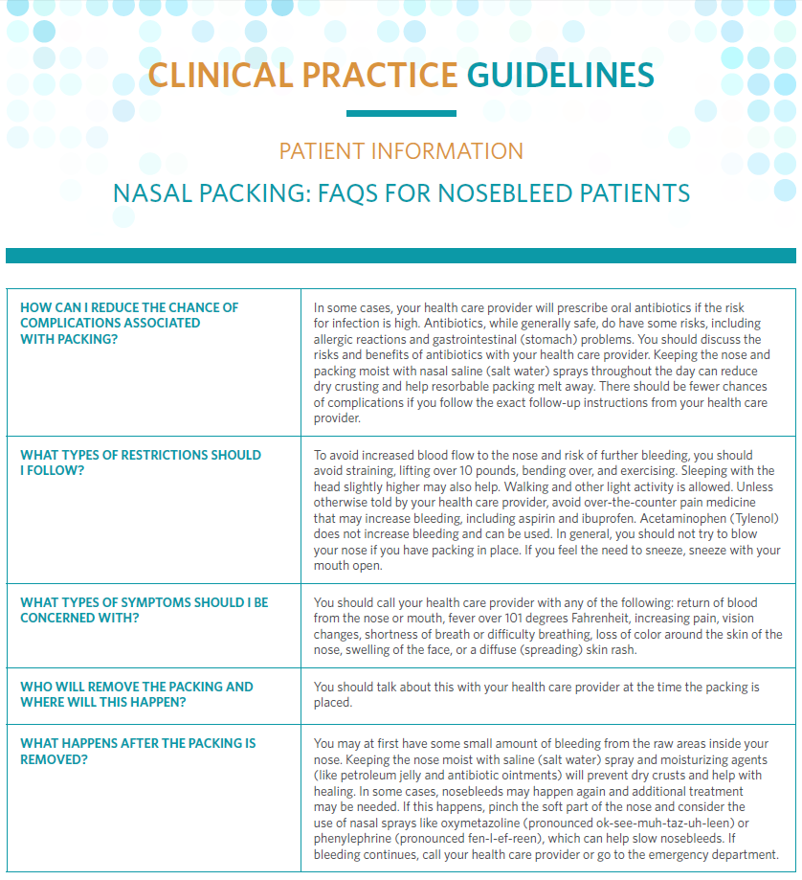
Nasal Packing FAQs

Slide 26
Statement 5. Risk Factors
Statement 5. Risk Factors: The clinician should document factors that increase the frequency or severity of bleeding for any patient with a nosebleed, including personal or family history of bleeding disorders, use of anticoagulant or antiplatelet medications, or intranasal drug use. Recommendation based on observational studies and a preponderance of benefit over harm.
Benefit: Adapt treatment to comorbid conditions and history, avoid delay in diagnosis, early identification of contributing causes of bleeding, reduce costs for patients with associated conditions
Risks, harms, costs: Unnecessary diagnostic procedures, potential delay in initiating first-line treatments for nosebleed while identifying and managing risk factors.

Slide 27
Statement 5. Risk Factors
Action Statement Profile
Quality improvement opportunity: To improve awareness of factors that modify management of nosebleeds; (National Quality Strategy Domains: Patient Safety, Effective Communication and Care Coordination)
Level of Confidence in Evidence: Medium
Aggregate Evidence Quality: Grade C, based on observational studies
Benefit-Harm Assessment: Preponderance of benefit over harm
Value Judgments: None
Intentional Vagueness: The bleeding disorders or medications that can increase risk of nosebleed are not specified, as there are many such disorders and medications
Role of Patient Preferences: None
Exclusions: None
Policy Level: Recommendation
Differences of Opinion: None

Slide 28
Statement 6. Anterior Rhinoscopy to Identify Location of Bleeding
Statement 6. Anterior Rhinoscopy to Identify Location of Bleeding: The clinician should perform anterior rhinoscopy to identify a source of bleeding after removal of any blood clot (if present) for patients with nosebleeds. Recommendation based on observational studies with a preponderance of benefit over harm.
Benefit: Identify a bleeding site that could expedite and focus treatment; instruct that removal of clot, when present, can assist with hemostasis and identification of the bleeding site; diagnose other causes of nosebleeds such as tumor, differentiate anterior from posterior nosebleeds, determine laterality of the bleeding
Risks, harms, costs: Potential trauma to the nose, patient discomfort, cause bleeding with clot removal or manipulation

Slide 29
Statement 6. Anterior Rhinoscopy to Identify Location of Bleeding
Action Statement Profile
Quality improvement opportunity: To educate clinicians regarding the importance of anterior rhinoscopy in diagnosis and treatment, and to show optimal techniques to perform anterior rhinoscopy; (National Quality Strategy Domains: Patient Safety, Prevention and Treatment of Leading Causes of Morbidity and Mortality)
Level of Confidence in Evidence: Medium
Aggregate Evidence Quality: Grade C, based on observational studies
Benefit-Harm Assessment: Preponderance of benefit over harm
Value Judgments: None
Intentional Vagueness: None
Role of Patient Preferences: None
Exclusions: None
Policy Level: Recommendation
Differences of Opinion: None

Slide 30
Statement 7a. EXAMINATION USING NASAL ENDOSCOPY
Statement 7a. EXAMINATION USING NASAL ENDOSCOPY: The clinician should perform, or should refer to a clinician who can perform, nasal endoscopy to identify the site of bleeding and guide further management in patients with recurrent nasal bleeding, despite prior treatment with packing or cautery, or in patients with recurrent unilateral nasal bleeding. Recommendation based on observational studies and a preponderance of benefit over harm.
Benefit: Improve localization of bleeding sites, improve identification of patients with posterior bleeding, improve identification of patients with nasal and nasopharyngeal pathology including tumors, reduce time required to control bleeding, reduce unnecessary interventions, use video- or photo-documentation to improve care and communications with patients/care team.
Risks, harms, costs: Procedural discomfort, cost of the procedure, lack of availability, risks of topical medications (anesthetics and decongestants), nasal bleeding risk from endoscopy

Slide 31
Statement 7a. EXAMINATION USING NASAL ENDOSCOPY
Action Statement Profile
Quality improvement opportunity: Improve utilization of nasal endoscopy to facilitate complete and accurate diagnosis, evaluate patients at risk for a posterior bleeding site or additional associated sinonasal pathology; identify foreign bodies; (National Quality Strategy Domains: Patient Safety, Prevention and Treatment of Leading Causes of Morbidity and Mortality)
Level of Confidence in Evidence: Medium
Aggregate Evidence Quality: Grade C, based on observational studies
Benefit-Harm Assessment: Preponderance of benefit over harm
Value Judgments: None
Intentional Vagueness: None
Role of Patient Preferences: Moderate because of alternative options, cost, and potential for discomfort
Exclusions: None
Policy Level: Recommendation
Differences of Opinion: None

Slide 32
Statement 7b. Examination of nasal cavity and nasopharynx using nasal endoscopy
Statement 7b. Examination of nasal cavity and nasopharynx using nasal endoscopy: The clinician may perform, or may refer to a clinician who can perform, nasal endoscopy to examine the nasal cavity and nasopharynx in patients with epistaxis that is difficult to control or when there is concern for unrecognized pathology contributing to epistaxis. Option based on observational studies with a balance of benefits and harms.
Benefit: Improve localization of bleeding sites, improve identification of patients with posterior bleeds, improve identification of patients with nasal and nasopharyngeal pathology including tumors, reduce time required to control bleeding, reduce unnecessary intervention
Risks, harms, costs: Procedural discomfort, cost of the procedure, lack of availability, risks of topical medications (anesthetics and decongestants), nasal bleeding risk from endoscopy

Slide 33
Statement 7b. Examination of nasal cavity and nasopharynx using nasal endoscopy
Action Statement Profile
Quality improvement opportunity: Improve utilization of nasal endoscopy to ensure complete diagnosis, especially for patients at risk for a posterior bleeding site or additional associated pathology; identify foreign bodies; (National Quality Strategy Domains: Patient Safety, Prevention and Treatment of Leading Causes of Morbidity and Mortality)
Level of Confidence in Evidence: Medium
Aggregate Evidence Quality: Grade C, based on observational studies
Benefit-Harm Assessment: Balance of Benefits and Harms
Value Judgments: None
Intentional Vagueness: The term unrecognized pathology was used, as multiple conditions could warrant nasal endoscopy for further evaluation in a patient with nosebleed
Role of Patient Preferences: Large
Exclusions: None
Policy Level: Option
Differences of Opinion: None

Slide 34
Statement 8. Appropriate interventions for identified bleeding site
Statement 8. Appropriate interventions for identified bleeding site: The clinician should treat patients with an identified site of bleeding with an appropriate intervention, which may include one or more of the following: topical vasoconstrictors, nasal cautery, and moisturizing or lubricating agents. Recommendation based on randomized controlled trials and a systematic review with a preponderance of benefit over harm.
Benefit: Provide effective treatment, encourage shared decision making, prevent recurrent bleeding, improve management by using effective therapies and avoiding harm associated with unproven or ineffective therapies
Risks, harms, costs: Specific adverse effects based on the treatments used – possible injury from cautery, side effects of vasoconstrictors; cost of treatments; some initial treatments may fail; patient discomfort from treatment

Slide 35
Statement 8. Appropriate interventions for identified bleeding site
Action Statement Profile
Quality improvement opportunity: To initiate appropriate treatment interventions when a bleeding site is identified; to reduce risk of recurrent nasal bleeding; (National Quality Strategy Domains: Patient Safety, Prevention and Treatment of Leading Causes of Morbidity and Mortality)
Level of Confidence in Evidence: Medium
Aggregate Evidence Quality: Grade B, based on randomized controlled trials and a systematic review
Benefit-Harm Assessment: Preponderance of benefit over harm
Value Judgments: None
Intentional Vagueness: A preferred treatment option is not specified, since there is little evidence comparing these options. In fact, combinations of several methods are often used. We also do not specify the order of interventions. Moisturizing and lubricating agents would not likely be used for an active bleed, but such agents would be used after bleeding is stopped with cautery and/or vasoconstrictors.
Role of Patient Preferences: Large
Exclusions: None
Policy Level: Recommendation
Differences of Opinion: None

Slide 36
STATEMENT 9: NASAL CAUTERY
STATEMENT 9: NASAL CAUTERY: When nasal cautery is chosen for treatment, the clinician should anesthetize the bleeding site and restrict application of cautery only to the active or suspected site(s) of bleeding. Recommendation based on observational studies with a preponderance of benefit over harm.
Benefit: Reduce complications, improve control of pain during the procedure, improve patient satisfaction, avoid injury to healthy tissue, avoid scarring
Risks, harms, costs: Possible reaction to the anesthetic medication, delay in treatment if anesthetics not readily available, cost of medication, inadequate control of bleeding, need for additional treatment, some severe nosebleeds and posterior bleeding sites may prove difficult to anesthetize

Slide 37
STATEMENT 9: NASAL CAUTERY
Action Statement Profile
Quality improvement opportunity: To limit the application of nasal cauterization to the site of bleeding to reduce damage to additional tissue, to reduce complications related to nasal cautery, to improve patient comfort during cautery. (National Quality Strategy Domains: Patient Safety, Prevention and Treatment of Leading Causes of Morbidity and Mortality)
Level of Confidence in Evidence: Medium
Aggregate Evidence Quality: Grade C, based on observational studies and indirect evidence from randomized controlled trials comparing types of cautery and a systematic review
Benefit-Harm Assessment: Preponderance of benefit over harm
Value Judgments: The GDG was concerned that topical anesthetics are perhaps underutilized before nasal cautery. The GDG also noted that cautery may be used in a manner not specifically directed to the specific site of bleeding
Intentional Vagueness: Choice of anesthetic agent and the method of delivery (topical versus injected) were not specified. The method of nasal cautery was also not specified
Role of Patient Preferences: Moderate for the use of an anesthetic; none for limiting the application of cautery to the identified bleeding site
Exclusions: None
Policy Level: Recommendation
Differences of Opinion: None

Slide 38
Statement 10. Ligation and/or embolization for persistent nosebleeds
Statement 10. Ligation and/or embolization for persistent nosebleeds: The clinician should evaluate, or refer to a clinician who can evaluate, candidacy for surgical arterial ligation or endovascular embolization for patients with persistent or recurrent bleeding not controlled by packing or nasal cauterization. Recommendation based on observational and case-controlled studies, with a preponderance of benefit over harm.
Benefit: Improve access to effective treatment options, raise awareness of effective treatment options, provide effective and timely control of bleeding, reduce length of stay and overall cost for the patient, allow opportunity for shared decision making about methods more invasive than cautery to control nosebleed
Risks, harms, costs: Complications of the procedures, risks of anesthesia, inappropriate patient selection, cost of the procedures

Slide 39
Statement 10. Ligation and/or embolization for persistent nosebleeds
Action Statement Profile
Quality improvement opportunity: To promote the appropriate use and awareness of these methods versus other less invasive use of control to allow more timely intervention in patients with severe or uncontrolled epistaxis; (National Quality Strategy Domain: Clinical Care)
Level of Confidence in Evidence: High
Aggregate Evidence Quality: Grade C, based on observational studies and case-controlled studies
Benefit-Harm Assessment: Preponderance of benefit over harm
Value Judgments: There may be inappropriate use (both underutilization or overutilization) and/or timing of these procedures
Intentional Vagueness: The GDG did not specify a preferred surgical procedure or preference for surgery versus endovascular embolization as selection would depend on clinical factors and expertise available
Role of Patient Preferences: Large
Exclusions: None
Policy Level: Recommendation
Differences of Opinion: None

Slide 40
Statement 11. Management of Patients using Anticoagulation and Antiplatelet medications
Statement 11. Management of Patients using Anticoagulation and Antiplatelet medications: In the absence of life-threatening bleeding, the clinician should initiate first-line treatments prior to transfusion, reversal of anticoagulation, or withdrawal of anticoagulation/antiplatelet medications for patients using these medications. Recommendation based on observational studies and expert opinion with a preponderance of benefit over harm.
Benefit: Control nosebleeds without increasing thrombotic risk associated with withholding medications, reduce blood product exposure, decrease cost associated with unnecessary administration of blood products and other agents
Risks, harms, costs: Persistence or recurrence of nose bleeds, delay in treatment

Slide 41
Statement 11. Management of Patients using Anticoagulation and Antiplatelet medications
Action Statement Profile
Quality improvement opportunity: To discourage overuse of reversal agents, withholding of medications, and/or administration of blood products, clotting factors or specific antidotes, prior to attempting first-line interventions for patients with nosebleeds; (National Quality Strategy Domains: Efficient use of health care resources and Patient Safety)
Level of Confidence in Evidence: High
Aggregate Evidence Quality: Grade C, based on observational studies and expert opinions
Benefit-Harm Assessment: Preponderance of benefit over harm
Value Judgments: The GDG felt that clinicians are willing to risk prolonging the time to resolution of nasal bleeding in order to avoid the increased risk of thrombotic events or the risks associated with blood products
Intentional Vagueness: The term “life-threatening” was used to both allow for some clinician flexibility and encourage judicious restraint regarding when to withhold medications, reverse medications, or administer blood products, clotting factors or specific antidotes
Role of Patient Preferences: Moderate
Exclusions: None
Policy Level: Recommendation
Differences of Opinion: None

Slide 42
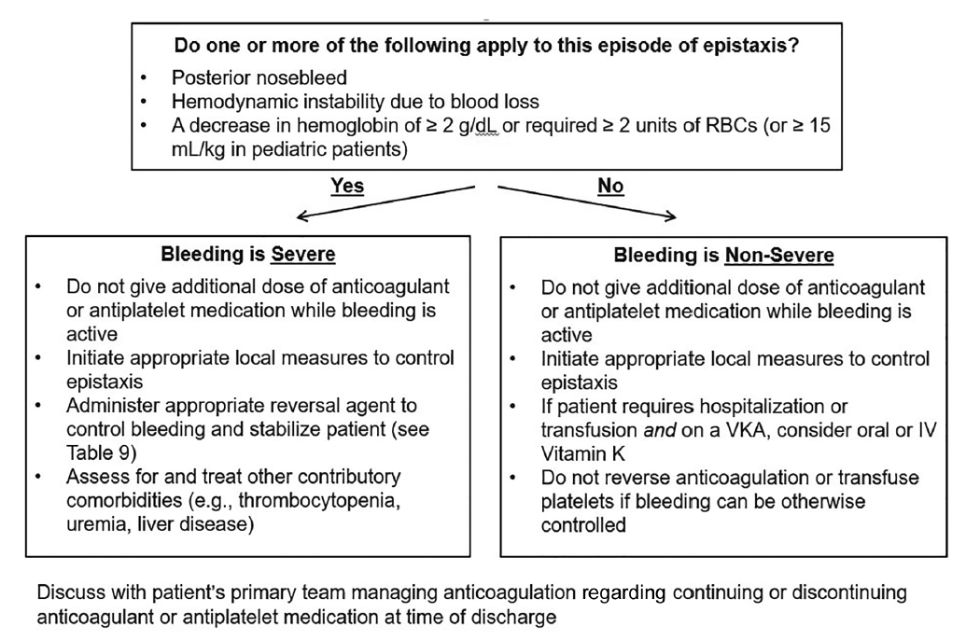
Flow chart to assess and treat epistaxis in patients on anticoagulants and/or antiplatelet medications
Adapted from the 2017 American College of Cardiology “Expert Consensus Decision Pathway on Management of Bleeding in Patients on Oral Anticoagulants.” RBCs=red blood cells, VKA=vitamin K antagonist, IV=intravenous).

Slide 43
Statement 12. Hereditary hemorrhagic telangiectasias (HHT) Identification
Statement 12. Hereditary hemorrhagic telangiectasias (HHT) Identification: The clinician should assess, or refer to a specialist who can assess, the presence of nasal telangiectasias and/or oral mucosal telangiectasias in patients who have a history of recurrent bilateral nosebleeds or a family history of recurrent nosebleeds to diagnose hereditary hemorrhagic telangiectasia syndrome (HHT). Recommendation based on systematic reviews of observational studies, randomized trials and cross-sectional studies with a preponderance of benefit over harm.
Benefit: Allow earlier diagnosis of HHT, increase use of resorbable packing for HHT patients, avoid inappropriate management of nasal bleeding
Risks, harms, costs: Patient anxiety regarding possible incorrect diagnosis, cost of over-referral

Slide 44
Statement 12. Hereditary hemorrhagic telangiectasias (HHT) Identification
Action Statement Profile
Quality improvement opportunity: To identify patients with HHT and refer them to the appropriate specialist for assessment and management of associated conditions; (National Quality Strategy Domains: Patient Safety, Prevention and Treatment of Leading Causes of Morbidity and Mortality)
Level of Confidence in Evidence: High
Aggregate Evidence Quality: Grade B, based on systematic reviews of observational studies, randomized trials and cross-sectional studies
Benefit-Harm Assessment: Preponderance of benefit over harm
Value Judgments: The GDG felt HHT is perhaps underdiagnosed or diagnosed after delays, and felt clinicians are often unfamiliar with the criteria for diagnosing HHT
Intentional Vagueness: None
Role of Patient Preferences: None
Exclusions: None
Policy Level: Recommendation
Differences of Opinion: None

Slide 45
Statement 13. Patient education and prevention
Statement 13. Patient education and prevention: The clinician should educate patients with nosebleeds and their caregivers about preventive measures for nosebleeds, home treatment for nosebleeds, and indications to seek additional medical care. Recommendation based on systematic reviews with a preponderance of benefit over harm.
Benefit: Reduce patient anxiety, foster patient empowerment, reduce nosebleed recurrence, reduce medical utilization, prevent use of improper or ineffective treatments
Risks, harms, costs: Time to educate patients and caregivers, cost of educational materials

Slide 46
Statement 13. Patient education and prevention
Action Statement Profile
Quality improvement opportunity: To educate patients and caregivers regarding home control for nosebleeds, preventive measures for nosebleeds, and when to seek medical care; (National Quality Strategy Domains: Patient Safety, Person and Family Centered Care, Prevention and Treatment of Leading Causes of Morbidity and Mortality)
Level of Confidence in Evidence: Medium
Aggregate Evidence Quality: Grade B, based on systematic reviews that suggest benefit on patient anxiety and comfort for other conditions
Benefit-Harm Assessment: Preponderance of benefit over harm
Value Judgments: None
Intentional Vagueness: Method and content of the education is not specified because there are no studies that specifically address education about nosebleeds
Role of Patient Preferences: None
Exclusions: None
Policy Level: Recommendation
Differences of Opinion: None

Slide 47
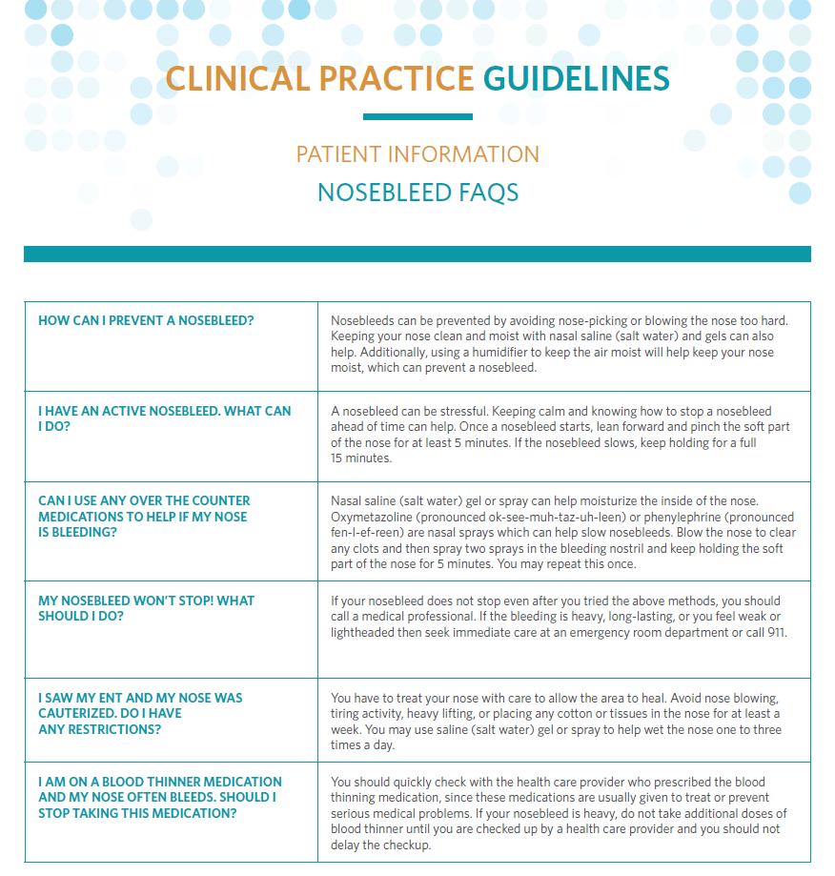
Patient Handout: Nosebleed FAQs

Slide 48
Statement 14. Nosebleed outcomes
Statement 14. Nosebleed outcomes: The clinician or designee should document the outcome of intervention within 30 days or document transition of care in patients who had a nosebleed treated with nonresorbable packing, surgery, or arterial ligation/embolization. Recommendation based on observational studies with a preponderance of benefit over harm.
Benefit: Improve patient outcomes by identifying patients who need additional care, evaluate the effectiveness of our interventions, assess patient satisfaction
Risks, harms, costs: Administrative burden, both cost and time, of obtaining follow-up data

Slide 49
Statement 14. Nosebleed outcomes
Action Statement Profile
Quality improvement opportunity: To encourage clinicians to systematically obtain follow-up data for patients treated for nose bleeds. Potential for clinicians to assess interventions and improve outcomes. (National Quality Strategy Domains: Patient Safety, Person and Family Centered Care, Effective Communication and Care Coordination)
Level of Confidence in Evidence: Medium
Aggregate Evidence Quality: Grade C, based on observational studies and large-scale audit that document up to 50% relapse rate
Benefit-Harm Assessment: Preponderance of benefit over harm
Value Judgments: The GDG felt that follow-up of treated nosebleed patients varied widely. The group also perceived lack of knowledge by individual clinicians as well as in the literature about the effectiveness of interventions for nosebleeds as well as the re-bleed rates for treated patients
Intentional Vagueness: The 30-day outcome suggestion is a broad range that may not be applicable to all patients. The group was also intentionally vague about specifying the method to determine and document outcomes, leaving this up to the discretion of the clinician
Role of Patient Preferences: None
Exclusions: None
Policy Level: Recommendation
Differences of Opinion: None

Slide 50
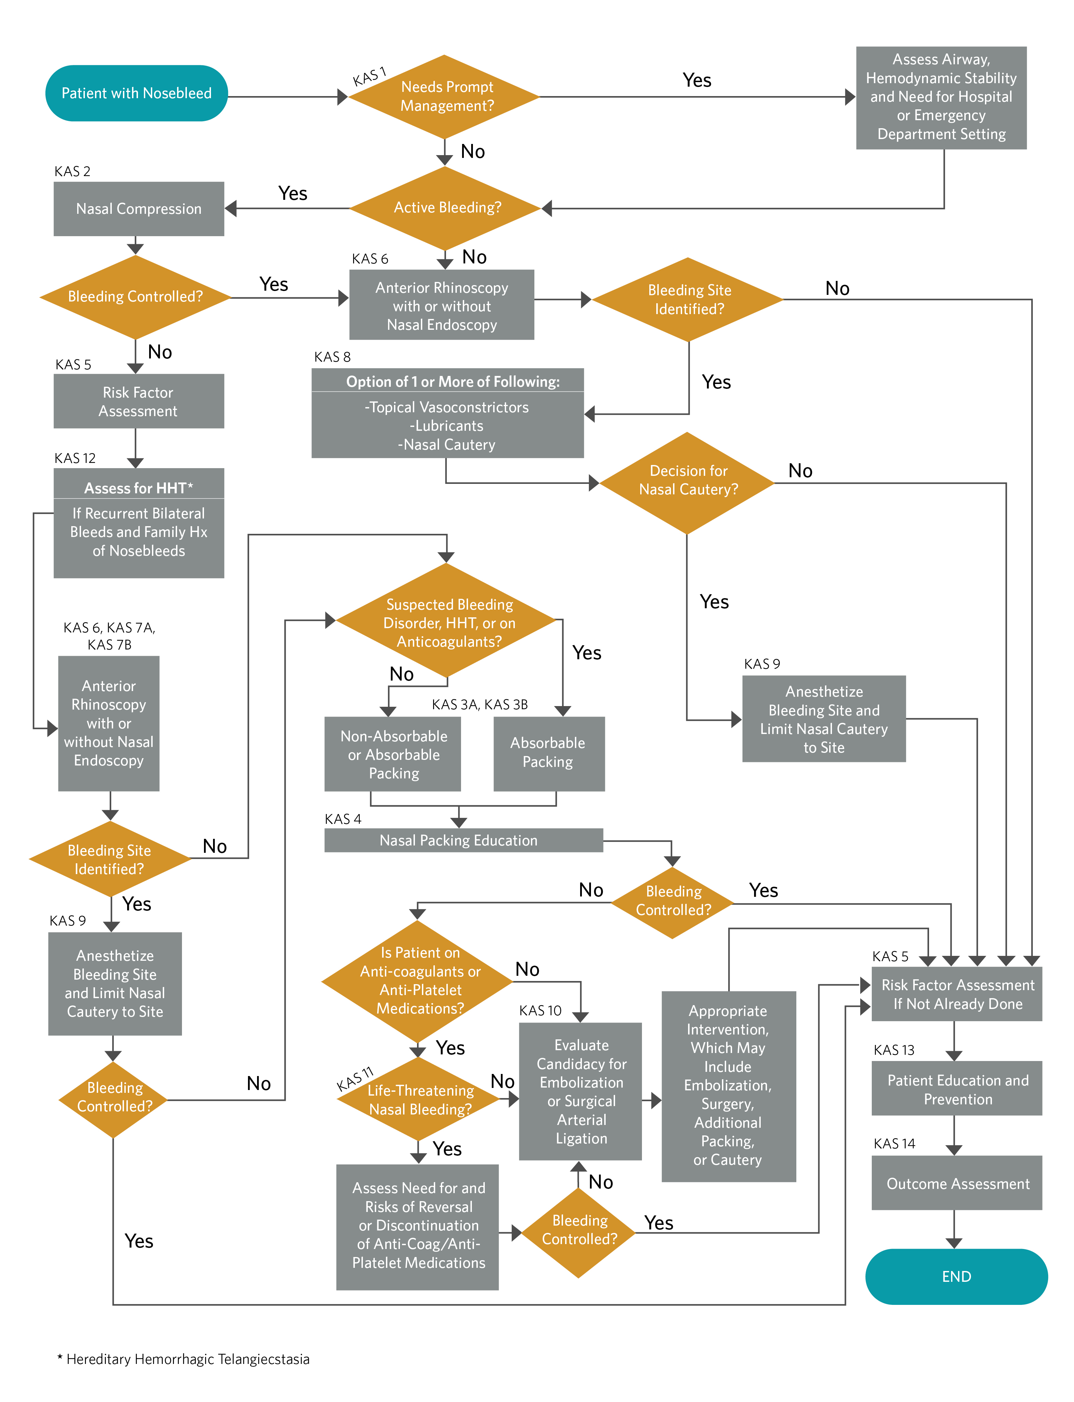
CPG Algorithm
Algorithm showing the interrelationship of guideline key action statements

Slide 51
Research Needs
While nosebleeds are common, with an evolving wide variety of treatment strategies, the number of high-quality studies on nosebleed diagnosis and treatment is surprisingly small. We provide a list to guide ongoing and future study of epistaxis.

Slide 52
Research Needs
Hot topics for nosebleed research will be:
Tranexamic acid use
Hypertension
Use of Direct Anticoagulants and Nosebleeds
Cost/Benefit Efficacy of Endoscopic Surgery for Nosebleed

Slide 53
Research Needs
Determine predictive factors in history that can help identify patients needing prompt management.
Determine efficacy of various home measures and over the counter medications to treat epistaxis. Should these be recommended prior to medical evaluation and treatment?
Determine optimal duration and techniques for digital nasal compression to stop an active nosebleed.
Determine if application of vasoconstrictors is a useful early step to control acute nosebleeds. What is the best timing and method for application of vasoconstrictors in relation to digital nasal compression? What are the effects of vasoconstrictors on short-term.
Determine the role and efficacy of hot water irrigation for treatment of severe or posterior epistaxis. (Schlegel-Wagner et al. Rhinology 2006)
Determine what factors in nasal packing will lead to short and long-term control of nosebleeds. Duration of packing? Type of packing material? Duration of observation after pack removal?
Determine the indications for inpatient hospital observation or intensive care monitoring for patients with nosebleeds. After anterior nasal packing? After posterior nasal packing?
Determine the most effective method for nasal cautery. Silver nitrate versus other chemicals versus electrocautery? Does endoscopic visualization improve nosebleed control and/or reduce complications?
Determine whether bilateral simultaneous septal cautery causes septal perforation, and if so, how can we minimize this risk if both sides need treatment.
Determine differences in efficacy, comfort, and morbidity with the use of various dissolvable packing materials.

Slide 54
Research Needs (cont’d)
Determine which patients will benefit from use of systemic antibiotics after nasal packing, and study ideal length of therapy if antibiotic prophylaxis is prescribed.
Determine the most time and cost -efficient indications for use of nasal endoscopy for patients with epistaxis.
Determine whether hypertension actually causes recurrent or severe nosebleed. What is the ideal management of elevated blood pressure in patients with recurrent epistaxis? With a severe acute nosebleed?
What is the optimal use of nasal saline and other lubricants and moisturizers for prevention of recurrent nosebleed?
Determine the role of tranexamic acid, topical or systemic, for acute treatment of nosebleeds. For prevention of nosebleeds? Are there certain clinical situations or patient groups who would benefit from TXA?
Determine the actual risk of nosebleeds for patients taking anticoagulation and/or antiplatelet medications. Are there differences in nosebleed risks among the various medications? What is the increase in nosebleed risk for patients taking low-dose aspirin?
Determine the risk of using various complementary medications and herbal supplements in terms of causing or increasing duration of nosebleeds.
What are the most effective treatments for the prevention of nosebleeds in patients with HHT? Are there topical medications that are beneficial in these patients? Is sclerotherapy helpful and safe?
Assess the impact of epistaxis on QOL in groups commonly affected with nosebleeds (ie, the elderly, patients with renal failure, patients taking medications that impair clotting).
Determine if patient and family education on nose bleeds improves outcomes (fewer recurrent nosebleeds) as well as patient satisfaction.
Determine what clinical information should be collected during the recommended follow-up assessment.
More information on research needs identified by the guideline development group can be found by visiting: https://www.entnet.org/content/clinical-practice-guideline-research-needs

Slide 55
The AAO-HNSF Maureen Hannley Research Grant
Mechanism of the CORE Grants Program
$50,000 over one year
Purpose:
Designed to fill “research gaps” identified by the AAO-HNSF clinical practice guideline panels.
Support the career development of investigators who have made a commitment to focus their research endeavors on patient-oriented research.
If you are interested in applying for an AAO-HNSF Maureen Hannley Research Grant, check out the CORE Grants webpage

Slide 56
For more information and additional resources visit www.entnet.org/CPGNosebleed

