Slide 1
AAO-HNSF
Clinical Practice Guideline:
Tinnitus
(Published October 2014)

Slide 2
Disclaimer
The clinical practice guideline is not intended as the sole source of guidance in managing patients with tinnitus. Rather, it is designed to assist clinicians by providing an evidence-based framework for decision-making strategies. The guideline is not intended to replace clinical judgment or establish a protocol for all individuals with this condition and may not provide the only appropriate approach to diagnosing and managing this program of care. As medical knowledge expands and technology advances, clinical indicators and guidelines are promoted as conditional and provisional proposals of what is recommended under specific conditions but are not absolute. Guidelines are not mandates. These do not and should not purport to be a legal standard of care. The responsible physician, in light of all circumstances presented by the individual patient, must determine the appropriate treatment. Adherence to these guidelines will not ensure successful patient outcomes in every situation. The American Academy of Otolaryngology-Head and Neck Surgery Foundation emphasizes that these clinical guidelines should not be deemed to include all proper treatment decisions or methods of care or to exclude other treatment decisions or methods of care reasonably directed to obtaining the same results.

Slide 3
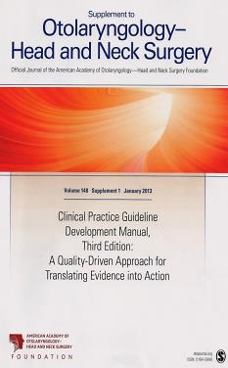
Clinical Practice Guideline Development Manual: Third Edition
Rosenfeld, Shiffman, and Robertson
Pragmatic, transparent approach to creating guidelines for performance assessment
Evidence-based, multidisciplinary process leading to publication in 12-18 months
Emphasizes a focused set of key action statements to promote quality improvement
Uses action statement profiles to summarize decisions in recommendations
Otolaryngol Head Neck Surg 2013; 148(Suppl):S1-55

Slide 4
CPG Development
Developed using an explicit and transparent a priori protocol
Create actionable statements based upon the supporting evidence and associated balance of benefit and harm

Slide 5
CPG Leadership
David Tunkel, MD (Chair)
Carol A. Bauer, MD (Assistant Chair)
Gordon H. Sun, MD, MS (Assistant Chair)
Richard M. Rosenfeld, MD, MPH (Methodologist)
Sujana Chandrasekhar, MD (Methodologist)

Slide 6
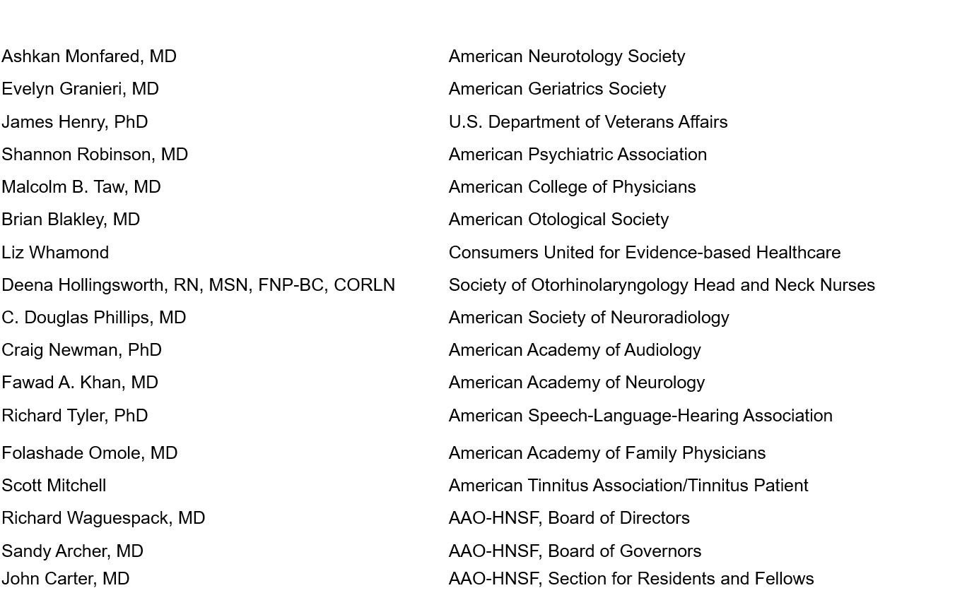
Multi-Disciplinary Panel

Slide 7
Purpose & Target Audience
Purpose: To provide evidence-based recommendations for clinicians managing patients with tinnitus.
Target audience: Any clinician, including non-physicians, involved in managing these patients. Patients with tinnitus will often be evaluated by a variety of healthcare providers including primary care clinicians, specialty physicians, and non-physician providers such as audiologists and mental health professionals.

Slide 8
Target Population
Limited to adults (18 years and older) with primary tinnitus that is persistent and bothersome

Slide 9
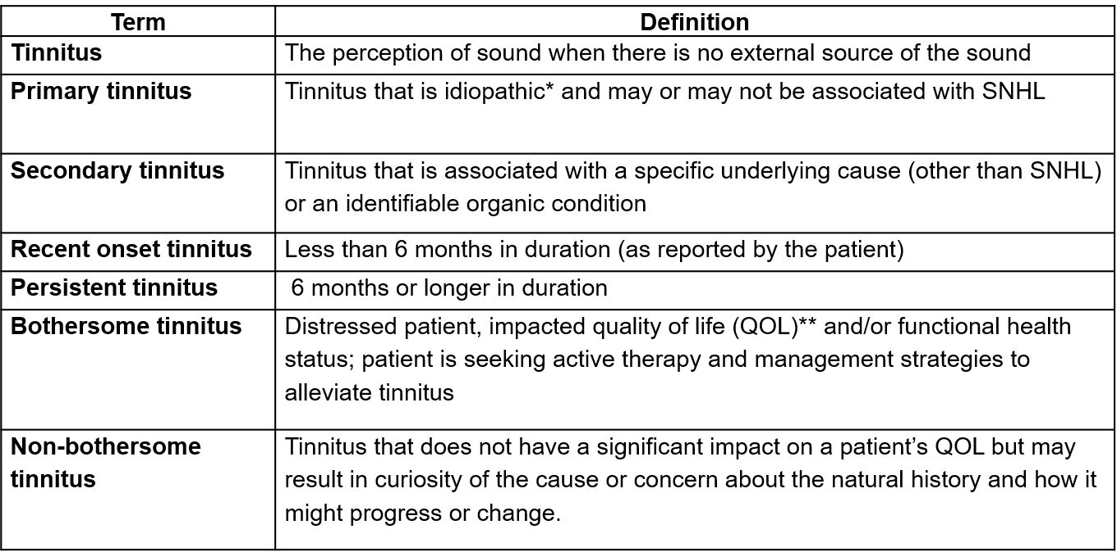
Definitions

Slide 10
Literature Search
Performed by an information specialist
Clinical Practice Guidelines – 271 identified, 8 included in the final CPG
Systematic Reviews – 621 identified, 71 included in the final CPG
Randomized Controlled Trials – 2046 identified, 232 included in the final CPG

Slide 11
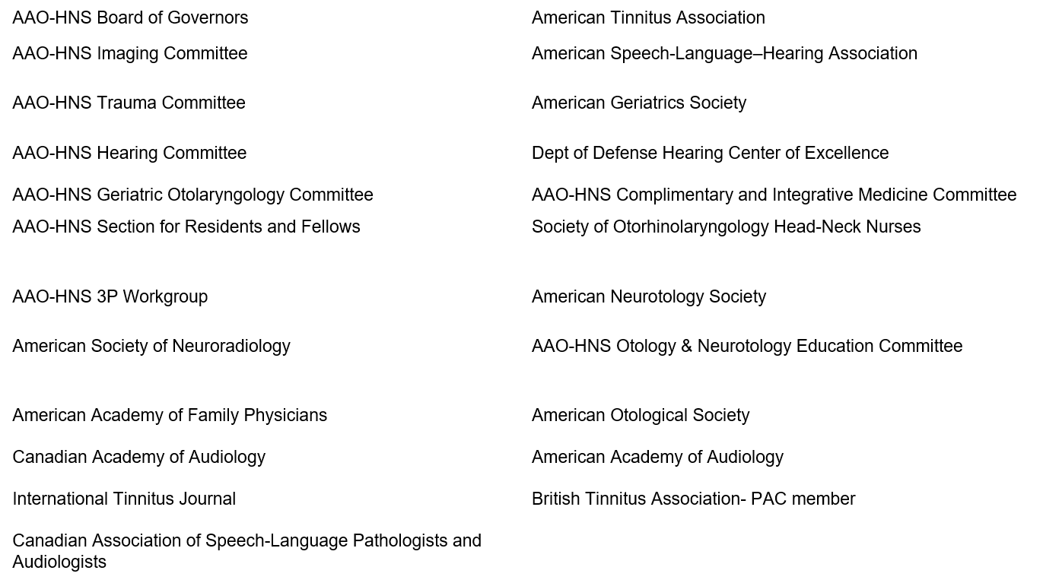
External Peer Review
34 reviewers from the 21 organizations/committees (listed below) submitted 450 comments. Resulted in 178 edits/changes to the draft CPG.

Slide 12
KAS 1: History & Physical Exam
Clinicians should perform a targeted history and physical examination at the initial evaluation of a patient with presumed primary tinnitus to identify conditions that if promptly identified and managed may relieve tinnitus. Recommendation based on observational studies, with a preponderance of benefit over harm.
Benefits: Identify organic, and potentially treatable, underlying causes (e.g. secondary tinnitus); minimize cost and administrative burden through a targeted approach to history and physical examination; streamline care/increase efficiency; improve patient satisfaction; identify patients with primary tinnitus who may benefit from further management (as outlined in this guideline)
Risks, harms, costs: None

Slide 13
KAS 1: History & Physical Exam
Action Statement Profile
Quality improvement opportunity: To promote a consistent and systematic approach to the initial evaluation of the patient with tinnitus
Aggregate evidence quality: Grade C, based on observational studies
Level of confidence in evidence: Moderate, as few if any studies specifically investigate the diagnostic yield or impact of history and examination on tinnitus patients.
Benefit-harm assessment: Preponderance of benefit
Value judgments: Perception by the GDG that tinnitus sufferers may not receive thorough evaluations from clinicians; further perception that many clinicians are unaware of the optimal targeted history and physical examination to evaluate a patient with tinnitus
Intentional vagueness: The definition of a ‘targeted’ history and physical examination is elaborated upon in the supporting text
Role of Patient Preferences: None
Exclusions: None
Policy level: Recommendation
Differences of opinion: None

Slide 14
KAS 2A: Prompt Audiologic Examination
Clinicians should obtain a comprehensive audiologic examination in patients with tinnitus that is unilateral, associated with hearing difficulties, or persistent (≥6months). Recommendation based on observational studies, with a preponderance of benefit over risk
Benefits: Prioritize the need for otolaryngologic evaluation (if not already completed) using audiologic criteria; identify hearing loss, which is frequently associated with tinnitus; characterize the nature of hearing loss (conductive, sensorineural, or mixed; unilateral or bilateral); detect hearing loss that may be unsuspected; initiate workup for serious disease that causes unilateral tinnitus and hearing loss (i.e., VS)
Risks, harms, costs: Direct cost of examination; access to testing; time

Slide 15
KAS 2A: Prompt Audiologic Examination
Action Statement Profile
Quality improvement opportunity: To address potential underutilization of audiologic testing in patients with tinnitus who are likely to have underlying hearing loss and to avoid delay in such diagnosis.
Aggregate evidence quality: Grade C, based on observational studies
Level of confidence in the evidence: Moderate, as literature about the impact of prompt audiologic assessment on tinnitus management is scant.
Benefit-harm assessment: Preponderance of benefit
Value judgments: None
Intentional vagueness: The term ‘prompt’ is used to emphasize the importance of ordering a timely test and ensuring it is done, preferable within 4 weeks of assessment
Role of Patient Preferences: Small; patients may participate in decisions regarding timing of audiogram
Exclusions: None
Policy level: Recommendation
Differences of opinion: None

Slide 16
KAS 2B: Audiologic Examination
Clinicians may obtain an initial comprehensive audiologic examination in patients who present with tinnitus (regardless of laterality, duration, or perceived hearing status). Option based on observational studies, with a balance of benefit and harm.
Benefits: Detect a hearing loss not perceived by the patient; SNHL, which is a treatable condition commonly associated with tinnitus; identify patients who may be candidates for sound therapy; identify opportunities for patient counseling/education
Risks, harms, costs: Direct costs of audiologic testing; detection of minor audiologic Avoidance of unnecessary radiation exposure, avoidance of incidental findings, avoidance of contrast reactions, cost savings

Slide 17
KAS 2B: Audiologic Examination
Action Statement Profile
Quality improvement opportunities: To promote awareness of hearing loss associated with tinnitus, even in patients who do not have unilateral tinnitus or hearing difficulties, and to emphasize that clinicians do not have to wait 6 months before obtaining an audiogram if deemed appropriate.
Aggregate evidence quality: Grade C, based on observational studies and prevalence of HL in randomized controlled trials of tinnitus therapy
Level of confidence in the evidence: High
Benefit-harm assessment: Equilibrium
Value judgments: None
Intentional vagueness: None
Role of patient preferences: Large role for shared-decision making to proceed with audiologic examination
Exclusions: None
Policy level: Option
Differences of opinion: None

Slide 18
KAS 3: Imaging Studies
Clinicians should not obtain imaging studies of the head and neck in patients with tinnitus, specifically to evaluate the tinnitus, unless they have one or more of the following: tinnitus that localizes to one ear, pulsatile tinnitus, focal neurological abnormalities, or asymmetric hearing loss. Strong recommendation against based on observational studies, with a preponderance of benefit over harm.
Benefits: Avoid testing with low yield; avoid harms of unnecessary tests (radiation, contrast, cost); avoid test anxiety; avoid detecting subclinical, incidental findings
Risks, harms, costs: Slight chance of missed diagnosis; relatively high costs and limited access to certain types of imaging studies

Slide 19
KAS 3: Imaging Studies
Action Statement Profile
Quality improvement opportunity: Avoid overuse of imaging in patients with a low likelihood of any significant benefit from the imaging.
Aggregate evidence quality: Grade C, based on observational studies
Level of confidence in the evidence: High
Benefit-harm assessment: Preponderance of benefit
Value judgments: The guideline development group (GDG) made this a strong recommendation against, instead of a recommendation against, based on consensus regarding the importance of avoiding low-yield, expensive tests with potential adverse events in patients with tinnitus
Intentional vagueness: Specific imaging studies are specified in the supporting text including: CT, CTA, MRI, MRA
Role of patient preferences: None
Exclusions: None
Policy level: Strong recommendation against
Differences of opinion: None

Slide 20
KAS 4: Bothersome Tinnitus
Clinicians must distinguish patients with bothersome tinnitus from patients with non-bothersome tinnitus. Strong recommendation based on inclusion criteria for randomized controlled trials on tinnitus treatment, with a preponderance of benefit over harm.
Benefits: Identify patients for further counseling and/ or intervention/management; determine impact of tinnitus on health-related QOL; identify patients with bothersome tinnitus who may benefit from additional assessment for anxiety and depression; encourage an explicit and systematic assessment of patients to avoid underestimating or trivializing the impact of tinnitus; avoid unnecessary interventions/management of patients with non-bothersome tinnitus
Risks, harms, costs: Time involved in assessment

Slide 21
KAS 4: Bothersome Tinnitus
Action Statement Profile
Quality improvement opportunity: To identify those patients in need of clinical management, and limit unnecessary testing and treatment for others.
Aggregate evidence quality: Grade B, based on inclusion criteria for randomized controlled trials on tinnitus treatment.
Level of confidence in evidence: High
Benefit-Harm Assessment: Preponderance of benefit
Value Judgments: None
Intentional Vagueness: Method of distinguishing bothersome vs. non-bothersome is not specifically stated. One or more of the validated questionnaires described in the supporting text may be helpful.
Role of Patient Preferences: None
Exclusions: None
Policy Level: Strong recommendation
Differences of opinion: None

Slide 22
KAS 5: Persistent Tinnitus
Clinicians should distinguish patients with bothersome tinnitus of recent onset from those with persistent symptoms (≥6months) to prioritize intervention and facilitate discussions about natural history and follow up care. Recommendation based on inclusion criteria in randomized controlled trials, with a preponderance of benefit over harm
Benefits: Identify patients that have duration of tinnitus similar to the patients included in randomized controlled trials, and identify those patients who are most likely to benefit from intervention.
Risks, harms, costs: Defer treatment that may benefit some tinnitus patients who do not have persistent symptoms.

Slide 23
KAS 5: Persistent Tinnitus
Action Statement Profile
Quality improvement opportunity: To identify patients with a duration of tinnitus similar to that studied in randomized controlled trials of tinnitus treatment; to identify those who may need and benefit from intervention; and to avoid inappropriate interventions for patients with shorter duration tinnitus.
Aggregate evidence quality: Grade B, based on inclusion criteria in randomized controlled trials
Level of confidence in the evidence: Moderate, based on varying tinnitus duration in randomized controlled trials, with some including patients with tinnitus of less than 3 months’ duration.
Benefit-Harm Assessment: Preponderance of benefit
Value Judgments: Despite some variation in inclusion criteria for duration of tinnitus used in clinical trials, the GDG felt that 6 months was a reasonable time to conclude that the tinnitus would likely persist.
Intentional Vagueness: None
Role of Patient Preferences: None
Exclusions: None
Policy Level: Recommendation
Differences of opinion: None

Slide 24
KAS 6: Education & Counseling
Clinicians should educate patients with persistent, bothersome tinnitus about management strategies. Recommendation based on studies of the value of education and counseling, with a preponderance of benefit over harm
Benefits: Improved QOL; increased ability to cope with tinnitus; improved outcomes and patient satisfaction; less healthcare utilization
Risks, harms, costs: Direct cost and time

Slide 25
KAS 6: Education & Counseling
Action Statement Profile
Quality improvement opportunity: To address potential underutilization of education and counseling by clinicians who manage patients with persistent, bothersome tinnitus. To bring awareness of available management strategies to the patient.
Aggregate evidence quality: Grade B, based on studies of the value of education and counseling in general, and Grade C based on such studies in tinnitus in particular.
Level of confidence in the evidence: High
Benefit-harm assessment: Preponderance of benefit
Value judgments: None
Intentional vagueness: None
Role of patient preferences: None
Exclusions: None
Policy level: Recommendation
Differences of opinion: None

Slide 26
KAS 7: Hearing Aid Evaluation
Clinicians should recommend a hearing aid evaluation for patients with hearing loss and persistent, bothersome tinnitus. Recommendation based on observational studies with a preponderance of benefit over harm
Benefits: Raise awareness of potential beneficial effects of hearing aids on tinnitus; ensure that patient receives proper guidance regarding benefits and costs of hearing aids; provide patients who have hearing loss with access to information and interventions that may alleviate hearing loss and improve function/QOL.
Risks, harms, costs: direct cost related to dispensing of a hearing aid.

Slide 27
KAS 7: Hearing Aid Evaluation
Action Statement Profile
Quality improvement opportunities: To promote awareness of the beneficial effect of hearing aids on tinnitus and encourage utilization of this first-line audiologic intervention for patients with tinnitus, even those who might otherwise be marginal hearing aid candidates.
Aggregate evidence quality: Grade C, based on observational studies
Level of confidence in the evidence: High
Benefit-harm assessment: Preponderance of benefit
Value judgments: Perceived lack of awareness regarding the ability of hearing aids to improve QOL for patients with tinnitus
Intentional vagueness: The level of hearing loss is not specified because hearing loss-associated tinnitus may benefit from hearing aids even if the hearing loss is only of a mild degree, or even if there is a more severe unilateral SNHL associated with the tinnitus.
Role of patient preferences: Patient may accept or decline the recommendation to pursue a hearing aid evaluation
Exclusions: None
Policy level: Recommendation
Differences of opinion: None

Slide 28
KAS 8: Sound Therapy
Clinicians may recommend sound therapy to patients with persistent, bothersome tinnitus. Option based on randomized controlled trials with methodological concerns, with a balance between benefit and harm
Benefit: Access to technology/devices that may relieve tinnitus; improve QOL, sleep, and concentration
Risk, harm, cost: Consequences of recommending an intervention of uncertain efficacy; promoting false hope; costs associated with sound therapy

Slide 29
KAS 8: Sound Therapy
Action Statement Profile
Quality improvement opportunity: To promote awareness and utilization of sound therapy as a reasonable management option in patients with persistent, bothersome tinnitus.
Aggregate evidence quality: Grade B, based on randomized controlled trials with methodological concerns
Level of confidence in the evidence: Medium, as strength of evidence is low.
Benefit-harm assessment: Equilibrium
Value judgments: None
Intentional vagueness: None
Role of patient preferences: Significant role in deciding whether to pursue sound therapy and to choose among the available options
Exclusions: None
Policy level: Option
Difference of opinion: One GDG member expressed a difference of opinion about mechanisms of sound therapy, in particular with the concepts of partial and total masking.

Slide 30
KAS 9: Cognitive Behavior Therapy
Clinicians should recommend CBT to patients with persistent, bothersome tinnitus. Recommendation based on randomized controlled trials, with a preponderance of benefit over harm
Benefits: Treatment of depression and anxiety; improved QOL, tinnitus coping skills, and adherence to other tinnitus treatments
Risks, harms, costs: Direct cost; time involved (multiple sessions, 1-2 hrs. each); availability to services may be limited

Slide 31
KAS 9: Cognitive Behavior Therapy
Action Statement Profile
Quality improvement opportunity: To promote awareness and utilization of CBT as an effective management option in patients with persistent, bothersome tinnitus.
Aggregate evidence quality: Grade A, based on multiple systematic reviews of randomized controlled trials
Level of confidence in the evidence: Moderate, based on concerns about methodology and sample size of trials
Benefit-harm assessment: Preponderance of benefit
Value judgments: None
Intentional vagueness: None
Role of patient preferences: None
Exclusions: None
Policy level: Recommendation
Differences in opinion: None

Slide 32
KAS 10: Medical Therapy
Clinicians should not routinely recommend antidepressants, anticonvulsants, anxiolytics, or intratympanic medications for a primary indication of treating persistent, bothersome tinnitus. Recommendation against based on systematic reviews and randomized controlled trials with methodological concerns, with a preponderance of benefit over harm.
Benefits: unproven therapy, side effects/adverse events (including tinnitus), and false hope; reduce expense. Avoid use of medications that are not approved for use in geriatric population.
Risks, harms, costs: Denying some patients benefit

Slide 33
KAS 10: Medical Therapy
Action Statement Profile
Quality improvement opportunity: To decrease the use of medications that may have no benefit and have significant potential side effects, in the management of patients with tinnitus.
Aggregate evidence quality: Grade B, based on randomized controlled trials with methodological concerns and systematic reviews demonstrating a low strength of evidence.
Level of confidence in the evidence: Medium regarding the lack of efficacy of medical therapy as a primary treatment for persistent bothersome tinnitus, as several studies with methodological flaws, bias and lack of power did show some benefit in certain tinnitus outcome measures.
Benefit-harm assessment: Preponderance of benefit
Value judgments: Although these therapies appear to be beneficial in some studies, the evidence from systematic reviews and randomized controlled trials is insufficient to justify routine use in managing tinnitus patients, especially given the known harms, cost of therapy, and potential for some medications (e.g. antidepressants) to worsen tinnitus
Intentional vagueness: The term ‘routine’ is used to acknowledge there may be individual circumstances for which clinicians and patients may wish to pursue therapy
Role of patient preferences: Limited; a trial of medication may be administered based on individual circumstances
Exclusions: Patients with depression, anxiety, or seizure disorders that constitute an indication for pharmacologic therapy independent of tinnitus
Policy level: Recommendation against
Differences in opinion: None

Slide 34
KAS 11: Dietary Supplements
Clinicians should not recommend Ginkgo biloba, melatonin, zinc, or other dietary supplements for treating patients with persistent, bothersome tinnitus. Recommendation against based on randomized controlled trials and Systematic Reviews with methodological concerns, with a preponderance of benefit over harm.
Benefits: Avoid unproven therapy, side effects/adverse events (including tinnitus), and false hope; reduce expense
Risks, harms, costs: None

Slide 35
KAS 11: Dietary Supplements
Action Statement Profile
Quality improvement opportunity: To avoid use of commonly-available supplements that have no proven efficacy and pose potential harm, in the management of patients with tinnitus.
Aggregate evidence quality: Grade C, randomized controlled trials and systematic reviews with extreme heterogeneity; most of the randomized controlled trials raise significant concerns regarding methodology and subject selection
Level of confidence in the evidence: high confidence regarding potential harm and adverse effects related to these agents, particularly in the elderly population; low confidence in benefits due to methodological concerns and study quality and ability to generalize results to patients with persistent, primary tinnitus.
Benefit-harm assessment: Preponderance of benefit
Value judgments: Concern regarding the actual content and dosage of proposed active agents in these preparations, as they are currently packaged OTC. Many of these supplements, not under the regulations of the USFDA, have varying amounts of the ‘active’ agent. The GDG was concerned over the widespread availability for easy purchase of these agents without considering potential drug interactions and adverse events.

Slide 36
KAS 11: Dietary Supplements
Action Statement Profile (cont’d)
Intentional vagueness: The term ‘dietary supplements’ is used to generalize nutritional and herbal supplements promoted as remedies for tinnitus
Role of patient preferences: Limited role
Exclusions: None
Policy level: Recommendation against
Differences in opinion: The majority of the GDG felt there was a clear predominance of harm over benefit; a minority felt there was an equilibrium. None of the group perceived a preponderance of benefit over harm.

Slide 37
KAS 12: Acupuncture
No recommendation can be made regarding the effect of acupuncture in patients with persistent bothersome tinnitus. No recommendation based on poor quality trials, no benefit, and minimal harm
Benefits: no direct benefits of no recommendation
Risks, harms, costs: Cost of acupuncture therapy, time required for therapy, and potential delay in instituting sound therapy or hearing aids

Slide 38
KAS 12: Acupuncture
Action Statement Profile
Quality improvement opportunity: limited, to educate patients and providers about the controversies regarding the use of acupuncture for tinnitus
Aggregate evidence quality: Grade C, based on inconclusive randomized controlled trials and the presence of costs and potential harm with no established benefit with the use of acupuncture for tinnitus
Level of confidence in the evidence: Low regarding benefit because of heterogeneity and methodological flaws in the randomized controlled trials; high regarding harm or cost, with the understanding that serious harm from acupuncture is rare.
Benefit-harm assessment: unknown
Value judgments: The poor quality of the data, the limited potential for harm from acupuncture kept the GDG from making a recommendation about acupuncture.
Intentional vagueness: none
Role of patient preferences: Significant role for shared decision making; patients may wish to try acupuncture based on circumstances
Exclusions: None
Policy level: No recommendation
Differences in opinion: Minor: The GDG was divided between making no recommendation and making a recommendation against the use of acupuncture.

Slide 39
KAS 13: Transcranial Magnetic Stimulation
Clinicians should not recommend TMS for the treatment of patients with persistent, bothersome tinnitus. Recommendation against based on inconclusive randomized controlled trials.
Benefits: Avoid unproven therapy, side effects/adverse events, and false hope; reduce expense
Risks, harms, costs: Denying some patients benefit

Slide 40
KAS 13: Transcranial Magnetic Stimulation
Action Statement Profile
Quality improvement opportunity: To avoid use of a therapy that has inconclusive efficacy and poses potential financial and physical harm, in the management of patients with tinnitus.
Aggregate evidence quality: Grade B, based on inconclusive randomized controlled trials and systematic reviews that show low strength of evidence.
Level of confidence in the evidence: High regarding the absence of a long-term (>6 months) benefit of TMS; moderate regarding the absence of a short-term benefit, since a minority of trials demonstrated transient beneficial outcomes , and strength of this evidence is low
Benefit-harm assessment: Preponderance of benefit
Value judgments: None
Intentional vagueness: None
Role of patient preferences: Limited
Exclusions: Patients with depression or other neurological conditions for which TMS is indicated
Policy level: Recommendation against
Differences in opinion: None

Slide 41
Research Needs
The large number of interventions for tinnitus, the limitations of the existing studies, and the difficulties with assessing impact of tinnitus help us identify areas that would benefit from further study and clinical research. In general, clinical trials of interventions for tinnitus need:
  well-defined entry criteria with regard to duration and severity of tinnitus, presence of co-morbid medical and psychiatric conditions, and the prior use of therapies,
  use of a validated instrument to assess impact of tinnitus on QOL and daily functions as well a reliable assessment of perceived tinnitus loudness; these instruments and assessments should also reliably assess changes afforded by the treatment intervention;
  careful selection of the placebo as well as randomization/blinding;
  short and long term assessments;
  adequate sample size;
  study of a population of tinnitus patients that are representative of most patients who suffer from this symptom, to allow generalizability of results. Recommendations for future research have been made in the recent AHRQ CER and several authors have made suggestions for improvement of tinnitus trials

Slide 42
Research Needs (cont’d)
Future clinical trials should be registered into databases such as ClinicalTrials.gov or the International Clinical Trials Registry Platform and adhere to the Consolidated Standards of Reporting Trials (CONSORT) statement to facilitate synthesis of evidence. Adequate power should be achieved during study recruitment to detect meaningful differences in outcomes.
Future studies of tinnitus should be methodologically enhanced in terms of reducing wide variations in patient characteristics, better defining the nature of tinnitus on entry (eg, auditory, emotional, and attentional features), and improving uniformity in the selection of validated outcome measures in order to assess clinically relevant changes in tinnitus severity and effect.
Future studies of tinnitus should use both audiologic testing and validated questionnaires for reliable and reproducible results and incorporate patient-reported outcomes with validated psychometric properties.
Assess the validity and responsiveness of each of the various instruments used in tinnitus trials.
Tinnitus trials should include a broader, more representative population of adults in terms of age, sex, and race/ethnicity in future clinical trials of tinnitus therapy.
Future studies of tinnitus treatments should control for the use of confounding medications and other therapies that could affect the severity and perception of tinnitus.
Include global QOL measures into clinical trials to assess how patients with tinnitus value the risk-benefit trade-off between benefits and harms of therapy.
Determine which validated tinnitus questionnaire is most effective in assessing the severity of tinnitus effects in patients. Determine which questionnaire is most useful for assessing relevant treatment effects.

Slide 43
Research Needs (cont’d)
Surveys or cohort studies are needed to determine which clinicians are approached first by patients with tinnitus (eg, otolaryngologists, audiologists, primary care physicians, psychiatrists) (where do tinnitus patients go for initial evaluation?). Are there differences in the characteristics of tinnitus patients who see primary care providers compared to those treated by tinnitus specialists?
Epidemiological studies are needed to establish duration/natural history of recent onset tinnitus and determine the time to spontaneous resolution of tinnitus when this occurs.
Document the most common medical and/or psychiatric comorbidities in patients with tinnitus.
Identify subsets of patients who respond especially well to specific treatments such as pharmacotherapy, sound therapy, and so on in open-label trials, and incorporate these specific patient subsets into subsequent RCTs.
Conduct methodologically rigorous research into CAM therapies for tinnitus.
Conduct surveys to determine utilization of hearing aids for tinnitus in community and academic settings, and assess the factors that could improve compliance and acceptance of hearing aids.
Conduct surveys to determine utilization of audiology evaluation for tinnitus with or without associated hearing loss.
Conduct surveys to determine frequency of patient education and counseling for tinnitus in community and academic settings.
Conduct studies on acamprosate, and other “promising” medical interventions, for tinnitus treatment.
Conduct additional studies on anticonvulsant medications for tinnitus treatment.

Slide 44
Research Needs (cont’d)
Conduct studies comparing the effectiveness of CBT, ACT, and bibliotherapy (ie, providing the person with a manual on tinnitus therapy and allowing the individual to do therapy on his or her own).
Conduct clinical trials comparing the different types of counseling treatments available for tinnitus.
Conduct clinical trials on new therapies for tinnitus such as cochlear implantation and deep brain stimulation.
Conduct clinical trials on auditory treatment strategies for tinnitus that could include bone conduction devices or middle ear implants.
Conduct studies comparing the effectiveness, as well as cost-benefits, of in-person versus Internet-based CBT for tinnitus.
Ensure that patient cohorts are stratified by concurrent depression and anxiety when conducting controlled trials of antidepressant and anxiolytic medications for tinnitus.
Study a variety of brain stimulation techniques, such as transcranial direct current stimulation.
Investigate rTMS, using stimulation schedules of longer duration or in combination with other treatment methods (CBT, medications, etc) to see if more prolonged efficacy can be achieved.
Study acupuncture for tinnitus in a rigorous methodological approach, including the study of electroacupuncture; study the response to acupuncture for tinnitus patients with somatic head and neck disorders.

Slide 45

Choosing Wisely®
It is an initiative of the American Board of Internal Medicine (ABIM) Foundation.
Aims to encourage discussions between physicians and patients about appropriate care.
Each of the campaign’s organization partners is asked to identify (initially) 5 items within its specialty that physicians and patients should question. The AAO-HNSF list has now grown to 10 items.
The AAO-HNSF’s list of recommendations were carefully selected after a review of the current evidence that included AAO-HNSF clinical practice guidelines.
More information is available at www.entnet.org/ChoosingWisely
What is Choosing Wisely®?

Slide 46


AAO-HNSF List of 10 Things Physicians and Patients Should Question
The Initial List

Slide 47


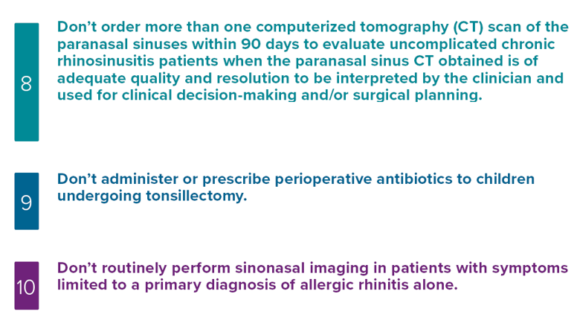
AAO-HNSF List of 10 Things Physicians and Patients Should Question
The Second List

Slide 48
AAO-HNSF List of 10 Things Physicians and Patients Should Question
The utility of imaging procedures in primary tinnitus is undocumented; imaging is costly, has potential for radiation exposure and does not change management.
What Statement Relates to this Clinical Practice Guideline?

Slide 49
Thank you for your attention
QUESTIONS?

