Slide 1
AAO-HNSF Clinical Practice Guideline: Otitis Media with Effusion
Published February 2016
Update to 2004 published CPG

Slide 2
Disclaimer
The clinical practice guideline is not intended as the sole source of guidance in managing patients with otitis media with effusion. Rather, it is designed to assist clinicians by providing an evidence-based framework for decision-making strategies. The guideline is not intended to replace clinical judgment or establish a protocol for all individuals with this condition and may not provide the only appropriate approach to diagnosing and managing this program of care. As medical knowledge expands and technology advances, clinical indicators and guidelines are promoted as conditional and provisional proposals of what is recommended under specific conditions but are not absolute. Guidelines are not mandates. These do not and should not purport to be a legal standard of care. The responsible physician, in light of all circumstances presented by the individual patient, must determine the appropriate treatment. Adherence to these guidelines will not ensure successful patient outcomes in every situation. The American Academy of Otolaryngology-Head and Neck Surgery Foundation emphasizes that these clinical guidelines should not be deemed to include all proper treatment decisions or methods of care or to exclude other treatment decisions or methods of care reasonably directed to obtaining the same results.

Slide 3

Burden
About 90% of children have OME before school age and develop, on average, 4 episodes of OME every year. OME is increased in children with developmental difficulties.
Approximately 2.2 million new cases of OME are diagnosed every year in the United States at a cost of $4.0 billion (Shekelle 2003).
OME is the most common cause of hearing impairment in children in developed nations (Qureishi 2014).
Direct costs related to otitis media, which includes OME and AOM, are $3 billion to $5 billion annually.
OME can have a substantial quality of life impact for both children and their caregivers. Otalgia, sleep disruption, and behavioral problems for the child and caregiver anxiety are a few issues that may be associated with OME.

Slide 4
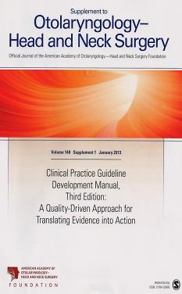
Clinical Practice Guideline Development Manual: Third Edition Rosenfeld, Shiffman, and Robertson
Pragmatic, transparent approach to creating guidelines for performance assessment
Evidence-based, multidisciplinary process leading to publication in 12-18 months
Emphasizes a focused set of key action statements to promote quality improvement
Uses action statement profiles to summarize decisions in recommendations
Otolaryngol Head Neck Surg 2013; 148(Suppl):S1-55

Slide 5
CPG Goals
Focus on quality improvement opportunities
Define actionable statements for clinicians regardless of discipline to improve care
The guideline is not intended to be comprehensive
The guideline is not intended to limit or restrict care provided by clinicians to individual patients

Slide 6
CPG Leadership
Richard M. Rosenfeld, MD, MPH (Chair)
Jennifer J. Shin, MD, SM (Assistant Chair)
Seth R. Schwartz, MD, MPH (Methodologist)

Slide 7
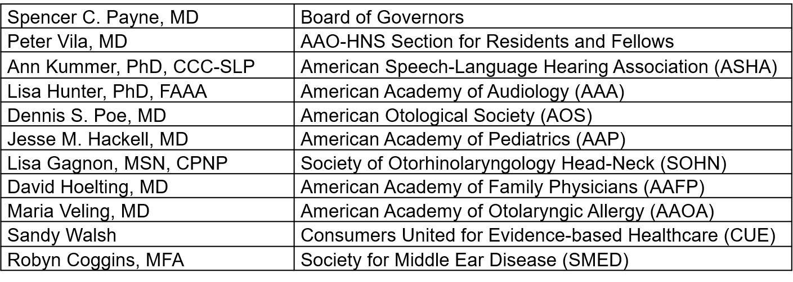
CPG Multi-Disciplinary Panel

Slide 8
CPG Development
Developed using an explicit and transparent a priori protocol
Create actionable statements based upon the supporting evidence and associated balance of benefit and harm

Slide 9
Difference from Prior CPG
Addition of consumer advocates to the guideline development group
New evidence from 4 clinical practice guidelines, 20 systematic reviews, and 49 randomized controlled trials
Emphasis on patient education and shared decision-making with an option grid for surgery and new tables of counseling opportunities and frequently asked questions
Expanded action statement profiles to explicitly state quality improvement opportunities, confidence in the evidence, intentional vagueness, and differences of opinion
Enhanced external review process to include public comment and journal peer review
Additional information on pneumatic otoscopy and tympanometry to improve diagnostic certainty for OME

Slide 10
Difference from Prior CPG
Expanded information on speech and language assessment for children with OME
New recommendations for managing OME in children who fail newborn hearing screening, evaluating at-risk children for OME, and educating and counseling parents
A new recommendation against using topical intranasal steroids for treating OME
A new recommendation against adenoidectomy for a primary indication of OME in children under age 4 years unless a distinct indication exists (nasal obstruction, chronic adenoiditis).
A new recommendation for assessing OME outcomes by documenting OME resolution, improved hearing, or improved quality of life
New algorithm to clarify decision making and action statement relationships

Slide 11
Target Population
The target patient for this guideline is a child aged 2 months through 12 years with OME, with or without developmental disabilities or underlying conditions that predispose to OME and its sequelae.

Slide 12
Purpose & Target Audience
Purpose: To provide evidence-based recommendations for clinicians managing patients with otitis media with effusion.
Target audience: All clinicians who are likely to diagnose and manage children with OME, and applies to any setting in which OME would be identified, monitored, or managed.

Slide 13
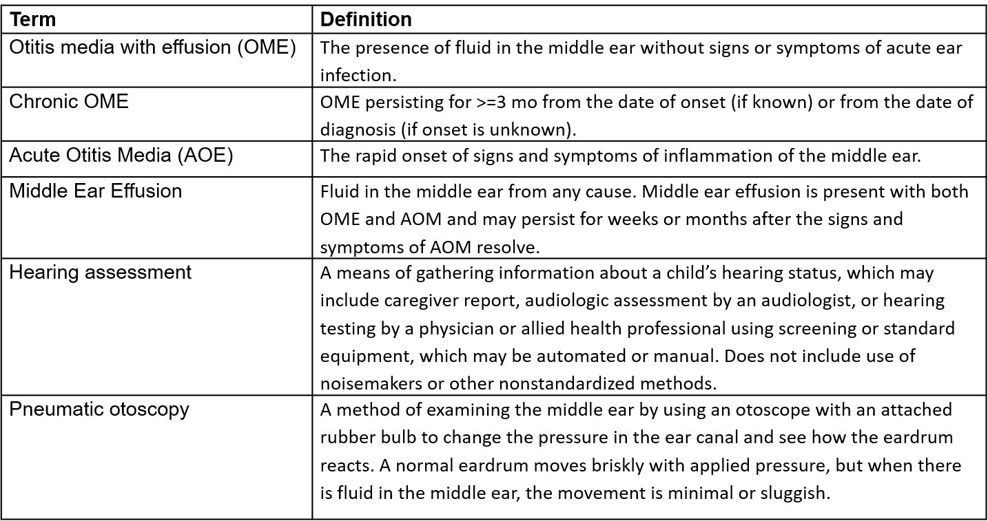
Definitions

Slide 14
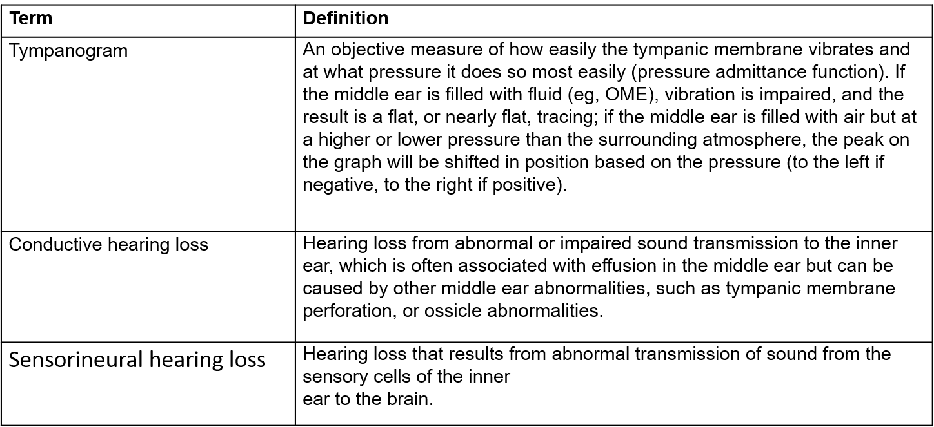
Definitions

Slide 15
Literature Search
Performed by an information specialist
Clinical Practice Guidelines – 13 identified, 4 included in the final CPG
Systematic Reviews – 138 identified, 20 included in the final CPG
Randomized Controlled Trials –86 identified, 49 included in the final CPG

Slide 16
KAS 1A and 1B: Pneumatic Otoscopy
STATEMENT 1a: The clinician should document the presence of middle-ear effusion with pneumatic otoscopy when diagnosing OME in a child. Strong recommendation based on systematic review of diagnostic studies with a preponderance of benefit over harm.
STATEMENT 1b: The clinician should perform pneumatic otoscopy to assess for OME in a child with otalgia, hearing loss, or both. Strong recommendation based on systematic review of diagnostic studies with a preponderance of benefit over harm.
Benefits: Improve diagnostic certainty; reduce false negative diagnoses caused by effusions that do not have obvious air bubbles or an air-fluid level; reduce false positive diagnoses that lead to unnecessary tests and costs; readily available equipment; document mobility of the tympanic membrane; efficient; cost-effective
Risks, harms, costs: Costs of training clinicians in pneumatic otoscopy; false positive diagnoses from non-intact tympanic membrane; minor procedural discomfort

Slide 17
KAS 1A and 1B: Pneumatic Otoscopy
Action Statement Profile
Quality improvement opportunity: To improve diagnostic accuracy for OME with a readily available, but likely underutilized, means of assessing middle ear status (National Quality Strategy domain: clinical process/effectiveness)
Aggregate evidence quality: Grade A, systematic review of cross-sectional studies with a consistent reference standard
Level of confidence in evidence: High
Benefit-harm assessment: Preponderance of Benefit
Value judgments: Pneumatic otoscopy is underutilized for diagnosing OME, especially in primary care settings; accurate diagnosis of OME using pneumatic otoscopy is a prerequisite for managing children with OME.
Intentional vagueness: None
Role of patient preferences: Very limited
Exclusions: None
Policy level: Strong recommendation
Differences of opinion: None

Slide 18
KAS 2: Tympanometry
Clinicians should obtain tympanometry in children with suspected OME for whom the diagnosis is uncertain after performing (or attempting) pneumatic otoscopy. Strong recommendation based on extrapolation of systematic reviews of diagnostic studies with a preponderance of benefit over harm.
Benefits: Improved diagnostic accuracy; confirm a suspected diagnosis of OME; obtain objective information regarding middle ear status; differentiate OME (low ear canal volume) vs. tympanic membrane perforation (high ear canal volume); obtain prognostic information on likelihood of timely spontaneous resolution; educational value in confirming pneumatic otoscopy findings
Risks, harms, costs: Cost; lack of access; equipment calibration and maintenance; misinterpretation of findings

Slide 19
KAS 2: Tympanometry
Action Statement Profile
Quality improvement opportunity: Improve diagnostic accuracy for OME and raise awareness regarding the value of tympanometry as an objective measure of middle ear status (National Quality Strategy domain: clinical process/effectiveness)
Aggregate evidence quality: Grade B, extrapolation from systematic review of cross-sectional studies with a consistent reference standard for tympanometry as a primary diagnostic method
Level of confidence in evidence: High regarding the value of tympanometry for primary diagnosis; medium regarding the value as an adjunct to pneumatic otoscopy
Benefit-harm assessment: Preponderance of Benefit
Value judgments: None
Intentional vagueness: The individual who performs tympanometry is not specified, and could be the clinician or another health professional; whether to use portable or table top tympanometry is at the discretion of the clinician
Role of patient preferences: Limited
Exclusions: Patients with recent ear surgery or trauma.
Policy level: Strong recommendation
Differences of opinion: None

Slide 20
KAS 3: Failed Newborn Hearing Screen
Clinicians should document in the medical record counseling of parents of infants with otitis media with effusion (OME) who fail a newborn hearing screen regarding the importance of follow-up to ensure that hearing is normal when OME resolves and to exclude an underlying sensorineural hearing loss (SNHL). Recommendation based on observational studies with a predominance of benefit over harm.
Benefits: More prompt diagnosis of SNHL; earlier intervention for hearing loss; reduce loss to follow-up; reassure parents
Risks, harms, costs: Time spent in counseling; parental anxiety from increased focus on child hearing issues

Slide 21
KAS 3: Failed Newborn Hearing Screen
Action Statement Profile
Quality improvement opportunity: Increase adherence to follow-up and ensure that an underlying SNHL is not missed (National Quality Strategy domains: care coordination, patient and family engagement)
Aggregate evidence quality: Grade C, indirect observational evidence on the benefits of longitudinal follow-up for effusions in newborn screening programs and the prevalence of SNHL in newborn screening failures with OME
Level of confidence in evidence: Medium
Benefit-harm assessment: Preponderance of benefit
Value judgments: None
Intentional vagueness: The method and specifics of follow-up are at the discretion of the clinician, but should seek resolution of OME within 3 months of onset, or, if known, diagnosis
Role of patient preferences: Minimal role regarding the need for counseling but a large role for shared decision-making in the specifics of how follow-up is implemented and in what specific care settings
Exclusions: None
Policy level: Recommendation
Differences of opinion: None

Slide 22
KAS 4A and 4B: At-Risk Children
STATEMENT 4a. IDENTIFYING AT-RISK CHILDREN: Clinicians should determine if a child with otitis media with effusion (OME) is at increased risk for speech, language, or learning problems from middle ear effusion because of baseline sensory, physical, cognitive, or behavioral factors (Table 3). Recommendation based on observational studies with a preponderance of benefit over harm.
STATEMENT 4b. EVALUATING AT-RISK CHILDREN: Clinicians should evaluate at-risk children (Table 3) for otitis media with effusion (OME) at the time of diagnosis of an at-risk condition and at 12 to 18 months of age (if diagnosed as being at-risk prior to this time). Recommendation based on observational studies with a preponderance of benefit over harm.
Benefits: Identify at-risk children who might benefit from early intervention for OME (including tympanostomy tubes) and from more active and accurate surveillance of middle ear status; identify unsuspected OME and reduce the impact of OME and associated hearing loss on child development
Risks, harms, costs: Direct costs of evaluating for OME (e.g. tympanometry), identifying self-limited effusions, parental anxiety, potential for overtreatment

Slide 23
KAS 4A and 4B: At-Risk Children
Action Statement Profile
Quality improvement opportunity: Raise awareness of a subset of children with OME (Table 3) who are disproportionately affected by middle-ear effusion compared to otherwise healthy children and to detect OME in at-risk children that might have been missed without explicit screening but could affect their developmental progress (National Quality Strategy domain: population/public health)
Aggregate evidence quality: Grade C, observational studies regarding the high prevalence of OME in at-risk children and the known impact of hearing loss on child development; D, expert opinion on the ability of prompt diagnosis to alter outcomes
Level of confidence in the evidence: Medium
Benefits-harms assessment: Preponderance of benefit over harm

Slide 24
KAS 4A and 4B: At-Risk Children
Action Statement Profile (cont’d)
Value judgments: The guideline update group assumed that at-risk children are less likely to tolerate OME than would the otherwise healthy child, and that persistent OME could limit the benefit of ongoing therapies and education interventions for at-risk children with special needs; assumption that early identification of OME in at-risk children could improve developmental outcomes
Intentional vagueness: The method of evaluating for OME is not specified, but should follow recommendations in this guideline regarding pneumatic otoscopy and tympanometry; a time interval of 12 to 18 months is stated to give the clinician flexibility and to ensure evaluation takes place at a critical time in the child’s development
Role of patient preferences: None
Exceptions: None
Policy level: Recommendation
Differences of opinion: None

Slide 25
KAS 5: Screening Healthy Children
Clinicians should not routinely screen children for otitis media with effusion (OME) who are not at-risk and do not have symptoms that may be attributable to OME, such as hearing difficulties, balance (vestibular) problems, poor school performance, behavioral problems, or ear discomfort. Recommendation based on randomized, controlled trials, and cohort studies with a preponderance of harm over benefit.
Benefit: Avoid unnecessary tests, avoid unnecessary treatment, limit parent anxiety
Risks, harms, costs: Potential to miss clinically relevant OME in some children

Slide 26
KAS 5: Screening Healthy Children
Action Statement Profile
Quality improvement opportunity: Avoid unnecessary tests, and treatment, for a highly prevalent and usually self-limited condition (National Quality Strategy domains: efficient use of healthcare resources, population/public health)
Aggregate evidence quality: Grade A, systematic review of RCTs
Level of confidence in the evidence: High
Benefits-harms assessment: Preponderance of benefit over harm
Value judgments: None
Role of patient preferences: Limited, but a parent can request screening if desired
Intentional vagueness: The word “routine” is used to indicate that there may be specific circumstances where screening is appropriate, for example, a child with a strong family history of otitis media or a child who is suspected to be at-risk but does not yet have a formal at-risk diagnosis
Exceptions: None
Policy level: Recommendation against
Difference of opinions: None

Slide 27
KAS 6: Patient Education
Clinicians should educate children with otitis media with effusion (OME) and their families regarding the natural history of OME, need for follow-up, and the possible sequelae. Recommendation based on observational studies and preponderance of benefit over harm.
Benefits: Reduce anxiety; facilitate shared decisions; provide parents with a fuller understanding of their child’s condition; emphasize the importance of follow-up; educate families about risk factors and coping strategies
Risks, harms, costs: Time for education

Slide 28
KAS 6: Patient Education
Action Statement Profile
Quality improvement opportunity: Provide clear, patient-friendly education regarding OME, its natural history, and possible sequelae to empower families for shared decisions (National Quality Strategy domain: patient and family engagement)
Aggregate evidence quality: Grade C, observational studies
Level of confidence in the evidence: High
Benefits-harms assessment: Preponderance of benefit over harm
Value judgments: None
Intentional vagueness: None
Role of patient preferences: Limited
Exceptions: None
Policy level: Recommendation
Differences of opinion: None

Slide 29
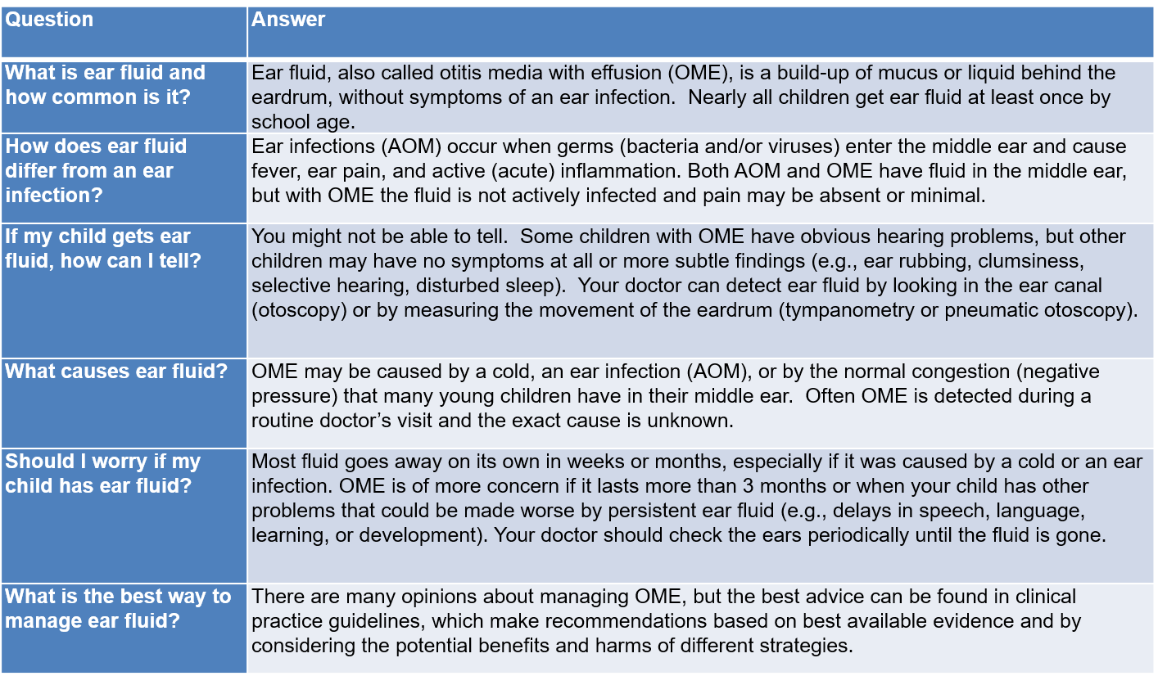
Patient FAQ
AOM, acute otitis media; MEE, middle ear effusion; OME, otitis media with effusion

Slide 30
KAS 7: Watchful Waiting
Clinicians should manage the child with otitis media with effusion (OME) who is not at risk with watchful waiting for 3 months from the date of effusion onset (if known) or 3 months from the date of diagnosis (if onset is unknown). Strong recommendation based on systematic review of cohort studies and preponderance of benefit over harm.
Benefit: Avoid unnecessary referrals, evaluations, and interventions, take advantage of favorable natural history
Risks, harms, costs: Delays in therapy for OME that persists for more than 3 months, prolongation of hearing loss

Slide 31
KAS 7: Watchful Waiting
Action Statement Profile
Quality improvement opportunity: Avoid interventions with potential adverse events and cost for a condition that is usually self-limited (National Quality Strategy domains: patient safety, efficient use of healthcare resources)
Aggregate evidence quality: Grade A, systematic review of cohort studies
Level of confidence in the evidence: High
Benefits-harms assessment: Preponderance of benefit over harm
Value judgments: Importance of avoiding interventions in an often self-limited condition
Intentional vagueness: None
Role of patient preferences: Small
Exceptions: At-risk children (Table 3) who may be offered tympanostomy tubes earlier than 3 months if there is a type B tympanogram in one or both ears
Policy level: Strong recommendation
Differences of opinion: None

Slide 32
KAS 8A, 8B, 8C: Steroids, Antibiotics, and Antihistamines or Decognestants
STATEMENT 8a. STEROIDS: Clinicians should recommend against using intranasal steroids or systemic steroids for treating otitis media with effusion (OME). Strong recommendation against based on systematic review of randomized, controlled trials and preponderance of harm over benefit.
STATEMENT 8b. ANTIBIOTICS: Clinicians should recommend against using systemic antibiotics for treating otitis media with effusion (OME). Strong recommendation against based on systematic review of randomized, controlled trials and preponderance of harm over benefit.
STATEMENT 8c. ANTIHISTAMINES OR DECONGESTANTS: Clinicians should recommend against using antihistamines, decongestants, or both for treating otitis media with effusion (OME). Strong recommendation against based on systematic review of randomized, controlled trials and preponderance of harm over benefit.
Benefit: Avoid side effects and reduce cost by not administering medications; avoid delays in definitive therapy caused by short-term improvement then relapse; avoid societal impact of inappropriate antibiotic prescribing on bacterial resistance and transmission of resistant pathogens
Risks, harms, costs: None

Slide 33
KAS 8A, 8B, 8C: Steroids, Antibiotics, and Antihistamines or Decongestants
Action Statement Profile
Quality improvement opportunity: Discourage medical therapy that does not impact long term outcomes for OME (resolution, hearing levels, or need for tympanostomy tubes) but does have significant cost and potential adverse events (National Quality Strategy domain: patient safety, efficient use of healthcare resources).
Aggregate evidence quality: Grade A, systematic review of well-designed randomized, controlled trials
Level of confidence in the evidence: High
Benefits-harms assessment: Preponderance of benefit over harm
Value judgments: Emphasis on long term outcomes, based on high quality systematic reviews, even though some therapies (e.g., antibiotics, systemic steroids) have documented short-term benefits
Intentional vagueness: None
Role of patient preferences: Small
Exceptions: Patients in whom any of these medications are indicated for primary management of a coexisting condition with OME
Policy level: Strong recommendation (against therapy)
Differences of opinion: None

Slide 34
KAS 9: Hearing Test
Clinicians should obtain an age-appropriate hearing test if otitis media with effusion (OME) persists for 3 months or longer OR for OME of any duration in an at-risk child. Recommendation based on cohort studies and preponderance of benefit over harm.
Benefit: Detect unsuspected hearing loss; quantify the severity and laterality of hearing loss to assist in management and follow-up decisions; identify children who are candidates for tympanostomy tubes
Risks, harms, costs: Access to pediatric audiology, cost of the audiology assessment

Slide 35
KAS 9: Hearing Test
Action Statement Profile
Quality improvement opportunity: Obtains objective information on hearing status that could influence counseling and management of OME (National Quality Strategy domain: clinical process/effectiveness)
Aggregate evidence quality: Grade C, Systematic review randomized control trials showing hearing loss in about 50% of children with OME and improved hearing after tympanostomy tube insertion; observational studies showing an impact of hearing loss associated with OME on children’s auditory and language skills.
Level of confidence in the evidence: Medium
Benefit-harm assessment: Preponderance of benefit over harm
Value judgments: Knowledge of hearing status is important for counseling and managing children with OME and optimizing their learning environment, even if this information does not determine surgical candidacy
Intentional vagueness: The words age-appropriate audiologic testing are used to recognize that the specific methods will vary with the age of the child, but a full discussion of the specifics of testing is beyond the scope of this guideline
Role of patient preferences: Small; caregivers may decline testing
Exceptions: None
Policy level: Recommendation
Difference of opinion: None

Slide 36
KAS 10: Speech and Language
Clinicians should counsel families of children with bilateral OME and documented hearing loss about the potential impact on speech and language development. Recommendation based on observational studies and preponderance of benefit over harm.
Benefit: Raise awareness among clinicians and caregivers; educate caregivers; identify and prioritize at-risk children for additional assessment
Risks, harms, costs: Time spent in counseling

Slide 37
KAS 10: Speech and Language
Action Statement Profile
Quality improvement opportunity: Raise awareness of the potential impact of hearing loss secondary to OME on a child’s speech and language and facilitate caregiver education (National Quality Strategy domains: patient and family engagement, care coordination)
Aggregate evidence quality: Grade C, observational studies; extrapolation of studies regarding the impact of permanent mild hearing loss on child speech and language
Level of confidence in the evidence: Medium
Benefit-harm assessment: Preponderance of benefit over harm
Value judgments: Group consensus that there is likely an under-appreciation of the impact of bilateral hearing loss secondary to OME on speech and language development
Intentional vagueness: None
Role of patient preferences: None
Exceptions: None
Policy level: Recommendation
Difference of opinion: None

Slide 38
KAS 11: Surveillance of Chronic OME
Clinicians should reevaluate, at 3- to 6-month intervals, children with chronic otitis media with effusion (OME) until the effusion is no longer present, significant hearing loss is identified, or structural abnormalities of the eardrum or middle ear are suspected. Recommendation based on observational studies with a preponderance of benefit over harm.
Benefit: Detection of structural changes in the tympanic membrane that may require intervention; detection of new hearing difficulties or symptoms that would lead to reassessing the need for intervention, including tympanostomy tubes; discussion of strategies for optimizing the listening-learning environment for children with OME; as well as ongoing counseling and education of parents/caregiver.
Risks, harms, costs: Cost of follow-up

Slide 39
KAS 11: Surveillance of Chronic OME
Action Statement Profile
Quality improvement opportunity: Emphasize that regular follow-up is an important aspect of managing chronic OME that can help avoid sequelae by identifying children who develop signs or symptoms that would prompt intervention (National Quality Strategy domains: patient safety, clinical process/effectiveness).
Aggregate evidence quality: Grade C, observational studies
Level of confidence in the evidence: High
Benefit-harm assessment: Preponderance of benefit over harm
Value judgments: Although it is uncommon, untreated OME can cause progressive changes in the tympanic membrane that require surgical intervention. There was an implicit assumption that surveillance and early detection/intervention could prevent complications and would also provide opportunities for ongoing education and counseling of caregivers.
Intentional vagueness: The surveillance interval is broadly defined at 3 to 6 months to accommodate provider and patient preference; “significant” hearing loss is broadly defined as one that is noticed by the caregiver, reported by the child, or interferes in school performance or QOL
Role of patient preferences: Moderate; opportunity for shared decision regarding the surveillance interval
Exceptions: None
Policy level: Recommendation
Differences of opinion: None

Slide 40
KAS 12A and 12B: Surgery
STATEMENT 12a. SURGERY FOR CHILDREN UNDER AGE 4 YEARS: Clinicians should recommend tympanostomy tubes when surgery is performed for otitis media with effusion (OME) in a child under age 4 years; adenoidectomy should not be performed unless a distinct indication (e.g., nasal obstruction, chronic adenoiditis) exists other than OME. Recommendation based on systematic reviews of randomized controlled trials with a preponderance of benefit over harm.
STATEMENT 12b: SURGERY FOR CHILDREN AGE 4 YEARS AND OLDER: Clinicians should recommend tympanostomy tubes, adenoidectomy, or both when surgery is performed for otitis media with effusion (OME) in a child aged 4 years or older. Recommendation based on systematic reviews of randomized controlled trials and observational studies with a preponderance of benefit over harm.
Benefit: promoting effective therapy; avoiding adenoidectomy in an age group where benefits have not been shown as a primary intervention for OME; benefits of surgery that include improved hearing reduced prevalence of OME, and less need for additional tube insertion (after adenoidectomy)
Risks, harms, costs: Risks of anesthesia and specific surgical procedures, sequelae of tympanostomy tubes and adenoidectomy

Slide 41
KAS 12A and 12B: Surgery
Action Statement Profile
Quality improvement opportunity: Promote effective therapy for OME (tubes at all ages; adenoidectomy age 4 years and older) and discourage therapy with limited or no benefits (adenoidectomy under age 4 years) (National Quality Strategy domains: patient safety, clinical process/effectiveness)
Aggregate evidence quality: Grade B, systematic review of randomized controlled trials (tubes, adenoidectomy) and observational studies (adenoidectomy)
Level of confidence in the evidence: Medium, because of limited data on long-term benefits of these interventions and heterogeneity among RCTs included in the systematic reviews
Benefits-harm assessment: Preponderance of benefit over harm
Value judgments: Although some studies suggest benefits of adenoidectomy for children under age 4 years as primary therapy for OME, the data are inconsistent and relatively sparse; the additional surgical risks of adenoidectomy (e.g., velopharyngeal insufficiency, more complex anesthesia) were felt to outweigh the uncertain benefits in this group
Intentional vagueness: For children aged 4 years and older the decision to offer tympanostomy tubes, adenoidectomy, or both is based on shared decision-making
Role of patient preferences: Moderate role in the choice of surgical procedure for children aged 4 years or older (tubes, adenoidectomy, or both)
Exceptions: Adenoidectomy is contraindicated in children with cleft palate or syndromes associated with a risk of velopharyngeal insufficiency
Policy level: Recommendation
Difference of opinion: None

Slide 42
KAS 13: Outcome Assessment
When managing a child with otitis media with effusion (OME) clinicians should document in the medical record resolution of OME, improved hearing, or improved quality of life (QOL). Recommendation based on randomized trials and cohort studies with a predominance of benefit over harm.
Benefit: Document favorable outcomes in management
Risks, harms, costs: Cost of follow-up visits and audiometry; administrative burden for QOL surveys

Slide 43
KAS 13: Outcome Assessment
Action Statement Profile
Quality improvement opportunity: Focus on patient-centered outcome assessment when managing children with OME (National Quality Strategy domain: clinical process/effectiveness)
Aggregate evidence quality: Grade C, randomized trials and before-and-after studies showing resolution, improved hearing, or improved QOL after management of OME
Level of confidence in the evidence: High
Benefits-harm assessment: Predominance of benefit over harm
Value judgments: None
Intentional vagueness: The time frame for assessing outcome is not stated; the method of demonstrating OME resolution (otoscopy or tympanometry) is at the discretion of the clinician.
Role of patient preferences: Small
Exceptions: None
Policy level: Recommendation
Differences of opinion: None

Slide 44
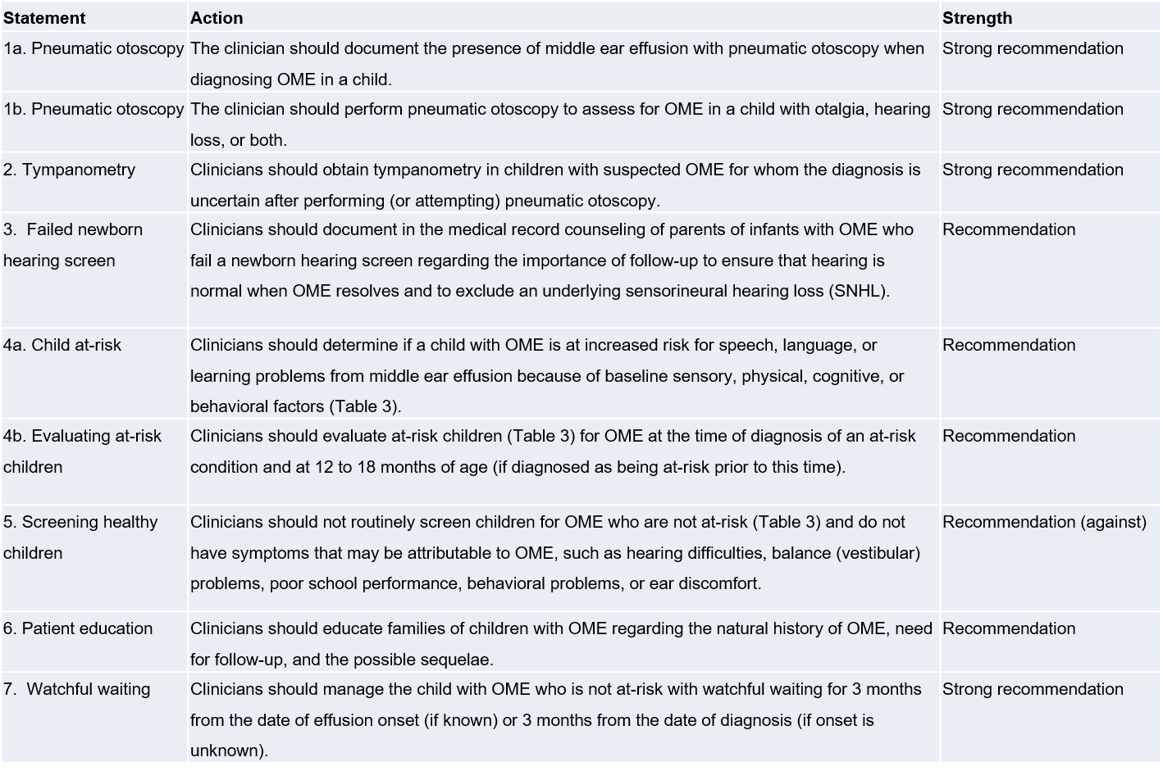
In Summary

Slide 45
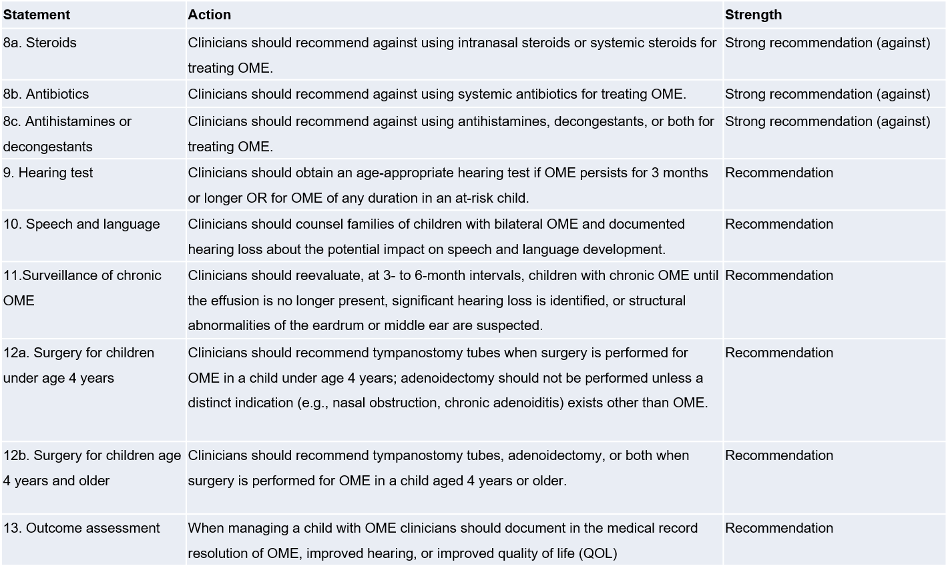
In Summary (cont’d)

Slide 46
Research Needs
Diagnosis
Further standardize the definition of OME and distinctions with regard to fluid from varying etiologies.
Assess the performance characteristics of pneumatic otoscopy as a diagnostic test for OME when performed by primary care physicians and advanced practice nurses in the routine office setting.
Determine the optimal methods for teaching pneumatic otoscopy to residents and clinicians.
Develop a brief, reliable, objective method for diagnosing OME, beyond pneumatic otoscopy.
Develop cost-effective tympanometry that facilitates testing in non-audiology settings.
Develop a classification method for identifying the presence of OME for practical use by clinicians that is based on quantifiable tympanometric characteristics.
Assess the usefulness of algorithms combining pneumatic otoscopy and tympanometry for detecting OME in clinical practice.
Conduct additional validating cohort studies of acoustic reflectometry as a diagnostic method for OME, particularly in children younger than 2 years.

Slide 47
Research Needs (cont’d)
Newborn Hearing Screen
Determine whether neonatal middle ear fluid has a differential rate of resolution or natural history than fluid in older infants and children.
Optimization of counseling to maximize rates of return for follow-up for those who fail neonatal hearing screening and have OME.
At-risk Children
Better define the child with OME who is at risk for speech, language, and learning problems.
Conduct large, multicenter observational cohort studies to identify the child at risk who is most susceptible to potential adverse sequelae of OME.
Conduct large, multicenter observational cohort studies to analyze outcomes achieved with alternative management strategies for OME in children at risk.

Slide 48
Research Needs (cont’d)
Watchful Waiting
Define the anticipated rate of spontaneous resolution of OME in infants and young children (existing data are limited primarily to children aged 2 years or older).
Conduct large-scale, prospective cohort studies to obtain current data on the spontaneous resolution of newly diagnosed OME of unknown prior duration (existing data are primarily from the late 1970s and early 1980s).
Develop prognostic indicators to identify the best candidates for watchful waiting.
Determine if the lack of impact from prompt insertion of tympanostomy tubes on speech and language outcomes seen in asymptomatic young children with OME identified by screening or intense surveillance can be generalized to older children with OME or to symptomatic children with OME referred for evaluation.
Determine whether children with an OME duration exceeding 1-2 years have an increased risk of hearing loss, balance problems, discomfort, or other findings that would prompt intervention.

Slide 49
Research Needs (cont’d)
Watchful Waiting
Define straightforward and efficient metrics to elucidate OME-related vestibular disturbance in patients too young to articulate related symptoms. Develop better tools for monitoring children with OME, suitable for routine clinical care.
Assess the value of new strategies for monitoring OME, such as acoustic reflectometry performed at home by the parent or caregiver.
Promote early detection of structural abnormalities in the tympanic membrane associated with OME that may require surgery to prevent complications.
Clarify and quantify the role of parent or caregiver education, socioeconomic status, and quality of the caregiving environment as modifiers of OME developmental outcomes.
Develop methods for minimizing loss to follow-up during OME watchful waiting.

Slide 50
Research Needs (cont’d)
Medication
Evaluate previously unstudied discrete patient subgroups who may have a differential effect in response to antimicrobials, steroids, antihistamines, or a combination thereof for OME.
Investigate the lack of efficacy of nasal steroids for OME in relation to their demonstrated capacity to decrease adenoid size.
Investigate the efficacy of adenoidectomy in children above 4 years of age.
Investigate the role of mucosal surface biofilms in refractory or recurrent OME and develop targeted interventions.

Slide 51
Research Needs (cont’d)
Hearing, Speech, and Language
Conduct longitudinal studies on the natural history of hearing loss accompanying OME.
Develop improved methods for describing and quantifying the fluctuations in hearing of children with OME over time.
Conduct prospective controlled studies on the relation of hearing loss associated with OME to later auditory, speech, language, behavioral, and academic sequelae.
Develop reliable, brief, objective methods for estimating hearing loss associated with OME.
Develop reliable, brief, objective methods for estimating speech, language or literacy delay associated with OME.
Agree on the aspects of speech, language, and literacy that are vulnerable to, or affected by, hearing loss caused by OME, and reach a consensus on the best tools for measurement.
Determine if OME and associated hearing loss place children from special populations at greater risk for speech and language delays.

Slide 52
Research Needs (cont’d)
Surgery
Define the role of adenoidectomy in children aged 3 years or younger as a specific OME therapy.
Conduct controlled trials on the efficacy of tympanostomy tubes for developmental outcomes in children with hearing loss, other symptoms, or speech and language delay.
Conduct randomized, controlled trials of surgery versus no surgery that emphasize patient-based outcome measures (QOL, functional health status) in addition to objective measures (effusion prevalence, hearing levels, AOM incidence, reoperation).
Identify the optimal ways to incorporate parent or caregiver preference into surgical decision making.

Slide 53
Research Needs (cont’d)
Allergy Management
Evaluate whether there is a causal role of atopy in OME.
Evaluate whether age impacts any relationship between allergy and OME.
Conduct randomized, controlled trials on the efficacy of immunotherapy and non-antihistamine allergy therapy for OME that are generalizable to the primary care setting.
Determine whether the subgroup with active allergy manifestations and positive allergy testing have a distinct natural history or response to interventions, including immunotherapy, compared to children without allergy.

Slide 54

Choosing Wisely®
It is an initiative of the American Board of Internal Medicine (ABIM) Foundation.
Aims to encourage discussions between physicians and patients about appropriate care.
Each of the campaign’s organization partners is asked to identify (initially) 5 items within its specialty that physicians and patients should question. The AAO-HNSF list has now grown to 10 items.
The AAO-HNSF’s list of recommendations were carefully selected after a review of the current evidence that included AAO-HNSF clinical practice guidelines.
More information is available at www.entnet.org/ChoosingWisely
What is Choosing Wisely®?

Slide 55


AAO-HNSF List of 10 Things Physicians and Patients Should Question
The Initial List

Slide 56


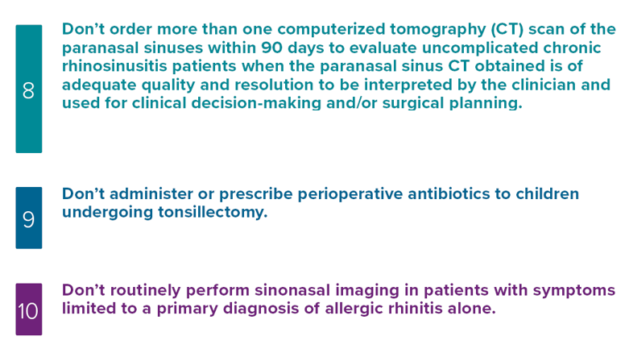
AAO-HNSF List of 10 Things Physicians and Patients Should Question
The Second List

Slide 57
Thank you for your attention
QUESTIONS?

