Slide 1
AAO-HNSF
Clinical Practice Guideline: Allergic Rhinitis
(Published February 2015)

Slide 2
Disclaimer
The clinical practice guideline is not intended as the sole source of guidance in managing patients with allergic rhinitis. Rather, it is designed to assist clinicians by providing an evidence-based framework for decision-making strategies. The guideline is not intended to replace clinical judgment or establish a protocol for all individuals with this condition and may not provide the only appropriate approach to diagnosing and managing this program of care. As medical knowledge expands and technology advances, clinical indicators and guidelines are promoted as conditional and provisional proposals of what is recommended under specific conditions but are not absolute. Guidelines are not mandates. These do not and should not purport to be a legal standard of care. The responsible physician, in light of all circumstances presented by the individual patient, must determine the appropriate treatment. Adherence to these guidelines will not ensure successful patient outcomes in every situation. The American Academy of Otolaryngology-Head and Neck Surgery Foundation emphasizes that these clinical guidelines should not be deemed to include all proper treatment decisions or methods of care or to exclude other treatment decisions or methods of care reasonably directed to obtaining the same results.

Slide 3
Burden
Allergic rhinitis (AR) is one of the most common diseases affecting adults. It is the most common chronic disease in children in the United States today; and is the fifth most common chronic disease in the U.S overall.
AR is estimated to affect nearly one in every six Americans and generates $2 to $5 billion dollars in direct health expenditures annually.
It can impair quality of life and through, loss of work and school, is responsible for as much as $2 to $4 billion dollars in lost productivity annually.

Slide 4
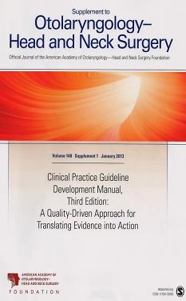
Clinical Practice Guideline Development Manual: Third Edition
Rosenfeld, Shiffman, and Robertson
Pragmatic, transparent approach to creating guidelines for performance assessment
Evidence-based, multidisciplinary process leading to publication in 12-18 months
Emphasizes a focused set of key action statements to promote quality improvement
Uses action statement profiles to summarize decisions in recommendations
Otolaryngol Head Neck Surg 2013; 148(Suppl):S1-55

Slide 5
CPG Leadership
Michael D. Seidman, MD (Chair)
Richard K. Gurgel, MD (Assistant Chair)
Sandra Y. Lin, MD (Assistant Chair)
Seth R. Schwartz, MD, MPH (Methodologist)

Slide 6
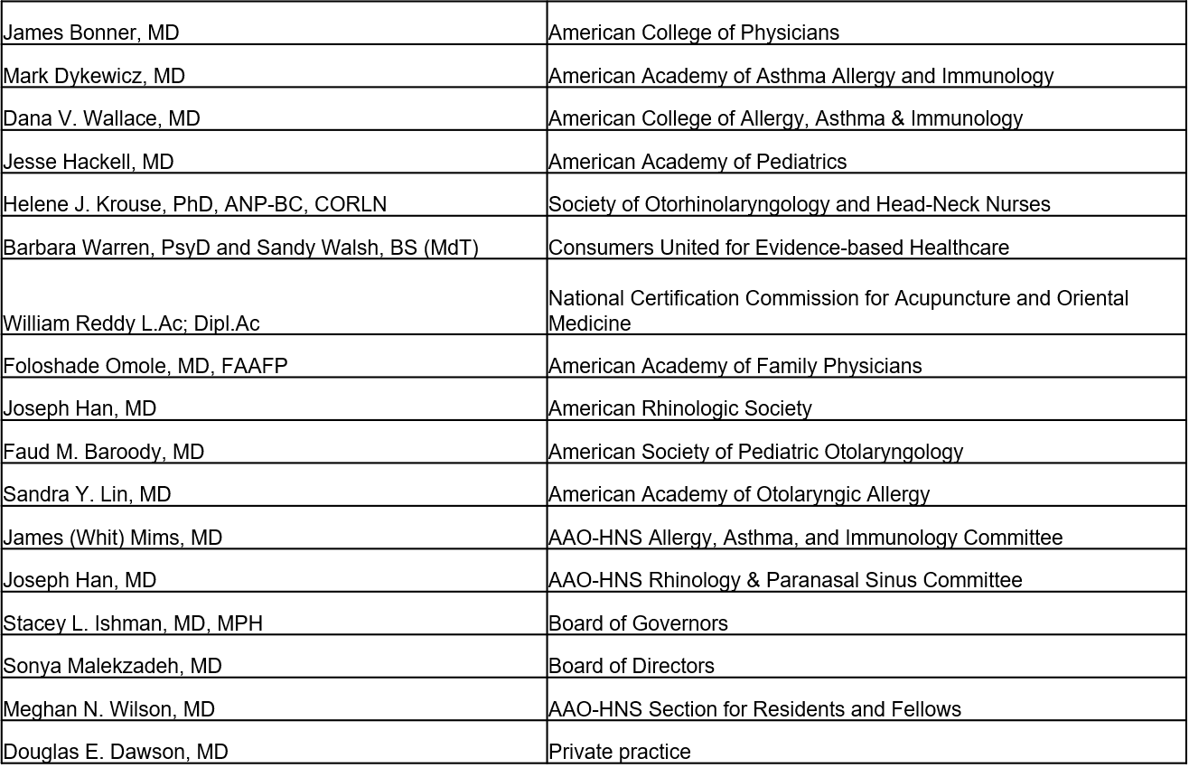
Multi-Disciplinary Panel

Slide 7
Purpose
To provide evidence-based recommendations for clinicians managing patients with allergic rhinitis, optimize patient care, promote effective diagnosis and therapy, and reduce harmful or unnecessary variations in care.

Slide 8
Target Population
Pediatric (over two years of age) and adult patients with Allergic Rhinitis.

Slide 9
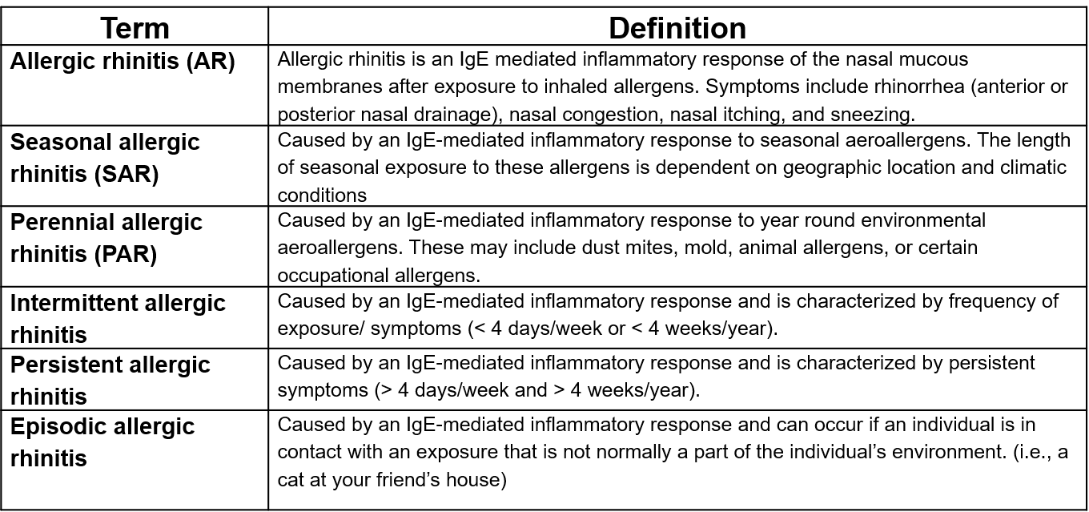
Definitions

Slide 10
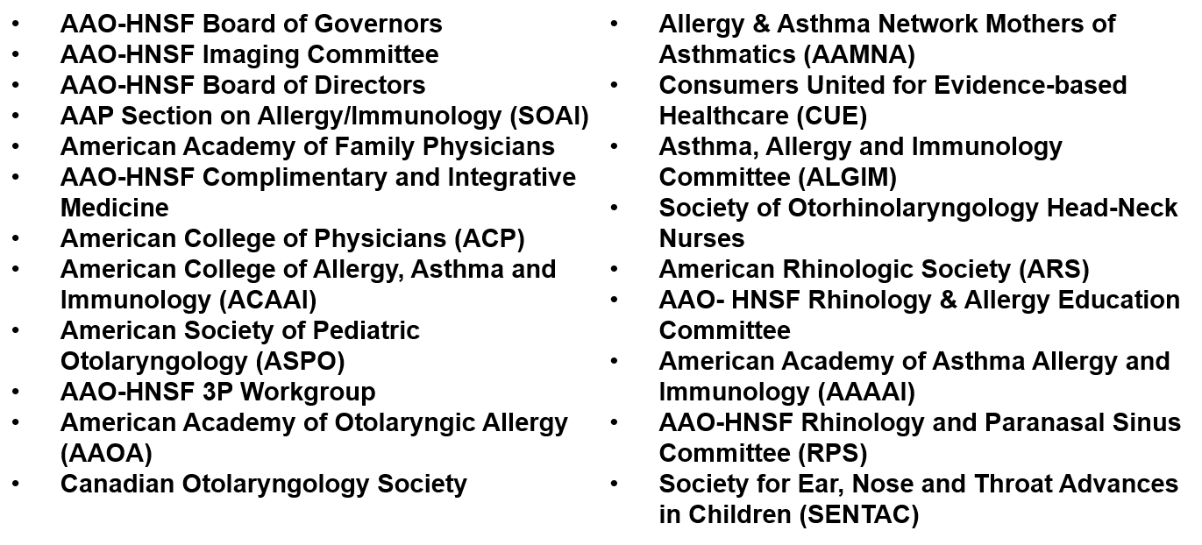
External Peer Review
43 reviewers from the 21 organizations/committees (listed below) submitted 682 comments. Resulted in 333 edits/changes to the draft CPG.

Slide 11
CPG Development
Developed using an explicit and transparent a priori protocol
Three systematic literature searches by information specialist (guidelines, SRs, RCTs, lower level evidence as needed) The 31 CPGs, 390 SRs, and 1,605 RCTs were broken down into the 14 key action statement categories. This material was supplemented, as needed, with targeted searches to address specific needs identified in writing the guideline through February, 2014. After assessing quality and relevance, we retained 7 of the CPGs, 74 of the SRs, and 186 of the RCTs.
Creation of actionable quality improvement statements based upon the supporting evidence and weighted by the balance of benefit and harm
Extensive peer review (43 reviewers and 682 comments)

Slide 12
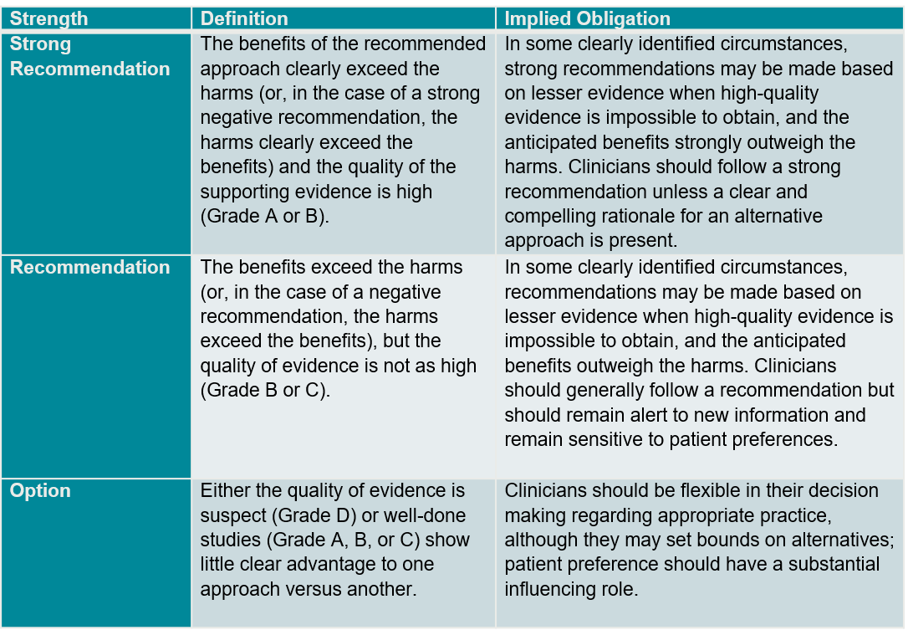
Strength of Action Terms/Implied Levels of Obligation

Slide 13
KAS 1: Patient History & Physical Examination
STATEMENT 1. PATIENT HISTORY AND PHYSICAL EXAMINATION: Clinicians should make the clinical diagnosis of allergic rhinitis when patients present with a history and physical exam consistent with an allergic cause and one or more of the following symptoms: nasal congestion, runny nose, itchy nose, or sneezing. Findings of AR consistent with an allergic cause include, but are not limited to, clear rhinorrhea, nasal congestion, pale discoloration of the nasal mucosa, red and watery eyes. Recommendation based on observational studies with a preponderance of benefit over harm.
Benefits: Avoid unnecessary treatment or testing, early referral, institute a specific therapy, improve QOL and productivity, improve accurate diagnosis
Risks, harms, costs: Inappropriate treatment, potential misdiagnosis from using history and physical alone

Slide 14
KAS 1: Patient History & Physical Examination
Action Statement Profile
Quality improvement opportunity: To promote a consistent and systematic approach to initial evaluation of the patient with allergic rhinitis
Aggregate evidence quality: Grade C
Level of confidence in evidence: High
Benefit-harm assessment: Preponderance of benefit over harm
Value judgments: Although the Guideline Development Group (GDG) recognized that a conclusive diagnosis of allergic rhinitis is difficult without diagnostic testing, making a presumptive diagnosis of allergic rhinitis based on history and physical examination alone is reasonable
Intentional vagueness: The use of the words “clinical diagnosis” acknowledges that this is a presumptive diagnosis not confirmed with testing
Role of patient preferences: Limited- Patient may request additional testing be conducted before deciding on initiation of treatment
Exclusions: None
Policy level: Recommendation
Differences of opinion: None

Slide 15
KAS 2: Allergy Testing
STATEMENT 2. ALLERGY TESTING: Clinicians should perform and interpret, or refer to a clinician who can perform and interpret, specific IgE (skin or blood) allergy testing for patients with a clinical diagnosis of allergic rhinitis who do not respond to empiric treatment, or when the diagnosis is uncertain, or when knowledge of the specific causative allergen is needed to target therapy. Recommendation based on randomized controlled trials and systematic reviews with a preponderance of benefit over harm.
Benefits: Confirming diagnosis, directing pharmacologic therapy, directing immunotherapy, avoidance strategies, avoidance of ineffective therapy, reduce cost of unnecessary testing
Risks, harms, costs: Cost of testing, adverse events from testing, misinterpretation of results, inaccurate test results (false positives and negatives)

Slide 16
KAS 2: Allergy Testing
Action Statement Profile
Quality improvement opportunity: Improve accurate diagnosis and avoid unnecessary testing
Aggregate evidence quality: Grade B
Level of confidence in evidence: High
Benefit-harm assessment: Preponderance of benefit over harm
Value judgments: Patients may benefit from identification of specific allergic cause
Intentional vagueness: We did not specify which specific IgE test (blood or skin) to order. We also did not specify which allergens to test as that was beyond the scope of this guideline. We did not specify what constitutes empiric treatment, though this is generally treatment that is initiated prior to confirmatory, IgE-specific testing and could include recommending environmental controls, allergen avoidance, or medical management. Lack of response to empiric treatment is not defined to allow the clinician to exercise judgment in making this determination
Role of patient preferences: Moderate- Shared decision-making in discussion of harms and benefits of testing; clinicians and patients should discuss potential costs, benefits, adverse effects of additional testing, and type of testing, either skin or blood, if neither is contraindicated
Exclusions: None
Policy level: Recommendation
Differences of opinion: None

Slide 17
KAS 3: Imaging
STATEMENT 3. IMAGING: Clinicians should not routinely perform sinonasal imaging in patients presenting with symptoms consistent with a diagnosis of allergic rhinitis. Recommendation (against) based on observational studies with a preponderance of benefit over harm.
Benefits: Avoiding un-necessary radiation exposure, reduction of cost, reducing variation in care
Risks, harms, costs: Inaccurate or missed diagnosis of pathology with similar presenting symptoms.

Slide 18
KAS 3: Imaging
Action Statement Profile
Quality improvement opportunity: Reduction of variation of care, reduction of potential harm from un-necessary radiation exposure
Aggregate evidence quality: Grade C-based on observational studies
Level of confidence in evidence: High
Benefit-harm assessment: Preponderance of benefit over harm
Value judgments: None
Intentional vagueness: The word routine was used to allow for circumstances where the patient history may warrant imaging for evaluation of another problem besides AR
Role of patient preferences: None
Exclusions: None
Policy level: Recommendation (against)
Differences of opinions: None

Slide 19
KAS 4: Environmental Factors
STATEMENT 4. ENVIRONMENTAL FACTORS: Clinicians may advise avoidance of known allergens or may advise environmental controls (i.e. removal of pets, the use of air filtration systems, bed covers, and acaricides [chemical agents that kill dust mites]) in allergic rhinitis patients who have identified allergens that correlate with clinical symptoms. Option based on randomized controlled trials with minor limitations and observational studies with equilibrium of benefit and harm.
Benefits: Decreased allergen levels and possible reduction in symptoms
Risks, harms, costs: Cost of environmental controls, emotional effect (i.e. recommending animal avoidance in pet lovers), cost of ineffective recommendation

Slide 20
KAS 4: Environmental Factors
Action Statement Profile
Quality improvement opportunity: Reduce expenditures on environmental measures that do not improve symptoms
Aggregate evidence quality: Grade B
Level of confidence in evidence: Moderate-With the exception of studies on house dust mites, the majority of the studies were small
Benefit-harm assessment: Equilibrium
Value judgments: Many studies have demonstrated a reduction in allergen levels with environmental controls, however benefits in alleviating symptoms is limited. Use of multiple avoidance techniques may be more effective than individual measures
Role of patient preferences: Large- Shared decision-making in discussion of evidence for effectiveness of possible controls and the need to weigh the costs and benefits
Exclusions: None
Policy level: Option
Differences of opinion: None

Slide 21
KAS 5: Chronic Conditions and Comorbidities
STATEMENT 5. CHRONIC CONDITIONS AND COMORBIDITIES: Clinicians should assess and document in the medical record patients with a clinical diagnosis of allergic rhinitis for the presence of associated conditions such as asthma, atopic dermatitis, sleep disordered breathing, conjunctivitis, rhinosinusitis and otitis media. Recommendation based on randomized trials with some heterogeneity and a preponderance of benefit over harm.
Benefits: Increase awareness of these conditions, identification of treatable conditions, knowledge of these conditions may alter recommendations for allergic rhinitis treatment as co-morbid conditions can alter response to treatment
Risks, harms, costs: Potential erroneous diagnosis of comorbid conditions

Slide 22
KAS 5: Chronic Conditions and Comorbidities
Action Statement Profile
Quality improvement opportunity: Identification of significant comorbid conditions or complications. Potential for treatment optimization
Aggregate evidence quality: Grade B
Level of confidence in evidence: High
Benefit-harm assessment: Preponderance of benefit over harm
Value judgments: None
Intentional vagueness: None
Role of patient preferences: None
Exclusions: None
Policy level: Recommendation
Differences of opinion: None

Slide 23
KAS 6: Topical Steroids
STATEMENT 6. TOPICAL STEROIDS: Clinicians should recommend intranasal steroids for patients with a clinical diagnosis of allergic rhinitis whose symptoms impact their quality of life (QOL). Strong Recommendation based on randomized controlled trials with minor limitations and a preponderance of benefit over harm.
Benefits: Improved symptom control, improved QOL, better sleep, potential cost saving with monotherapy, targeted local effect
Risks, harms, costs: Topical side effects, epistaxis, drug side effects, potential growth concerns in children, septal perforation and the cost of medication.

Slide 24
KAS 6: Topical Steroids
Action Statement Profile
Quality improvement opportunity: Optimizing the use of proven effective therapy
Aggregate evidence quality: Grade A
Level of confidence in evidence: High.
Benefit-harm assessment: Preponderance of benefit over harm
Value judgments: None
Intentional vagueness: None
Role of patient preferences: Large- There are multiple classes of effective therapy with differing risks, adverse effects, costs and benefits. The clinician should use his or her expertise in assisting patients to evaluate the best treatment and to ensure patient compliance.
Exclusions: None
Policy level: Strong recommendation
Differences of opinions: Minor. There were some differences of opinion as to what the best therapy for mild or intermittent symptoms are, as oral or nasal antihistamines may be adequate therapy for those patients

Slide 25
KAS 7: Oral Antihistamines
STATEMENT 7. ORAL ANTIHISTAMINES: Clinicians should recommend oral second generation/less sedating antihistamines for patients with allergic rhinitis and primary complaints of sneezing and itching. Strong Recommendation based on randomized controlled trials with minor limitations and a preponderance of benefit over harm.
Benefits: Rapid onset of action, oral administration, relief of symptoms, counter availability, potentially cost saving (generic brand), relief of eye symptoms
Risks, harms, costs: Systemic side effects (sedation), dry eyes, urinary retention

Slide 26
KAS 7: Oral Antihistamines
Action Statement Profile
Quality improvement opportunity: Avoidance of sedating antihistamine use and promotion of use of effective symptom directed therapy
Aggregate evidence quality: Grade A
Level of confidence in evidence: High
Benefit-harm assessment: Preponderance of benefit over harm
Value judgments: None
Intentional vagueness: None
Role of patient preferences: Large- Shared decision-making in considering the benefits, harms, costs and evaluation of the best treatment options. Clinicians should offer a comparison of evidence for the effectiveness of oral versus nasal administration of antihistamines and nasal steroids that will provide good patient adherence and treatment efficacy.
Exclusions: None
Policy Level: Strong Recommendation
Differences of opinions: None

Slide 27
KAS 8: Intranasal Antihistamines
STATEMENT 8. INTRANASAL ANTIHISTAMINES: Clinicians may offer intranasal antihistamines for patients with seasonal, perennial, or episodic allergic rhinitis. Option based on randomized controlled trials with minor limitations and observational studies with equilibrium of benefit and harm.
Benefits: Rapid onset, increased effectiveness over oral antihistamines for nasal congestion
Risks, harms, costs: Increased cost relative to oral antihistamines, poor taste, sedation, more frequent dosing, epistaxis, local side effects

Slide 28
KAS 8: Intranasal Antihistamines
Action Statement Profile
Quality improvement opportunity: Improve awareness of this class of medications as another effective treatment for allergic rhinitis that may be an alternative to other medication classes
Aggregate evidence quality: Grade A
Level of confidence in evidence: High, but most of the trials were of short duration
Benefit-harm assessment: Equilibrium
Value judgments: The GDG felt that in general this class of medications would represent second line therapy after failure of nasal steroids or oral antihistamines due to poor acceptance due to taste and cost, but that there may be specific patients in whom this class would be an appropriate first line therapy
Intentional vagueness: None
Role of patient preferences: Large- There is equilibrium of benefits to risks when using intranasal antihistamine. Shared decision making may help ensure that the patient understands the potential benefits versus harms of undergoing this treatment; while also promoting patient compliance with medication
Exclusions: Not approved for children below the age of 5
Policy level: Option
Differences of opinion: Minor; there is reasonable data supporting their use, but there was some debate regarding the harm-benefit ratio leading this to be an option. Several panel members thought these should be recommended at the same level as oral antihistamines

Slide 29
KAS 9: Oral Leukotriene Receptor Antagonist (LTRAs)
STATEMENT 9. ORAL LEUKOTRIENE RECEPTOR ANTAGONISTS (LTRAs): Clinicians should not offer oral leukotriene receptor antagonists as primary therapy for patients with allergic rhinitis. Recommendation (against) based on randomized controlled trials and systematic reviews with a preponderance of benefit over harm.
Benefits: Avoid ineffective or less effective therapy, cost saving, decreased variations in care
Risks, harms, costs: There may be a subset of patients who would benefit from this medication (i.e. Patient with both AR and asthma)

Slide 30
KAS 9: Oral Leukotriene Receptor Antagonist (LTRAs)
Action Statement Profile
Quality improvement opportunity: Reduced use of a less effective agent for initial therapy
Aggregate evidence quality: Grade A
Level of confidence in evidence: High
Benefit-harm assessment: Preponderance of benefit over harm
Value judgments: The panel was concerned with the cost of this medication in combination with the evidence that it is less effective than first line medications
Intentional vagueness: None
Role of patient preferences: Low –rare patients with intolerance of intranasal therapy and concerns regarding somnolence may benefit from consideration of use of this class of medicine
Exclusions: Patient with concurrent diagnosis of asthma. These patients may benefit from oral leukotriene receptor antagonists as a first line therapy
Policy level: Recommendation (against)
Differences of opinion: None

Slide 31
KAS 10: Combination Therapy
STATEMENT 10. COMBINATION THERAPY: Clinicians may offer combination pharmacologic therapy in patients with allergic rhinitis who have inadequate response to pharmacologic monotherapy. Option based on randomized controlled trials with minor limitations and observational studies with equilibrium of benefit and harm.
Benefits: Improved effectiveness and symptom control of combined therapy
Risks, harms, costs: Increased cost, overuse of medication, use of ineffective combinations, multiple medication side effects, drug interactions

Slide 32
KAS 10: Combination Therapy
Action Statement Profile
Quality improvement opportunity: Reduce variations in care. Improve symptom control.
Aggregate evidence quality: Grade A
Level of confidence in evidence: High. There is strong evidence supporting the use of some combinations and the ineffectiveness of other combinations
Benefit-harm assessment: Equilibrium
Value judgments: None
Intentional vagueness: The term “combination therapy” is non-specific as there are multiple different combinations. The details are elaborated in the supporting text. The term inadequate response to monotherapy also allows for some interpretation by clinicians and patients
Role of patient preferences: Moderate– Shared decision making in consideration of evidence for benefits, harms and cost of combinations, effective dosing and potential medication interactions to assist the patient in more effective treatment compliance
Exclusions: Decongestants that are part of some combined products are not approved for children under the age of 4
Policy level: Option
Differences of opinion: None

Slide 33
KAS 11: Immunotherapy
STATEMENT 11. IMMUNOTHERAPY: Clinicians should offer or refer to a clinician who can offer immunotherapy (sublingual or subcutaneous) for patients with allergic rhinitis who have inadequate response to symptoms with pharmacologic therapy with or without environmental controls. Recommendation based on randomized controlled trials and systematic reviews with a preponderance of benefit over harm.
Benefits: Altered natural history, improved symptom control, decreased need for medical therapy, long-term cost effectiveness, may improve or prevent asthma or other comorbidities, and may prevent new sensitizations
Risks, harms, costs: Local reactions, and systemic reactions including anaphylaxis, increased initial cost, frequency of treatment (logistics), pain of injection, delayed onset of symptom control (months)

Slide 34
KAS 11: Immunotherapy
Action Statement Profile
Quality improvement opportunity: Increased appropriate use of immunotherapy and reduce variation in care; Increased awareness of immunotherapy
Aggregate evidence quality: Grade A
Level of confidence in evidence: High
Benefit-harm assessment: Preponderance of benefit over harm
Value judgments: None
Intentional vagueness: We elected to use the term inadequate response to medical therapy as there are circumstances where immunotherapy may be beneficial for symptom control even if there is some response to medical therapy since immunotherapy addresses the underlying pathophysiology of atopy
Role of patient preferences: Large - There are potential risks, harms and costs associated with the use of immunotherapy and a delayed onset. Shared decision making may help the patient understand the potential harms of undergoing this treatment. In addition, the efficacy of using this mode of therapy also depends upon patient compliance with frequency and duration of treatment, as well as delay in onset of effect with immunotherapy
Exclusions: Uncontrolled asthma
Policy Level: Recommendation
Differences of opinion: Minor; some panel members felt that immunotherapy could be offered as first line treatment to patients who elect not to use medical therapy

Slide 35
KAS 12: Inferior Turbinate Reduction
STATEMENT 12. INFERIOR TURBUNATE REDUCTION: Clinicians may offer, or refer to a surgeon who can offer, inferior turbinate reduction in patients with allergic rhinitis with nasal airway obstruction and enlarged inferior turbinates who have failed medical management. Option based on observational studies with a preponderance of benefit over harm.
Benefits: Improved symptoms, improved QOL, improved medication delivery, reduced medication use, better sleep
Risks, harms, costs: Unnecessary surgery, cost of surgery, risks of surgery, atrophic rhinitis

Slide 36
KAS 12: Inferior Turbinate Reduction
Action Statement Profile
Quality improvement opportunity: Improved nasal breathing and QOL
Aggregate evidence quality: Grade C
Level of confidence in the evidence: Moderate
Benefit-harm assessment: Preponderance of benefit over harm
Value judgments: The panel felt that in spite of lack of head-to-head trials between medical and surgical therapy, surgery should be reserved for patients failing medical therapy due to the higher risk of any surgical management
Intentional vagueness: The panel elected to use the term failure of medical therapy as there are circumstances where inferior turbinate reduction may be beneficial for symptom control even if there is some response to medical therapy
Role of patient preferences: Large-Clinicians should utilize a shared decision-making process about the risks, benefits and costs of undergoing surgery and associated use of anesthesia
Exclusions: Patients who are not surgical candidates
Policy level: Option
Differences of opinion: Minor difference of opinion whether allergic rhinitis is an independent risk factor for turbinate hypertrophy

Slide 37
KAS 13: Acupuncture
STATEMENT 13. ACUPUNCTURE: Clinicians may offer acupuncture, or refer to a clinician who can offer acupuncture, for patients with allergic rhinitis who are interested in non-pharmacologic therapy. Option based on Randomized controlled trials with limitations, observational studies with consistent effects, and a preponderance of benefit over harm.
Benefits: Effective alternative to medical therapies, reduction of symptoms, may more closely align with patient values, improved quality of life, avoidance of medication use and potential side effects
Risks, harms, costs: logistics of multiple treatments, need for multiple needle sticks, cost of treatment, rare infections.

Slide 38
KAS 13: Acupuncture
Action Statement Profile
Quality improvement opportunity: Increased awareness of acupuncture as a treatment option for allergic rhinitis
Aggregate evidence quality: Grade B
Level of confidence in evidence: Low; the randomized trials did not show comparison to traditional medical therapy for allergic rhinitis and had methodological flaws
Benefit-harm assessment: Preponderance of benefit over harm
Value judgments: Panel members varied in their preconceived bias for or against acupuncture
Intentional vagueness: None
Role of patient preferences: Limited- Potential for shared decision-making
Exclusions: None
Policy level: Option
Differences of opinions: None

Slide 39
KAS 14: Herbal Therapy
STATEMENT 14. HERBAL THERAPY: No recommendation regarding the use of herbal therapy for patients with allergic rhinitis. No recommendation based on limited knowledge of herbal medicines, concern about the quality of standardization and safety.
Benefits: Improved awareness of alternative treatments, improved education of side effects of herbal therapy
Risks, harms, costs: Not applicable

Slide 40
KAS 14: Herbal Therapy
Action Statement Profile
Quality improvement opportunity: Not applicable
Aggregate evidence quality: Uncertain
Level of confidence in evidence: Low. Many of the studies were small and of questionable methodology; The meta analyses were done in English, but looked at articles from the Chinese literature which are not available for assessment by the panel
Benefit-harm assessment: Not applicable
Value judgments: There are many herbal therapies but there is only evidence for a few that have appropriate studies. There is limited knowledge about these products among most of the panel members and accordingly there was a bias against their use. There is concern about the quality of standardization of herbal medicines and their safety
Intentional vagueness: None
Role of patient preferences: None
Exclusions: None
Policy level: No recommendation
Differences of opinion: None

Slide 41
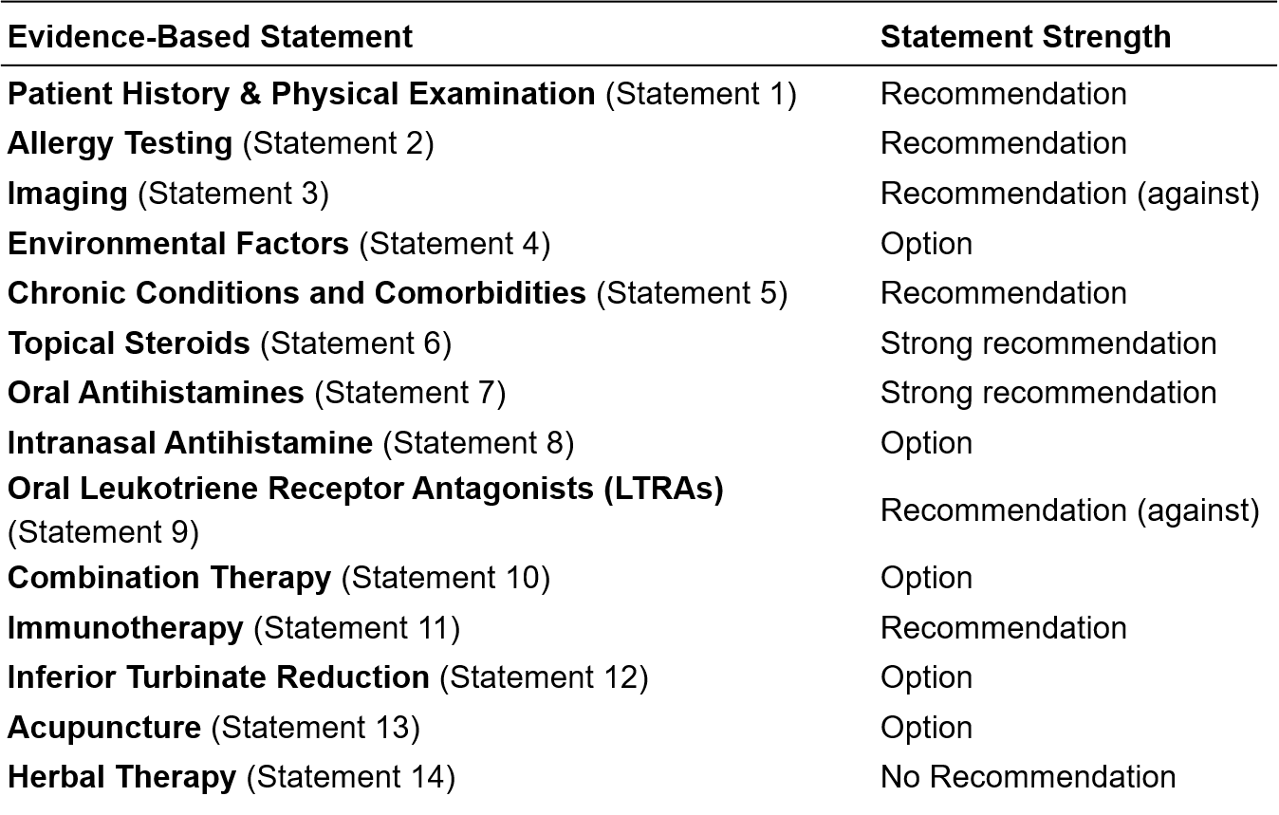
Summary of Guideline Key Action Statements

Slide 42
Research Needs
The GDG identified 15 research needs as a result of writing this guideline.
Determine the effect of environmental control strategies on AR. The aggregate evidence profile for environmental controls was a grade B. Controlled trials to identify the efficacy of environmental controls on measurable AR endpoints are needed.
Evaluate the safety and efficacy of SIT, specifically SLIT. There have been few U.S.-based studies evaluating SLIT which has been offered in the United States in an off-label, non-FDA approved fashion. With FDA approval of ORALAIR, a mixed allergen extract consisting of the following pollens: (Sweet Vernal, Orchard, Perennial Rye, Timothy, and Kentucky Blue Grass), Grastek (treatment for Timothy grass pollen) and Ragwitek (treatment for short ragweed pollen) in 2014, prospective, randomized, controlled studies are needed to properly evaluate the effect of the office-sold physician-diluted, non-standardized products and other SLIT preparations.
Cost-effectiveness research (including direct and indirect costs) of SCIT compared to SLIT is needed. There also needs to be better comparisons of SLIT vs. SCIT which are very few and far between and of which there are none in the United States.
Determine the molecular effects of first-line therapies for AR target end-organ immune responses (i.e. topical steroids and antihistamines for nasal symptoms). Basic, mechanistic research in the fields of allergy and immunology addressing the underlying triggers for specific patients is needed, as well as other immune-modulating treatments that alter the pathophysiology of AR and its comorbid conditions.

Slide 43
Research Needs (cont’d)
Determine the safety and efficacy of acupuncture for AR. There is a relative paucity of data in the English literature regarding the use of complementary and integrative medicine for AR. As such, specific recommendations for or against these treatments could not be made. Higher levels of evidence regarding these therapies need to be obtained through well-designed clinical trials and/or systematic reviews of existing data.
The studies on herbal therapies involve use of preparations that combine numerous herbal extracts in varying amounts, thus research needs to be conducted on specific herbal extracts along with standardization of dosing to determine efficacy for AR.
Controlled trials comparing surgical versus medical management of inferior turbinate hypertrophy with nasal congestion in patients with AR. In addition, there is a need for further research regarding the role of septoplasty in the treatment of AR.
Determine the relationship between AR and comorbid conditions such as otitis media and sinusitis. In addition, research is needed to determine the effect of AR treatment on comorbid conditions and the effect of treatment for comorbid conditions on AR.
Impact of patient adherence to different treatments, and treatment outcomes, which often is neglected in establishing the evidence base for AR or other treatments in trials. There is a need for increased diversity in trial subjects and the examination of other factors influencing treatment outcomes such as ease or utility of treatment administrations, as well as the impact of patient education aides, etc. on patient adherence and subsequent outcomes.

Slide 44
Research Needs (cont’d)
More research, including basic and/or translational trials, evaluating novel forms of immunotherapy such as peptide vaccines, DNA conjugated vaccines, intradermal injections or intralymphatic injections. These are all strategies that are hypothesized to reduce the allergenicity of extracts while maintaining or enhancing the beneficial effects on the immune system.
Analyze the impact of immunomodulatory agents for the treatment of asthma on allergic rhinitis.
Determine the relationship between AR and comorbid conditions such as otitis media and sinusitis. In addition, research is needed to determine the effect of AR on comorbid conditions.
Determine whether different forms of allergy testing can provide clinically meaningful information. It is still unclear whether one form of testing is superior than the other in identifying clinically relevant allergens.
Studies to determine the effect of combined allergen formulations for AR that are standardized, tolerable and effectively dosed.
Outcome measures needed using SN-5 or other tools to measure and compare efficacy of medical and surgical treatments for nasal congestion/AR in both children and adults.

Slide 45
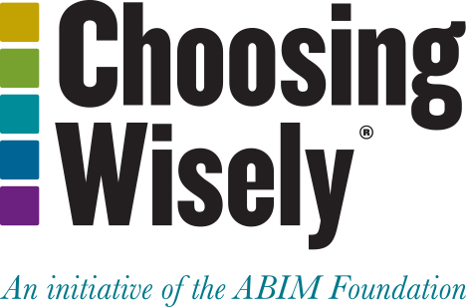
Choosing Wisely®
It is an initiative of the American Board of Internal Medicine (ABIM) Foundation.
Aims to encourage discussions between physicians and patients about appropriate care.
Each of the campaign’s organization partners is asked to identify (initially) 5 items within its specialty that physicians and patients should question. The AAO-HNSF list has now grown to 10 items.
The AAO-HNSF’s list of recommendations were carefully selected after a review of the current evidence that included AAO-HNSF clinical practice guidelines.
More information is available at www.entnet.org/ChoosingWisely
What is Choosing Wisely®?

Slide 46


AAO-HNSF List of 10 Things Physicians and Patients Should Question
The Initial List

Slide 47


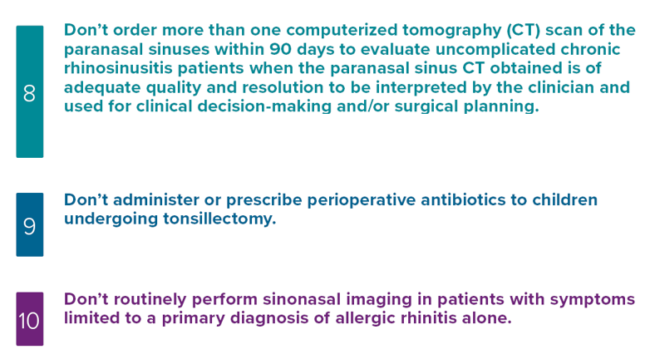
AAO-HNSF List of 10 Things Physicians and Patients Should Question
The Second List

Slide 48

AAO-HNSF List of 10 Things Physicians and Patients Should Question
History, physical examination and allergy testing are the cornerstones of diagnosis of allergic rhinitis. The utility of imaging for allergic rhinitis is unproven.
What Statement Relates to this Clinical Practice Guideline?
More information is available at www.entnet.org/ChoosingWisely.org

Slide 49
Thank you for your attention
QUESTIONS?

