Slide 1
AAO-HNSF Clinical Practice Guideline: Hoarseness (Dysphonia) (Update)
Update to 2009 Guideline
Publication Date: March 1, 2018

Slide 2
Disclaimer
The clinical practice guideline is not intended as the sole source of guidance in managing patients with hoarseness. Rather, it is designed to assist clinicians by providing an evidence-based framework for decision-making strategies. The guideline is not intended to replace clinical judgment or establish a protocol for all individuals with this condition and may not provide the only appropriate approach to diagnosing and managing this program of care. As medical knowledge expands and technology advances, clinical indicators and guidelines are promoted as conditional and provisional proposals of what is recommended under specific conditions but are not absolute. Guidelines are not mandates. These do not and should not purport to be a legal standard of care. The responsible physician, in light of all circumstances presented by the individual patient, must determine the appropriate treatment. Adherence to these guidelines will not ensure successful patient outcomes in every situation. The American Academy of Otolaryngology-Head and Neck Surgery Foundation emphasizes that these clinical guidelines should not be deemed to include all proper treatment decisions or methods of care or to exclude other treatment decisions or methods of care reasonably directed to obtaining the same results.

Slide 3

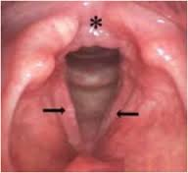
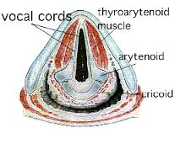
What is dysphonia (hoarseness)?
Dysphonia can be defined as altered vocal quality, pitch, loudness, or vocal effort that impairs communication and QOL

Slide 4

Burden of dysphonia (hoarseness)
Dysphonia (impaired voice production) is a very common complaint affecting nearly one-third of the population at some point in their lives.
Dysphonia can affect patients of all ages and genders, but has an increased prevalence in teachers, older adults, and other persons with significant vocal demands.
Direct costs of dysphonia estimated from a large administrative database study reported a mean cost per patient of between $577 and $953 per year. This translates into estimated total direct healthcare costs up to $13.5 billion annually.
Quality of life consequences of dysphonia are substantial and can be debilitating. Affected patients often suffer social isolation, depression, anxiety, missed work, lost wages, and lifestyle changes.

Slide 5

Why bother with an update?
National Academies of Sciences, Engineering, and Medicine (formerly Institute of Medicine) Clinical Practice Guidelines We Can Trust Standard 8 states:
    Literature should be monitored regularly following CPG publication to identify the emergence of new, potentially relevant evidence and to evaluate the continued validity of the CPG.
The AAO-HNSF strives to update every 5-years.

Slide 6
What’s new?
Incorporation of new evidence profiles to include the role of patient preferences, confidence in the evidence, differences of opinion, quality improvement opportunities, and any exclusion to which the action statement does not apply
New evidence from 3 guidelines, 16 systematic reviews, 4 RCTs
Addition of consumer advocate to guideline update group
Changes to 9 KASs (key action statements) from the original guideline
New KAS 3 (escalation of care) and KAS 13 (outcomes)
Enhanced external review process to include public comment and journal peer review
Addition of an algorithm outlining KASs for patients with dysphonia

Slide 7
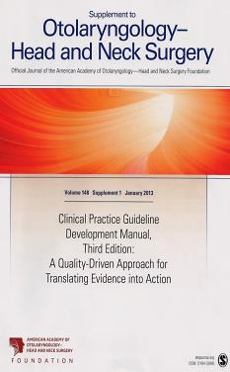
Clinical Practice Guideline Development Manual: Third Edition
Rosenfeld, Shiffman, and Robertson
Pragmatic, transparent approach to creating guidelines for performance assessment
Evidence-based, multidisciplinary process leading to publication in 12-18 months
Emphasizes a focused set of key action statements to promote quality improvement
Uses action statement profiles to summarize decisions in recommendations
Otolaryngol Head Neck Surg 2013; 148(Suppl):S1-55

Slide 8

Clinical Practice Guidelines (CPG) Goals
Focus on quality improvement opportunities
Define actionable recommendations for clinicians regardless of discipline to improve care
The guideline is not intended to be comprehensive
The guideline is not intended to limit or restrict care provided by clinicians to individual patients

Slide 9

AAO-HNSF Guideline Update Group
Robert J. Stachler, MD, Chair
David O. Francis, MD, MS, Assistant Chair
Seth R. Schwartz, MD, MPH, Methodologist
Cecelia C. Damask, DO, FAAOA, American Academy of Otolaryngic Allergy (AAOA)
German P. Digoy, MD, FAAP, American Academy of Pediatrics (AAP)
Helene J. Krouse, PhD, RN, ANP-BC, CORLN, FAAN, Society of Otorhinolaryngology and Head-Neck Nurses
Scott J. McCoy, DMA, National Association of Teachers of Singing (NATS)
Daniel R. Ouellette, MD, American College of Chest Physicians (ACCP)
Rita R. Patel, PhD, CCC-SLP, Consumers United for Evidence-based Healthcare
Charles (Charlie) W. Reavis, National Spasmodic Dysphonia Association (NSDA)
Libby J. Smith, DO, FAOCO, American Broncho-Esophagological Association (ABEA)
Marshall Smith, MD, American Society of Pediatric Otolaryngology (ASPO)
Steven W. Strode, MD, Med, MPH, American Academy of Family Physicians (AAFP)
Peak Woo, MD, FACS, American Laryngological Association (ALA)

Slide 10
AAO-HNSF Guideline Update Group
ENT physicians
Chair Assistant Chair BOG BOD Methodologist
Other physicians
Pediatrician Family physician Chest physician
Non- physicians
SLP Nurse Staff liaison Teachers of Singing Consumer

Slide 11
Purpose and Target Audience
PURPOSE: The primary purpose of this guideline is to improve the quality of care for patients with dysphonia, based on current best evidence
TARGET PATIENT: All patients all age groups evaluated in a setting where dysphonia would be identified or managed.
TARGET AUDIENCE: The guideline is intended for all clinicians who diagnose and manage patients with dysphonia and applies to any setting in which dysphonia would be identified, monitored, treated, or managed.
EXCLUSIONS: Does not apply to patients with dysphonia with the following conditions: history of laryngectomy (total or partial), craniofacial anomalies, velopharyngeal insufficiency, and dysarthria (impaired articulation).

Slide 12

Literature Search
Performed by an information specialist.
New evidence included:
  Clinical Practice Guidelines: 3
  Systematic Reviews: 16
  Randomized Control Trials: 4

Slide 13
Strength of Action Terms/Implied Levels of Obligation
Strength | Definition | Implied Obligation
Strong Recommendation | The benefits of the recommended approach clearly exceed the harms (or, in the case of a strong negative recommendation, the harms clearly exceed the benefits) and the quality of the supporting evidence is high (Grade A or B). | In some clearly identified circumstances, strong recommendations may be made based on lesser evidence when high-quality evidence is impossible to obtain, and the anticipated benefits strongly outweigh the harms. Clinicians should follow a strong recommendation unless a clear and compelling rationale for an alternative approach is present.
Recommendation | The benefits exceed the harms (or, in the case of a negative recommendation, the harms exceed the benefits), but the quality of evidence is not as high (Grade B or C). | In some clearly identified circumstances, recommendations may be made based on lesser evidence when high-quality evidence is impossible to obtain, and the anticipated benefits outweigh the harms. Clinicians should generally follow a recommendation but should remain alert to new information and remain sensitive to patient preferences.
Option | Either the quality of evidence is suspect (Grade D) or well-done studies (Grade A, B, or C) show little clear advantage to one approach versus another. | Clinicians should be flexible in their decision making regarding appropriate practice, although they may set bounds on alternatives; patient preference should have a substantial influencing role.

Slide 14
External Review and Endorsements
449 comments received during External Peer Review which ended on December 5, 2016
38 comments received from reviewers during public comment which ended on March 29, 2017
Endorsements received from the following organizations:
Endorsed
  American Academy of Otolaryngic Allergy (AAOA)
  Society of Otorhinolaryngology and Head-Neck Nurses (SOHN)
  National Association of Teachers of Singing (NATS)
  National Spasmodic Dysphonia Association (NSDA)
  American Broncho-Esophagological Association (ABEA)
  American Laryngological Association (ALA)
  American Speech-Language-Hearing Association (ASHA)
  American Society of Pediatric Otolaryngology (ASPO)
  American Academy of Pediatrics (AAP)
  American College of Chest Physicians (ACCP)
Affirmation of Value
  American Academy of Family Physicians (AAFP)

Slide 15
STATEMENT 1. IDENTIFICATION OF ABNORMAL VOICE
STATEMENT 1: IDENTIFICATION OF ABNORMAL VOICE: Clinicians should identify dysphonia in a patient with altered voice quality, pitch, loudness, or vocal effort that impairs communication or reduces QOL. Recommendation based on observational studies with a preponderance of benefit over harm.
Benefit: Timely recognition of the need to search for an underlying etiology, identify patients who may benefit from treatment, discourage the perception of hoarseness as a trivial condition that does not warrant attention
Risks, harms, costs: Potential anxiety related to diagnosis; time expended in diagnosis, documentation, and discussion

Slide 16
STATEMENT 1. IDENTIFICATION OF ABNORMAL VOICE
Action Statement Profile
Quality improvement opportunity: To promote awareness of dysphonia by all clinicians as a condition that may require intervention or additional investigation. (National Quality Strategy Domains): Prevention and Treatment of Leading Causes of Morbidity and Mortality
Aggregate evidence quality: Grade C, observational studies for symptoms with one systematic review of QOL in voice disorders and two systematic reviews on medication side effects
Level of confidence in evidence: High
Benefits-harm assessment: Preponderance of benefits over harm
Value judgments: The group feels that this is a critical component to caring for patients with altered voice, but were constrained from calling this a strong recommendation from lack of A or B level evidence.
Intentional vagueness: None
Role of patient preference: Small
Exclusions: None
Policy Level: Recommendation
Differences of opinions: None

Slide 17
STATEMENT 2. IDENTIFYING THE UNDERLYING CAUSE OF DYSPHONIA
STATEMENT 2: IDENTIFYING UNDERLYING CAUSE OF DYSPHONIA: Clinicians should assess the patient with dysphonia by history and physical examination for underlying causes of dysphonia and factors that modify management. Recommendation based on observational studies with a preponderance of benefit over harm.
Benefit: To identify potential causative factors of the dysphonia, increase awareness of underlying causes of dysphonia, identify patients at risk for serious underlying conditions, and identify underlying cause to allow for targeted treatment.
Risks, harms, costs: None

Slide 18
STATEMENT 2. IDENTIFYING THE UNDERLYING CAUSE OF DYSPHONIA
Action Statement Profile
Quality improvement opportunity: To guide the expediency and nature of recommended treatments/investigations through identification of potential underlying causes of the dysphonia (National Quality Strategy domain): Prevention and Treatment of Leading Causes of Morbidity and Mortality; Effective Communication and Care Coordination.
Aggregate evidence quality: Grade C, observational studies
Level of confidence in evidence: High
Benefits-harm assessment: Preponderance of benefit over harm
Value judgments: Further management of dysphonia is completely dependent on the underlying cause. The group felt that while this seems obvious, it was an opportunity to educate clinicians about potential etiologies
Intentional vagueness: None
Role of patient preferences: Small
Exclusions: None
Policy level: Strong Recommendation
Differences of opinions: None

Slide 19
STATEMENT 3. ESCALATION OF CARE
STATEMENT 3: ESCALATION OF CARE: Clinicians should assess the patient with dysphonia by history and physical examination to identify factors where expedited laryngeal evaluation is indicated; these include but are not limited to: recent surgical procedures involving the head, neck or chest, recent endotracheal intubation, presence of concomitant neck mass, respiratory distress or stridor, history of tobacco abuse, and whether he/she is a professional voice user. Strong recommendation based on observational studies with a preponderance of benefit over harm.
Benefit: To identify factors early in the course of management that could influence the timing of diagnostic procedures, choice of interventions, or provision of follow-up care; to identify risk factors; to identify populations for whom early or more aggressive intervention may be warranted (i.e. professional voice).
Risks, harms, costs: Time in assessment

Slide 20
STATEMENT 3. ESCALATION OF CARE
Action Statement Profile
Quality improvement opportunity: To encourage early referral of dysphonic patients whose history, symptoms, or physical examination is concerning for a serious underlying etiology. (National Quality Strategy domains):Prevention and Treatment of Leading Causes of Morbidity and Mortality; Effective Communication and Care Coordination; Patient Safety
Aggregate evidence quality: Grade B, based on overwhelmingly consistent evidence from observational studies
Level of confidence in evidence: High
Benefits-harm assessment: Preponderance of benefit over harm
Value judgments: Importance of history taking and identifying modifying factors as an essential component of providing quality care
Intentional vagueness: The term expedited does not specify exact timing
Role of patient preferences: Moderate (small; in the setting of a neck mass with dysphonia, or concern for malignancy)
Exclusions: None
Policy level: Strong Recommendation
Differences of opinions: None

Slide 21
STATEMENT 4A. LARYNGOSCOPY AND DYSPHONA
STATEMENT 4A. LARYNGOSCOPY AND DYSPHONIA: Clinicians may perform diagnostic laryngoscopy at any time in a patient with dysphonia. Option based on observational studies, expert opinion, and a balance of benefit and harm.
Benefit: Establishing the underlying diagnosis, possible reduction in cost, improved diagnostic accuracy, appropriate referrals, appropriate treatment, avoid missed or delayed diagnosis, reduced anxiety by establishing diagnosis.
Risks, harms, costs: Patient discomfort, cost of examination, procedure-related morbidity

Slide 22
STATEMENT 4A. LARYNGOSCOPY AND DYSPHONA
Action Statement Profile
Quality improvement opportunity: To highlight the important role of visualizing the larynx and vocal folds in managing a patient with dysphonia.(National Quality Strategy domains): Prevention and Treatment of Leading Causes of Morbidity and Mortality; Effective Communication and Care Coordination; Patient Safety
Aggregate evidence quality: Grade C, based on observational studies
Level of confidence in evidence: High
Benefits-harm assessment: Balance of benefit and harm
Value judgments: Laryngoscopy is an essential tool for diagnosing the cause of dysphonia and should be available to those who can perform it; however, dysphonia is often self-limited and may resolve spontaneously without a diagnosis.
Intentional vagueness: None
Role of patient preferences: Moderate
Exclusions: None
Policy level: Option
Differences of opinions: None

Slide 23
STATEMENT 4B. NEED FOR LARYNGOSCOPY IN PERSISTENT DYSPHONIA
STATEMENT 4B. NEED FOR LARYNGOSCOPY IN PERSISTENT DYSPHONIA: Clinicians should perform laryngoscopy, or refer to a clinician who can perform laryngoscopy, when dysphonia fails to resolve or improve within 4 weeks, or irrespective of duration if a serious underlying cause is suspected. Recommendation based on observational studies, expert opinion, and a preponderance of benefit over harm.
Benefit: Avoid missed or delayed diagnosis of serious conditions in patients without additional signs and/or symptoms to suggest underlying disease; permit prompt assessment of the larynx when serious concern exists
Risks, harms, costs: Potential for delay in diagnosis; procedure-related morbidity; procedure-related expense, patient discomfort

Slide 24
STATEMENT 4B. NEED FOR LARYNGOSCOPY IN PERSISTENT DYSPHONIA
Action Statement Profile
Quality improvement opportunity: To highlight the important role of visualizing the larynx and vocal folds in managing a patient with dysphonia, especially if the dysphonia fails to improve within 4-weeks’ onset (National Quality Strategy domains): Prevention and Treatment of Leading Causes of Morbidity and Mortality; Effective Communication and Care Coordination
Aggregate evidence quality: Grade C, observational studies on the natural history of benign laryngeal disorders; grade C for observational studies plus expert opinion on defining what constitutes a serious underlying condition
Level of confidence in evidence: High
Benefits-harm assessment: Preponderance of benefit over harm
Value judgments: A need to balance timely diagnostic intervention with the potential for overutilization and excessive cost. The guideline update panel debated the optimal time for assessment of the larynx using a consensus based approach and agreed upon 4-weeks with the option to proceed more promptly based on clinical circumstances.

Slide 25
STATEMENT 4B. NEED FOR LARYNGOSCOPY IN PERSISTENT DYSPHONIA
Action Statement Profile (cont’d)
Intentional vagueness: The term “serious underlying concern” is subject to the discretion of the clinician. Some conditions are clearly serious, but in other patients, the seriousness of the condition is dependent on the patient. Intentional vagueness was incorporated to allow for clinical judgment in the expediency of evaluation.
Role of patient preferences: If there is a serious underlying concern then there is a limited role for patient preference; however, in patients without a serious underlying concern, the role for patient preference is moderate
Exclusions: None
Policy level: Recommendation
Differences in opinions: There was some disagreement about whether the time frame should be 4 weeks or 6 weeks. After casting their votes, 10 panel members favored the 4-week time frame and 5 favored a 6-week time frame.

Slide 26
STATEMENT 5. IMAGING
STATEMENT 5. IMAGING: Clinicians should not obtain computed tomography (CT) or magnetic resonance imaging (MRI) in patients with a primary voice complaint prior to visualization of the larynx. Recommendation against imaging based on observational studies of harm, absence of evidence concerning benefit, and a preponderance of harm over benefit.
Benefit: Avoid unnecessary testing; avoid overdiagnosis; minimize cost and adverse events; maximizing the diagnostic yield of CT and MRI when indicated; avoid radiation
Risks, harms, costs: Potential for delayed/missed diagnosis

Slide 27
STATEMENT 5. IMAGING
Action Statement Profile
Quality improvement opportunity: To reduce variations of care and unnecessary expense as well as harm from radiation and/or contrast exposure. (National Quality Strategy domain): Making Quality Care More Affordable
Aggregate evidence quality: Grade C, observational studies regarding the adverse events of CT and MRI; no evidence identified concerning benefits in patients with dysphonia before laryngoscopy
Level of confidence in evidence: High
Benefits-harm assessment: Preponderance of benefit over harm
Value judgments: None
Intentional vagueness: None
Role of patient preferences: Small
Exclusions: None
Policy level: Recommendation against
Differences of opinions: None

Slide 28
STATEMENT 6. ANTI-REFLUX MEDICATION AND DYSPHONIA
STATEMENT 6. ANTIREFLUX MEDICATION AND DYSPHONIA. Clinicians should not prescribe antireflux medications to treat isolated dysphonia, based on symptoms alone attributed to suspected gastroesophageal reflux disease (GERD) or laryngopharyngeal reflux (LPR), without visualization of the larynx. Recommendation against prescribing based on randomized trials with limitations and observational studies with a preponderance of harm over benefit.
Benefit: Avoidance of unnecessary therapy; reduced cost; avoidance of complications from proton pump inhibitors (PPIs); avoidance of diagnostic and treatment delay due to course of PPI therapy.
Risks, harms, costs: Potential withholding of therapy from patients who may benefit

Slide 29
STATEMENT 6. ANTI-REFLUX MEDICATION AND DYSPHONIA
Action Statement Profile
Quality improvement opportunity: To limit widespread use of antireflux medications as empiric therapy for dysphonia without symptoms of GERD or seeing changes in the larynx associated with LPR or laryngitis, given limited evidence of benefit and the potential adverse effects of the medications. (National Quality Strategy domains): Prevention and Treatment of Leading Causes of Morbidity and Mortality; Patient Safety; Making Quality Care More Affordable
Aggregate evidence quality: Grade B, randomized trials with limitations showing lack of benefits for antireflux therapy among patients with laryngeal symptoms alone, including dysphonia; observational studies with inconsistent or inconclusive results; inconclusive evidence regarding the prevalence of dysphonia as the only manifestation of reflux disease
Level of confidence in evidence: Medium based on small inconsistent randomized trials with heterogeneous entry criteria and poorly defined outcome measures
Benefits-harm assessment: Preponderance of benefit over harm

Slide 30
STATEMENT 6. ANTI-REFLUX MEDICATION AND DYSPHONIA
Action Statement Profile (cont’d)
Value judgments: The committee felt that there is general overuse of these medications and that they have limited usefulness for most patients with dysphonia but that there may be a role for antireflux medications in a subset of hard-to-define cases. We also recognize that there is a role for these medications to treat gastroesophageal reflux
Intentional vagueness: None
Role of patient preferences: Small
Exclusions: None
Policy level: Recommendation against
Differences of opinions: The panel was divided about whether to include the terms GERD and LPR in the action statement or to leave it simply as symptoms alone. The majority favored inclusion of these terms in the KAS

Slide 31
STATEMENT 7. CORTICOSTEROID THERAPY
STATEMENT CORTICOSTEROID THERAPY: Clinicians should not routinely prescribe corticosteroids in patients with dysphonia prior to visualization of the larynx. Recommendation against prescribing based on randomized trials showing adverse events and absence of clinical trials demonstrating benefits with a preponderance of harm over benefit for steroid use.
Benefit: Avoid potential adverse events associated with unproven therapy
Risks, harms, costs: None

Slide 32
STATEMENT 7. CORTICOSTEROID THERAPY
Action Statement Profile
Quality improvement opportunity: To discourage the empiric use of steroids for dysphonia prior to laryngeal examination (National Quality Strategy domains): Prevention and Treatment of Leading Causes of Morbidity and Mortality; Making Quality Care More Affordable.
Aggregate evidence quality: Grade B, randomized trials showing increased incidence of adverse events associated with orally administered steroids; absence of clinical trials demonstrating any benefit of steroid treatment on outcomes
Level of confidence in evidence: High
Benefits-harm assessment: Preponderance of harm over benefit for steroid use
Value judgments: Avoid adverse events of ineffective or unproven therapy

Slide 33
STATEMENT 7. CORTICOSTEROID THERAPY
Action Statement Profile (cont’d)
Intentional vagueness: The word “routine” is used to acknowledge that there may be specific situations, based on laryngoscopy results, or other associated conditions that may justify steroid use on an individualized basis
Role of patient preferences: Small; there is a role for shared decision making in weighing the harms of steroids against the potential yet unproven benefit in specific circumstances (i.e. professional or avocation voice use and acute laryngitis)
Exclusions: Children with croup
Policy level: Recommendation against
Differences of opinions: None

Slide 34
STATEMENT 8. ANTIMICROBIAL THERAPY
STATEMENT 8. ANTIMICROBIAL THERAPY: Clinicians should not routinely prescribe antibiotics to treat dysphonia. Strong recommendation against prescribing based on systematic reviews and randomized trials showing ineffectiveness of antibiotic therapy and a preponderance of harm over benefit.
Benefit: Avoidance of ineffective therapy; unnecessary cost, and antibiotic resistance
Risks, harms, costs: Potential for failing to treat bacterial, fungal, or mycobacterial causes of dysphonia

Slide 35
STATEMENT 8. ANTIMICROBIAL THERAPY
Action Statement Profile
Quality improvement opportunity: To discourage the misuse of antibiotics (National Quality Strategy domains): Prevention and Treatment of Leading Causes of Morbidity and Mortality; Patient Safety, Making Quality Care More Affordable.
Aggregate evidence quality: Grade A, systematic reviews showing no benefit for antibiotics for acute laryngitis or upper respiratory tract infection; grade A evidence showing potential harms of antibiotic therapy
Level of confidence in evidence: High
Benefit-harm assessment: Preponderance of harm over benefit if antibiotics are prescribed
Value judgments: Importance of limiting antimicrobial therapy to treating bacterial or fungal infections
Intentional vagueness: The word “routine” is used in the KAS to discourage empiric therapy yet to acknowledge there are occasional circumstances where antimicrobial use may be appropriate
Role of patient preferences: None
Exclusions: Patients with dysphonia caused by bacterial, fungal, or mycobacterial infection
Policy level: Strong recommendation against
Differences of opinions: None

Slide 36
STATEMENT 9A. LARYNGOSCOPY PRIOR TO VOICE THERAPY
STATEMENT 9A. LARYNGOSCOPY PRIOR TO VOICE THERAPY: Clinicians should perform diagnostic laryngoscopy, or refer to a clinician who can perform diagnostic laryngoscopy, before prescribing voice therapy and document/communicate the results to the speech-language pathologist (SLP). Recommendation based on observational studies showing benefit and a preponderance of benefit over harm.
Benefit: Avoid delay in diagnosing laryngeal conditions not treatable with voice therapy, optimize voice therapy by allowing targeted therapy
Risks, harms, costs: Delay in initiation of voice therapy; Cost of the laryngoscopy and associated clinician visit, patient discomfort

Slide 37
STATEMENT 9A. LARYNGOSCOPY PRIOR TO VOICE THERAPY
Action Statement Profile
Quality improvement opportunity: To encourage the routine use of diagnostic laryngoscopy for patients with dysphonia (hoarseness) before initiation of voice therapy and to promote the most effective treatment practices for patients with dysphonia (National Quality Strategy domains): Effective Communication and Care Coordination; Prevention and Treatment of Leading Causes of Morbidity and Mortality
Aggregate evidence quality: Grade C, observational studies of the benefit of laryngoscopy for voice therapy
Level of confidence in evidence: High
Benefits-harm assessment: Preponderance of benefit over harm
Value judgments: To ensure no delay in identifying pathology not treatable with voice therapy. The SLP should not initiate therapy prior to laryngoscopy.
Intentional vagueness: None
Role of patient preferences: Small
Exclusions: None
Policy level: Recommendation
Differences of opinions: None

Slide 38
STATEMENT 9B. ADVOCATING FOR VOICE THERAPY
STATEMENT 9B. ADVOCATING FOR VOICE THERAPY: Clinicians should advocate voice therapy for patients with dysphonia from a cause amenable to voice therapy. Strong recommendation based on systematic reviews and randomized trials with a preponderance of benefit over harm.
Benefit: Improve voice-related QOL; prevent relapse; potentially prevent need for more invasive therapy
Risks, harms, costs: No harm reported in controlled trials; cost of treatment

Slide 39
STATEMENT 9B. ADVOCATING FOR VOICE THERAPY
Action Statement Profile
Quality improvement opportunity: To promote effective communication with patients and to promote the most effective prevention and treatment practices for patients with dysphonia. (National Quality Strategy domains): Person and Family Centered Care; Prevention and Treatment of Leading Causes of Morbidity and Mortality; Making Quality Care More Affordable
Aggregate evidence quality: Grade A, randomized controlled trials and systematic reviews
Level of confidence in evidence: High
Benefits-harm assessment: Preponderance of benefit over harm
Value judgments: Voice therapy is underutilized in managing dysphonia despite efficacy; advocacy is needed
Intentional vagueness: Deciding which patients will benefit from voice therapy is often determined by the voice therapist (SLP)
Role of patient preferences: Small
Exclusions: Patients unable to participate in therapy
Policy level: Strong recommendation
Differences of opinions: None

Slide 40
STATEMENT 10. SURGERY
STATEMENT 10. SURGERY: Clinicians should advocate for surgery as a therapeutic option in patients with dysphonia with conditions amenable to surgical intervention such as suspected malignancy, symptomatic benign vocal fold lesions that do not respond to conservative management, or glottic insufficiency. Recommendation based on observational studies demonstrating a benefit of surgery in these conditions and a preponderance of benefit over harm.
Benefit: Potential for improved voice outcomes in carefully selected patients
Risks, harms, costs: None

Slide 41
STATEMENT 10. SURGERY
Action Statement Profile
Quality improvement opportunity: To advocate that clinicians discuss and consider surgery as a therapeutic option for dysphonic patients whose underlying etiology is amenable to surgical intervention. (National Quality Strategy domains): Person and Family Centered Care; Prevention and Treatment of Leading Causes of Morbidity and Mortality
Aggregate evidence quality: Grade B, in support of surgery to reduce dysphonia and improve voice quality in selected patients based on observational studies overwhelmingly demonstrating the benefit of surgery
Level of confidence in evidence: High
Benefits-harm assessment: Preponderance of benefit over harm
Value judgments: Surgical options for treating dysphonia are not always recognized
Intentional vagueness: None
Role of patient preferences: Small
Exclusions: None
Policy level: Recommendation
Differences of opinions: None

Slide 42
STATEMENT 11. BOTULINUM TOXIN
STATEMENT 11. BOTULINUM TOXIN: Clinicians should offer, or refer to a clinician who can offer, botulinum toxin injections for the treatment of dysphonia caused by spasmodic dysphonia (SD) and other types of laryngeal dystonia. Recommendation based on randomized controlled trials with minor limitations and preponderance of benefit over harm.
Benefit: Improved voice quality and voice-related QOL
Risks, harms, costs: Dysphagia, airway obstruction, breathy voice, direct costs of treatment, time off work, and indirect costs of repeated treatments

Slide 43
STATEMENT 11. BOTULINUM TOXIN
Action Statement Profile
Quality improvement opportunity: To expedite referral for suspected SD. (National Quality Strategy domains): Person and Family Centered Care; Prevention and Treatment of Leading Causes of Morbidity and Mortality
Aggregate evidence quality: Grade B, few controlled trials, diagnostic studies with minor limitations, and overwhelmingly consistent evidence from observational studies
Level of confidence in evidence: High
Benefit-harm assessment: Preponderance of benefit over harm
Value judgments: Botulinum toxin is beneficial despite the potential need for repeated treatments considering the limited availability of other effective interventions for SD
Intentional vagueness: None
Role of patient preferences: Large
Exclusions: Allergy to Botulinum Toxin
Policy level: Recommendation
Differences of opinions: None

Slide 44
STATEMENT 12. EDUCATION/PREVENTION
STATEMENT 12. EDUCATION/PREVENTION: Clinicians should inform patients with dysphonia about control/preventive measures. Recommendation based on observational studies, small sample RCTs, expert opinion, and a preponderance of benefit over harm.
Benefit: possible decreased risk of recurrence of dysphonia, improved vocal hygiene may reduce dysphonia, possible prevention of dysphonia in high risk persons.
Risks, harms, costs: time of education; cost of potentially ineffective interventions

Slide 45
STATEMENT 12. EDUCATION/PREVENTION
Action Statement Profile
Quality improvement opportunity: To provide guidance to clinicians in educating patients on behavioral strategies and environmental measures that may prevent or decrease the risk of dysphonia. (National Quality Strategy domains): Person and Family Centered Care; Prevention and Treatment of Leading Causes of Morbidity and Mortality
Aggregate evidence quality: Grade C, evidence based on observational studies, small sample RCTs, expert opinion, and a preponderance of benefit over harm.
Level of confidence in the evidence: High
Benefits-harm assessment: Preponderance of benefit over harm
Value judgments: None
Intentional vagueness: None
Role of patient preferences: Small role in terms of receiving information from clinician; moderate to large role in shared decision making that involves choosing specific preventive and control measures to use.
Exclusions: None
Policy level: Recommendation
Differences of opinions: None

Slide 46
STATEMENT 13. OUTCOMES
STATEMENT 13. OUTCOMES: Clinicians should document resolution, improvement or worsened symptoms of dysphonia, or change in quality of life in patients with dysphonia after treatment or observation. Recommendation based on randomized trials and cohort studies with a preponderance of benefit over harm.
Benefit: Document the final status of dysphonia, communicate with referring clinicians, document favorable outcomes or failures of treatment
Risks, harms, costs: Cost of follow-up visits

Slide 47
STATEMENT 13. OUTCOMES
Action Statement Profile
Quality improvement opportunity: To ensure that patients with dysphonia are followed until the dysphonia has improved or resolved or the underlying condition has been diagnosed and appropriately managed. (National Quality Strategy domain): Effective Communication and Care Coordination
Aggregate evidence quality: Grade C, Recommendation based on randomized trials and cohort studies with a preponderance of benefit over harm
Level of Confidence in the Evidence: High
Benefits-harm assessment: Preponderance of benefit over harm
Value judgments: None
Intentional vagueness: The time frame for assessing outcome is not stated
Role of patient preferences: Small
Exclusions: None
Policy level: Recommendation
Differences of opinions: None

Slide 48
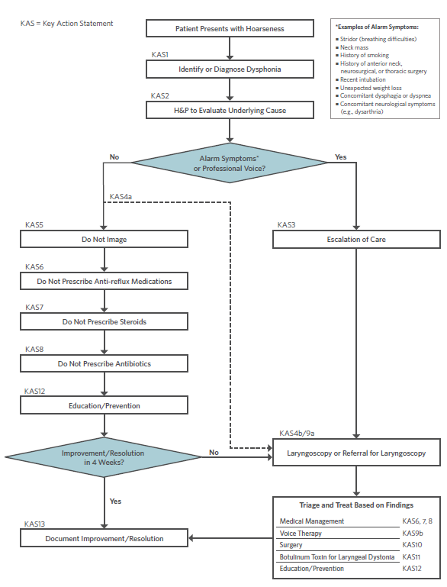
New Algorithm
Algorithm showing the interrelationship of guideline key action statements

Slide 49
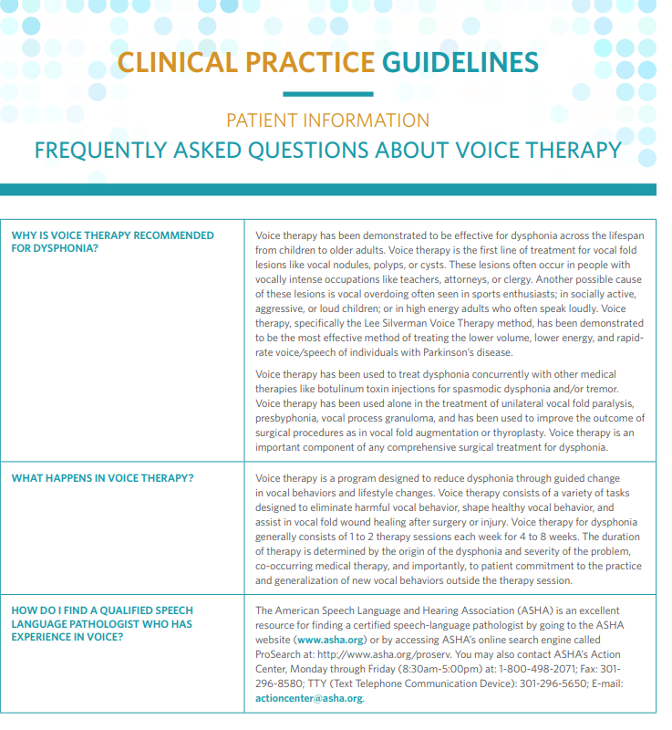
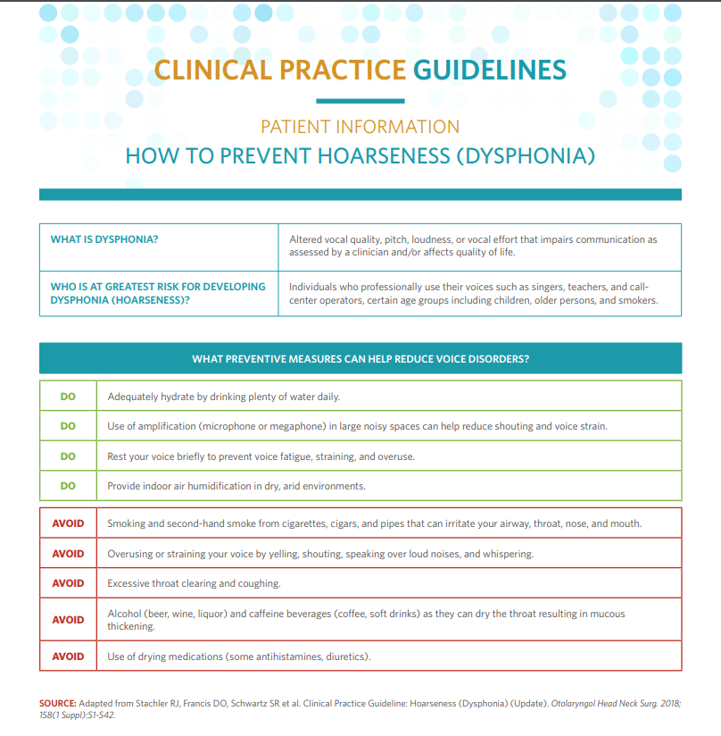
Patient Resources
Available for download: www.entnet.org/dysphoniaCPG

Slide 50
Research Needs
While there is a body of literature from which these recommendations were drawn, significant gaps in our knowledge about dysphonia and its management remain. The guideline committee identified several areas where further research would improve the ability of clinicians to optimally treat patients with dysphonia.

Slide 51
Research Needs (cont’d)
Areas identified for further research:
Escalation of Care and Laryngoscopy and Dysphonia (KASs 3 and 4)
Antireflux Medication and Dysphonia (KAS 6)
Corticosteroids and Antibiotics in Treatment of Dysphonia (KASs 7 and 8)
Surgery (KAS 10)
Botulinum Toxin (KAS 11)
Education/Prevention (KAS 12)
Outcomes (KAS 13)
More information on research needs identified by the guideline committee can be found by visiting: http://www.entnet.org/content/research-gaps-hoarseness

Slide 52
Thank you for your attention
QUESTIONS?

