Slide 1
AAO-HNSF Clinical Practice Guideline: Opioid Prescribing for Analgesia After Common Otolaryngology Operations
Published April 6, 2021

Slide 2
Disclaimer
This guideline is not intended as the sole source of guidance in prescribing opioids and/or analgesics for common otolaryngology procedures. Rather, it is designed to assist clinicians by providing an evidence-based framework for decision-making strategies. The guideline is not intended to replace clinical judgment or establish a protocol for all individuals with this condition and may not provide the only appropriate approach to managing this problem. As medical knowledge expands, and technology advances, clinical indicators and guidelines are promoted as conditional and provisional proposals of what is recommended under specific conditions but are not absolute. Guidelines are not mandates. These do not and should not purport to be a legal standard of care. The responsible physician, in light of all circumstances presented by the individual patient, must determine the appropriate treatment. Adherence to these guidelines will not ensure successful patient outcomes in every situation. The AAO-HNSF emphasizes that these clinical guidelines should not be deemed to include all proper treatment decisions or methods of care, or to exclude other treatment decisions or methods of care reasonably directed to obtaining the same results.

Slide 3

AAO-HNSF Guideline Development Group
Samantha Anne, MD, MS Chair
James “Whit” Mims, MD Assistant Chair
David E. Tunkel, MD Methodologist
Richard M. Rosenfeld, MD, MPH, MBA Methodologist
David S. Boisoneau, MD, AAO-HNSF Board of Directors (BOD)/Board of Governors (BOG)
Michael J. Brenner, MD AAO-HNS Medical Devices and Drugs Committee
John D. Cramer, MD AAO-HNSF Patient Safety and Quality Improvement Committee
David M. Dickerson, MD American Society of Anesthesiologists (ASA)
Sandy A. Finestone, PsyD, Consumers United for Evidence-based Healthcare (CUE)
Adam J. Folbe, MD, MS American Rhinologic Society (ARS)
Deepa J. Galaiya, MD AAO-HNS Section for Residents and Fellows
Anna H. Messner, MD American Society of Pediatric Otolaryngology (ASPO)
Allison M. Paisley, CRNP Society of Otorhinolaryngology Head and Neck Nurses (SOHN)
Ahmad R. Sedaghat, MD, PhD Triological Society
Kerstin M. Stenson, MD American Head and Neck Society (AHNS)
Angela K. Sturm, MD American Academy of Facial Plastics and Reconstructive Surgery (AAFPRS)
Erin M. Lambie, MS, MPH AAO-HNSF Staff Liaison
Nui Dhepyasuwan, MEd AAO-HNSF Staff Liaison
Taskin M. Monjur AAO-HNSF Staff Liaison

Slide 4
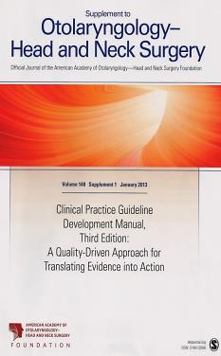
Clinical Practice Guideline Development Manual: Third Edition
Rosenfeld, Shiffman, and Robertson
Pragmatic, transparent approach to creating guidelines for performance assessment
Evidence-based, multidisciplinary process leading to publication in 12-18 months
Emphasizes a focused set of key action statements to promote quality improvement
Uses action statement profiles to summarize decisions in recommendations

Slide 5

Clinical Practice Guidelines (CPG) Goals
Focus on quality improvement opportunities
Define actionable recommendations for clinicians regardless of discipline to improve care
The guideline is not intended to be comprehensive
The guideline is not intended to limit or restrict care provided by clinicians to individual patients

Slide 6
Opioids: Healthcare Burden
The epidemic of opioid misuse, abuse, and overdose in the United States has overwhelmed resources available for treating substance abuse (Dowell et al. 2016) and has led to lost productivity, increased health care costs, and significant mortality.(Reinhart et al. 2018)
In addition to recreational drug abuse and opioid use for chronic pain, inappropriate opioid prescribing practices for acute surgical pain has also contributed to OUD, opioid diversion, and the opioid epidemic.(Kaplovitch et al 2015) (Washington State Agency Medical Directors’ Group 2015)

Slide 7
Opioids: Healthcare Burden
Otolaryngologists wrote nearly 1 million days’ worth of opioids to Medicare beneficiaries in 2015. (Svider et al. 2018) (Khalid et al. 2020)
Reported rates of misuse range from 21% to 29% and addiction ranges from 8% to 12% in chronic pain patients.
Nearly 10% of opioid-naive patients who were prescribed opioids for low-pain short stay surgery were shown to continue use of opioids after one year.(Alam et al. 2012)
According to National Survey on Drug Use and Health data, over 6 million individuals aged 12 years or older misuse prescription pain relievers in a given year, representing over 4 % of the population.(Center for Behavioral Health Statistics and Quality 2014)
The prevalence of prescription opioid misuse was surveyed at 3.6% (11.5 million persons) of the US population in 2018.(2018 Annual Surveillance Report of Drug-Related Risks and Outcomes — United States 2018)

Slide 8
Opioids: Healthcare Burden
The overall rate of death attributed to drug overdose in 2018 was 20.7 per 100,000 persons, with 46,802 overdose deaths from opioids overall. (Wide-ranging online data for epidemiologic research (WONDER))
Synthetic opioids other than methadone, primarily involving illicitly manufactured fentanyl, accounted for the most deaths (more than 31,000 deaths). Prescription opioids were the second leading cause, followed by heroin as the third leading cause amongst all opioid drug overdose deaths. (2018 Annual Surveillance Report of Drug-Related Risks and Outcomes — United States 2018)
There were 613,293 persons reported to have died from unintentional or undetermined drug overdose between 1999 and 2017 per the CDC WONDER database. (Multiple Cause of Death 1999-2017 2018)

Slide 9
Opioids: Healthcare Burden
Over the years, despite the number of prescriptions decreasing, the annual cost of the opioid crisis has continued to increase from $29.1 billion in 2001 to $78.5 billion in 2013 and an estimated $115 billion in 2017.(Florence et al. 2016) (Altarum 2018)
Kirson et al compared 9,342 matched pairs of patients with opioid abuse, overdose, or dependence with non-abusers and calculated an increase of direct medical costs in the opioid abuse patients of $14,810 per patient per year (2012-2015). (Kirson et al. 2017)

Slide 10
Purpose and Target Audience
PURPOSE: to provide clinicians who treat patients with otolaryngologic disorders with evidence-based recommendations on perioperative opioid-based pain management for common otolaryngologic surgical procedures. This guideline also identifies quality improvement opportunities including patient assessment, side effect and complication prevention, and reduction in unnecessary variation in practice. Where evidence is lacking, expert consensus is provided and detailed in the guideline.
TARGET PATIENT: any individual who requires treatment for anticipated or reported pain within the first 30 days after undergoing common otolaryngologic procedures.
TARGET AUDIENCE: otolaryngologists who perform surgery and clinicians that manage pain after surgical procedures.
EXCLUSIONS: The guideline does not apply to patients diagnosed with chronic pain (pain lasting more than 3 months or past the time of normal tissue healing), including those with pain related to cancer itself and not from surgery for cancer, or patients already enrolled in chronic pain management.

Slide 11
Literature Search
Performed by an information specialist
Evidence included:
  Clinical Practice Guidelines: 7
  Systematic Reviews/Meta Analyses: 35
  Randomized Control Trials: 28
  Observational and Other Studies: 136
230 references in the final CPG document

Slide 12
Strength of Action Terms/Implied Levels of Obligation
Strength | Definition | Implied Obligation
Strong Recommendation | The benefits of the recommended approach clearly exceed the harms (or that the harms clearly exceed the benefits in the case of a strong negative recommendation) and that the quality of the supporting evidence is excellent (Grade A or B) | In some clearly identified circumstances, strong recommendations may be made based on lesser evidence when high-quality evidence is impossible to obtain, and the anticipated benefits strongly outweigh the harms. Clinicians should follow a strong recommendation unless a clear and compelling rationale for an alternative approach is present.
Recommendation | A recommendation means the benefits exceed the harms (or that the harms exceed the benefits in the case of a negative recommendation), but the quality of evidence is not as strong (Grade B or C) | In some clearly identified circumstances, recommendations may be made based on lesser evidence when high-quality evidence is impossible to obtain and the anticipated benefits outweigh the harms. Clinicians should also generally follow a recommendation but should remain alert to new information and sensitive to patient preferences.
Option | An option means that either the quality of evidence that exists is suspect (Grade D) or that well-done studies (Grade A, B, or C) show little clear advantage to one approach versus another. | Clinicians should be flexible in their decision making regarding appropriate practice, although they may set bounds on alternatives. Patient preference should have a substantial influencing role.

Slide 13
Opioids CPG: Action Statements
Recommendations: 9
  Expected Pain; Modifying Factors; Patients At-Risk for OUD; Shared Decision Making; Multimodal Therapy; Opioid Prescribing; Patient Feedback; Stopping Pain Medications; Assessment of Pain Control with Opioids
Strong Recommendations: 3
  Risk Factors for Opioid Use Disorder; Non-Opioid Analgesia; Storage and Disposal of Opioids
Options: 0

Slide 14
STATEMENT 1. EXPECTED PAIN
STATEMENT 1. EXPECTED PAIN: Prior to surgery, clinicians should advise patients, and others involved in the postoperative care, about the expected duration and severity of pain. Recommendation based on observational studies with a preponderance of benefit over harms.
Benefits: Educate about expected pain severity, manage expectations for pain and for treatment, ensure expectations are aligned with experience of clinicians, relieve patient anxiety, enable informed decisions for elective procedures, shared decisions for surgery.
Risk, Harm, Cost: Increased patient anxiety, potential for discrepancy between predicted and observed pain, delay or deferral of treatment.

Slide 15
STATEMENT 1. EXPECTED PAIN
Action Statement Profile
Quality Improvement Opportunity: Align patient expectations with actual pain severity and duration and reducing uncertainty regarding recovery. (National Quality Strategy Domain: Engaging Patients)
Aggregate Evidence Quality: Grade C, based on observational studies in otolaryngology populations; indirect evidence from RCTs in other specialties.
Level of Confidence in Evidence: High
Benefit-Harm Assessment: Preponderance of benefit over harm.
Value Judgments: None.
Intentional Vagueness: Method of counseling not specified (oral, written, videos).
Role of Patient Preferences: None to limited regarding counseling; high regarding inclusion of caregivers/others in the counseling process.
Exclusions: None.
Policy Level: Recommendation.
Differences of Opinion: None

Slide 16
STATEMENT 2. MODIFYING FACTORS
STATEMENT 2. MODIFYING FACTORS: Prior to surgery, clinicians should gather information specific to the patient that modifies severity and/ or duration of pain. Recommendation based on observational studies with a preponderance of benefit over harms.
Benefits: Individualize the plan for analgesia for the specific patient and clinical setting, improve patient satisfaction/expectation, minimize overtreatment or undertreatment of pain, engagement of patient in design of postop pain management, reduce potential bias and decrease disparities in pain management.
Risk, Harm, Cost: Information may lead to inaccurate estimates of pain, administrative burden of gathering and documenting information, heighten implicit bias.

Slide 17
STATEMENT 2. MODIFYING FACTORS
Action Statement Profile
Quality Improvement Opportunity: Individualize assessment and plan for patient pain management and to encourage explicit thinking by clinicians about factors that will modify pain after surgery. (National Quality Strategy Domain: Promoting Effective Prevention/Treatments)
Aggregate Evidence Quality: Grade C, based on observational studies
Level of Confidence in Evidence: high
Benefit-Harm Assessment: Preponderance of benefit over harm.
Value Judgments: This inquiry may not be done routinely; this is independent but complementary to assessing risk profile for OUD.
Intentional Vagueness: Method of inquiry not specified, may involve written survey, interview or standardized history.
Role of Patient Preferences: None.
Exclusions: None.
Policy Level: Recommendation.
Differences of Opinion: None.

Slide 18
STATEMENT 3A. RISK FACTORS FOR OPIOID USE DISORDER
STATEMENT 3A. RISK FACTORS FOR OPIOID USE DISORDER: Prior to surgery, clinicians should identify risk factors for opioid use disorder when analgesia using opioids is anticipated. Strong recommendation based on systematic reviews of randomized controlled trials with limitations and observational studies with a preponderance of benefit over harm.
Benefits: Increased monitoring for OUD after surgery, increased use of non-opioid modalities of analgesia, increased coordination of care with other providers including pain specialists, limit opioid use after surgery and monitor duration of use, identify patients at risk for opioid use associated respiratory depression.
Risk, Harm, Cost: Undertreatment of pain, false positive assessment of risk for OUD, implicit biases about OUD are heightened, strained therapeutic alliance.

Slide 19
STATEMENT 3A. RISK FACTORS FOR OPIOID USE DISORDER
Action Statement Profile
Quality Improvement Opportunity: Identify patients at risk for OUD for preoperative intervention and postoperative vigilance. (National Quality Strategy Domain: Safety)
Aggregate Evidence Quality: Grade A, based on systematic reviews
Level of Confidence in Evidence: High
Benefit-Harm Assessment: Preponderance of benefit over harm.
Value Judgments: Risk assessment for OUD is not routinely done prior to surgery and opioid prescription.
Intentional Vagueness: None.
Role of Patient Preferences: None.
Exclusions: None.
Policy Level: Strong recommendation.
Differences of Opinion: None.

Slide 20
STATEMENT 3B. PATIENTS AT RISK FOR OPIOID USE DISORDER
STATEMENT 3B. PATIENTS AT RISK FOR OUD: In patients at risk for OUD, clinicians should evaluate the need to modify the analgesia plan. Recommendation based on observational studies with a preponderance of benefit over harms.
Benefits: Decrease risk of developing OUD, decrease risk of opioid complications in patients with OUD, increased safety of analgesia plans, modify analgesia regimen to non-opioid methods, heightened awareness of need for referral to addiction specialist, patient education about identified risk of OUD.
Risk, Harm, Cost: Potential delay of care, need for more perioperative resources, risk to therapeutic alliance, stigma of labelling at risk for OUD.

Slide 21
STATEMENT 3B. PATIENTS AT RISK FOR OPIOID USE DISORDER
Action Statement Profile
Quality Improvement Opportunity: Actively intervene for at risk patients to reduce risk of OUD. (National Quality Strategy Domain: Promoting Effective Prevention/Treatment)
Aggregate Evidence Quality: Grade C, based on observational studies
Level of Confidence in Evidence: Medium
Benefit-Harm Assessment: Preponderance of benefit over harm.
Value Judgments: None.
Intentional Vagueness: Modifications to the analgesic plan are not specified, but include vigilance with monitoring for development of OUD
Role of Patient Preferences: Patients may decline or modify referral or interventions for “at-risk”.
Exclusions: None.
Policy Level: Recommendation.
Differences of Opinion: None.

Slide 22
STATEMENT 4. SHARED DECISION MAKING
STATEMENT 4. SHARED DECISION-MAKING: Clinicians should promote shared decision making by informing patients of the benefits and risks of postoperative pain treatments that include non-opioid analgesics, opioid analgesics, and non-pharmacologic interventions. Recommendation based on expert opinion with a preponderance of benefit over harms.
Benefits: Incorporation of patient values and preferences in the analgesia plan, promote shared decision making, encourage use of nonopioid medications, encourage nonpharmacologic pain management, opportunity for discussion of risks of opioids/OUD, opportunity to address misperceptions, curtail overuse of opioids, opportunity to counsel about opioid use.
Risk, Harm, Cost: Time expended, increased anxiety when opioids are used, possible reduced use of opioids when needed, increased potential for nonadherence to plan based on risk assessment.

Slide 23
STATEMENT 4. SHARED DECISION MAKING
Action Statement Profile
Quality Improvement Opportunity: Educate patients in preparation for shared decision making regarding analgesic plan. (National Quality Strategy Domain: Engaging Patients)
Aggregate Evidence Quality: Grade C based on observational studies
Level of Confidence in Evidence: Medium, as the studies are not specific to pain management after otolaryngology surgery.
Benefit-Harm Assessment: Preponderance of benefit over harm.
Value Judgments: The GDG felt patient education and counseling are valuable parts of formulating analgesic plan and may increase adherence to the plan.
Intentional Vagueness: None.
Role of Patient Preferences: None.
Exclusions: None.
Policy Level: Recommendation.
Differences of Opinion: None.

Slide 24
STATEMENT 5. MULTIMODAL THERAPY
STATEMENT 5. MULTIMODAL THERAPY: Clinicians should develop a multimodal treatment plan for managing postoperative pain. Recommendation based on observational studies with a preponderance of benefit over harms.
Benefits: Establish mutual expectations, encourage proactive thinking for best practice, shared decision making, makes a template for structured pain management, coordinates care, reduced ad hoc decisions that could lead to increased opioid use.
Risk, Harm, Cost: Conflict between clinician and patient, potential delay or deferral of surgery if patient does not accept plan, costs of alternate therapies (may not be covered by insurance plans).

Slide 25
STATEMENT 5. MULTIMODAL THERAPY
Action Statement Profile
Quality Improvement Opportunity: Promote adherence to plan for pain management; establish goals and objectives of the plan. (National Quality Strategy Domain: Promoting Effective Prevention/Treatments)
Aggregate Evidence Quality: Grade C, based on observational studies
Level of Confidence in Evidence: High
Benefit-Harm Assessment: Preponderance of benefit over harm.
Value Judgments: Articulation of the plan for pain management will promote adherence.
Intentional Vagueness: Factors related to procedures and patients are specified in prior action statements; multi-modal treatment plan will include nonpharmacologic interventions, opioids and non-opioid medications.
Role of Patient Preferences: High; patients will participate in selection of specific components of the analgesic plans.
Exclusions: None.
Policy Level: Recommendation.
Differences of Opinion: None.

Slide 26
STATEMENT 6. NONOPIOID ANALGESIA
STATEMENT 6. NON-OPIOID ANALGESIA: Clinicians should advocate for nonopioid medications as first-line management of pain after otolaryngologic surgery. Strong recommendation based on randomized controlled studies with a preponderance of benefits over harm.
Benefits: Reduce the use of opioids, reduce risk of OUD, more effective pain control, enhanced recovery after surgery with reduced nausea and vomiting, better ambulation, avoiding opioid diversion, maintaining opioid naïve state.
Risk, Harm, Cost: Potential undertreatment of pain, overuse of nonopioids when not needed.

Slide 27
STATEMENT 6. NONOPIOID ANALGESIA
Action Statement Profile
Quality Improvement Opportunity: Emphasize the effectiveness of non-opioids for pain control and reduction of opioid risks. (National Quality Strategy Domain: Promoting Effective Prevention/Treatments)
Aggregate Evidence Quality: Grade A, based on systematic reviews and randomized controlled trials
Level of Confidence in Evidence: High
Benefit-Harm Assessment: Preponderance of benefit over harm.
Value Judgments: Threshold for use of opioids may be too low and nonopioids may not be considered.
Intentional Vagueness: Types of nonopioids are not specified, as they are many and may depend on patient and specific factors.
Role of Patient Preferences: None.
Exclusions: Patients who have specific contraindications to nonopioid medications.
Policy Level: Strong recommendation.
Differences of Opinion: None.

Slide 28
STATEMENT 7. OPIOID PRESCRIBING
STATEMENT 7. OPIOID PRESCRIBING: When treating postoperative pain with opioids, clinicians should limit therapy to the lowest effective dose and the shortest duration. Recommendation based on observational studies with a preponderance of benefit over harms.
Benefits: Reduce risk of OUD, reduce adverse effects of opioids, reduce opioid diversion, optimize pain control, encourage use of non-opioid strategies.
Risk, Harm, Cost: Ineffective pain control, administrative burden, potential increase in patient encounters.

Slide 29
STATEMENT 7. OPIOID PRESCRIBING
Action Statement Profile
Quality Improvement Opportunity: Reduce the exposure to opioids and reduce complications and risk of OUD. (National Quality Strategy Domain: Safety)
Aggregate Evidence Quality: Grade C, randomized trials and observational studies reporting opioid consumption in common otolaryngology procedures.
Level of Confidence in Evidence: Medium
Benefit-Harm Assessment: Preponderance of benefit over harm.
Value Judgments: None.
Intentional Vagueness: Shortest duration and lowest dose not specified as depends on the patient, procedure, and pain assessments.
Role of Patient Preferences: None.
Exclusions: None.
Policy Level: Recommendation.
Differences of Opinion: None.

Slide 30
STATEMENT 8A. PATIENT FEEDBACK
STATEMENT 8A. PATIENT FEEDBACK: Clinicians should instruct patients and caregivers how to communicate if pain is not controlled or if medication side effects occur. Recommendation based on observational studies with a preponderance of benefit over harms.
Benefits: Improved pain management, implementation of step-wise multimodal therapy, reduce or avoid side effects/complications.
Risk, Harm, Cost: None.

Slide 31
STATEMENT 8A. PATIENT FEEDBACK
Action Statement Profile
Quality Improvement Opportunity: Coordination of care; person- and family centered care. (National Quality Strategy Domain: Engaging Patients)
Aggregate Evidence Quality: Grade C, based on observational studies.
Level of Confidence in Evidence: Medium.
Benefit-Harm Assessment: Preponderance of benefit over harm.
Value Judgments: None.
Intentional Vagueness: Methods of communication may vary.
Role of Patient Preferences: None.
Exclusions: None.
Policy Level: Recommendation.
Differences of Opinion: None.

Slide 32
STATEMENT 8B. STOPPING PAIN MEDICATIONS
STATEMENT 8B. STOPPING PAIN MEDICATIONS: Clinicians should educate patients to stop opioids when pain is controlled with nonopioids and stop all analgesics when pain has resolved. Recommendation based on observational studies with a preponderance of benefit over harms.
Benefits: Reduced risk of OUD, reduced side effects of opioids or other medications
Risk, Harm, Cost: None.

Slide 33
STATEMENT 8B. STOPPING PAIN MEDICATIONS
Action Statement Profile
Quality Improvement Opportunity: Reduce duration of opioid use to reduce OUD and other risks. (National Quality Strategy Domain: Promoting Effective Prevention/Treatments)
Aggregate Evidence Quality: Grade C, based on observational studies
Level of Confidence in Evidence: Medium
Benefit-Harm Assessment: Preponderance of benefit over harm.
Value Judgments: Clinicians are not informing patients about end of therapy.
Intentional Vagueness: Method of informing and education is not specified.
Role of Patient Preferences: None.
Exclusions: None.
Policy Level: Recommendation.
Differences of Opinion: None.

Slide 34
STATEMENT 9. STORAGE AND DISPOSAL OF OPIOIDS
STATEMENT 9. STORAGE AND DISPOSAL OF OPIOIDS: Clinicians should recommend that patients (or their caregivers) store prescribed opioids securely and dispose of unused opioids through take-back programs or another accepted method. Strong Recommendation based on observational studies with a preponderance of benefit over harms.
Benefits: Reduce risk of opioid diversion, decrease risk of side effects including overdose, decrease risk of subsequent OUD.
Risk, Harm, Cost: Cost of disposal.

Slide 35
STATEMENT 9. STORAGE AND DISPOSAL OF OPIOIDS
Action Statement Profile
Quality Improvement Opportunity: Reduce instances of accidental overdose, decrease opioid diversion, reduce prevalence of OUD. (National Quality Strategy Domain: Safety)
Aggregate Evidence Quality: Grade C, observational studies associating the practices of secure storage and disposal with diminished opioid misuse and opioid diversion.
Level of Confidence in Evidence: Medium
Benefit-Harm Assessment: Preponderance of benefit over harm.
Value Judgments: The GDG felt that opioids are seldom stored securely and that disposal of unused opioids is not routinely performed. Strong recommendation because benefits much greater than harms, and that high quality studies not likely to be performed regarding storage and disposal of opioids.
Intentional Vagueness: Methods of storage and disposal are not explicitly specified.
Role of Patient Preferences: Patients may elect methods of storage and disposal with the range of accepted safe practices. Patients may expend time, money, or other resources to obtain opioids; some patients may perceive that the opioids are their personal property and that it is their prerogative to save medications for future use even after pain resolves.
Exclusions: None.
Policy Level: Strong Recommendation.
Differences of Opinion: None.

Slide 36
STATEMENT 10. ASSESSMENT OF PAIN CONTROL WITH OPIOIDS
STATEMENT 10. ASSESSMENT OF PAIN CONTROL WITH OPIOIDS: Clinicians should inquire, within 30 days of surgery, whether the patient has stopped using opioids, has disposed of unused opioids, and was satisfied with the pain management plan. Recommendation based on observational studies with a preponderance of benefit over harms.
Benefits: Identify patients with persistent pain, identify patients at risk of OUD and need for referral, assess effectiveness of pain management plan, ability to adjust plan for future patients.
Risk, Harm, Cost: Administrative burden of obtaining information and referral.

Slide 37
STATEMENT 10. ASSESSMENT OF PAIN CONTROL WITH OPIOIDS
Action Statement Profile
Quality Improvement Opportunity: Collect outcomes on pain management plan and methods do reduce OUD and diversion. (National Quality Strategy Domain: Promoting Effective Prevention/Treatments)
Aggregate Evidence Quality: Grade C, based on observational studies.
Level of Confidence in Evidence: Medium
Benefit-Harm Assessment: Preponderance of benefit over harm.
Value Judgments: None.
Intentional Vagueness: The methods of collecting this information are not specified.
Role of Patient Preferences: None.
Exclusions: None.
Policy Level: Recommendation.
Differences of Opinion: None.

Slide 38
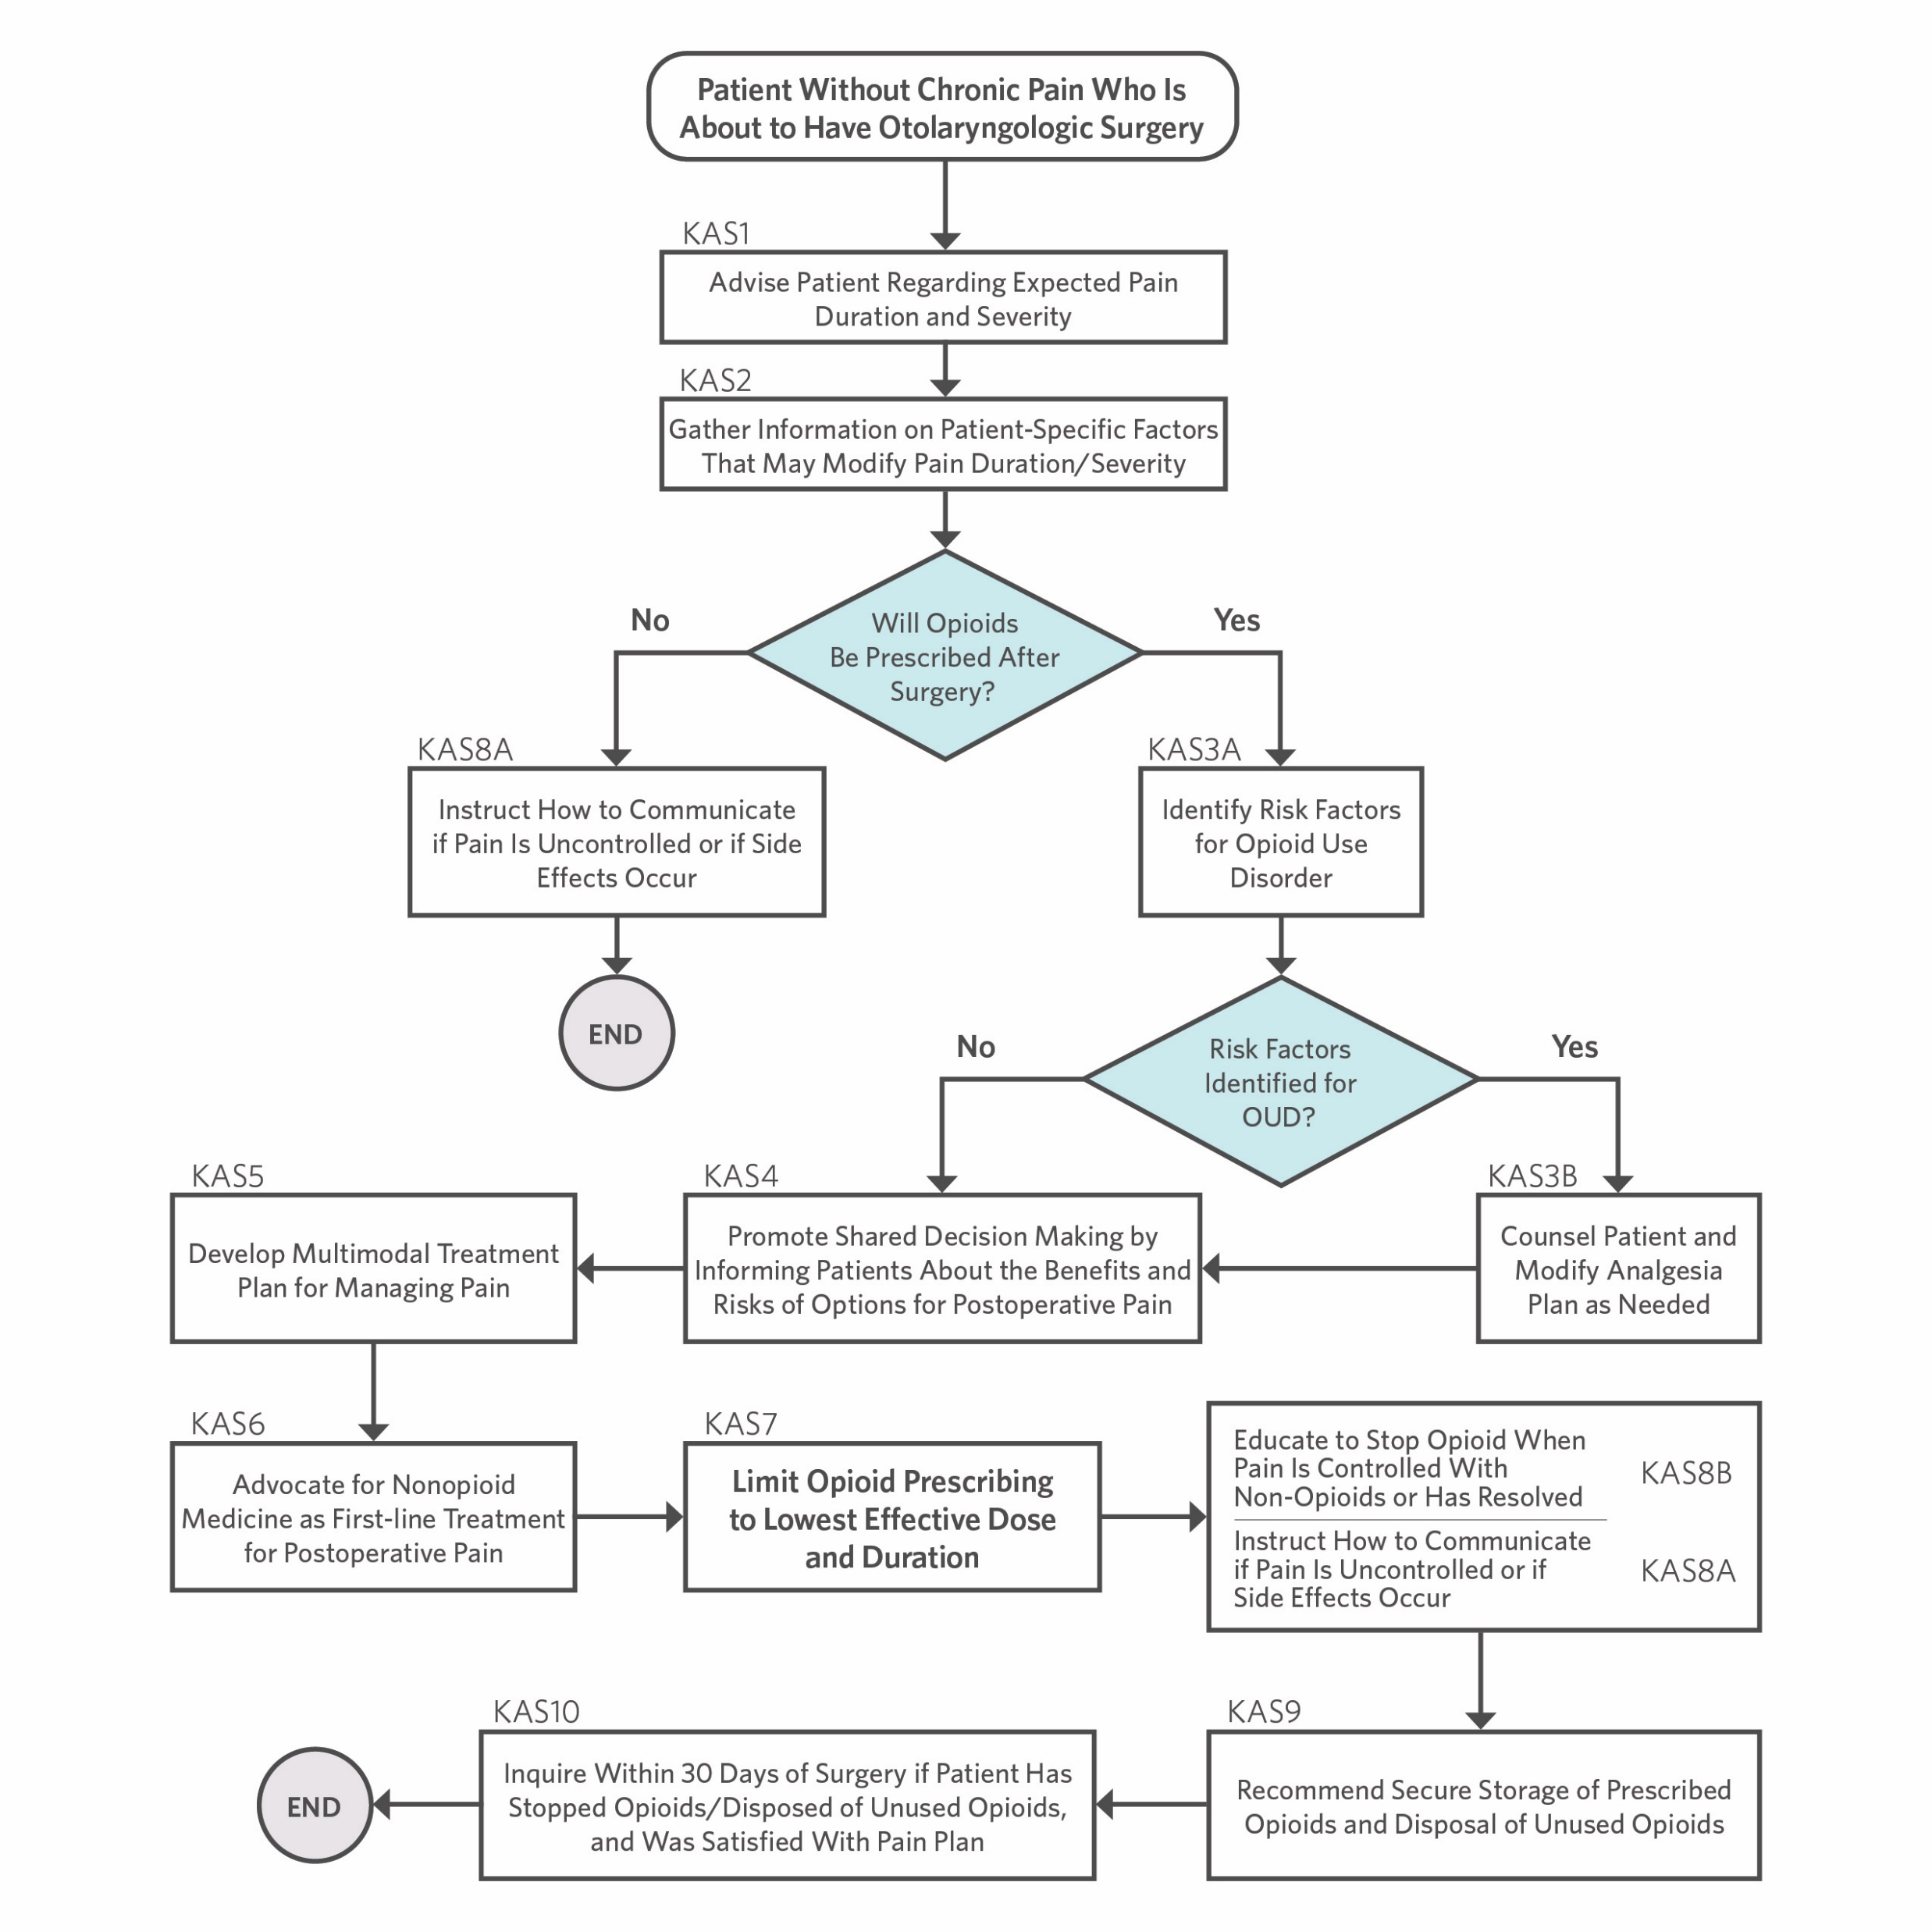
CPG Algorithm
Algorithm showing the interrelationship of guideline key action statements

Slide 39
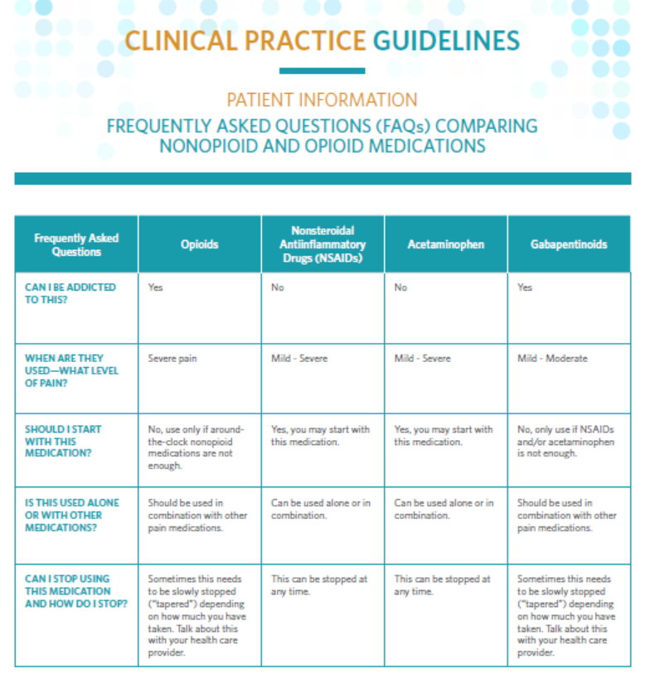
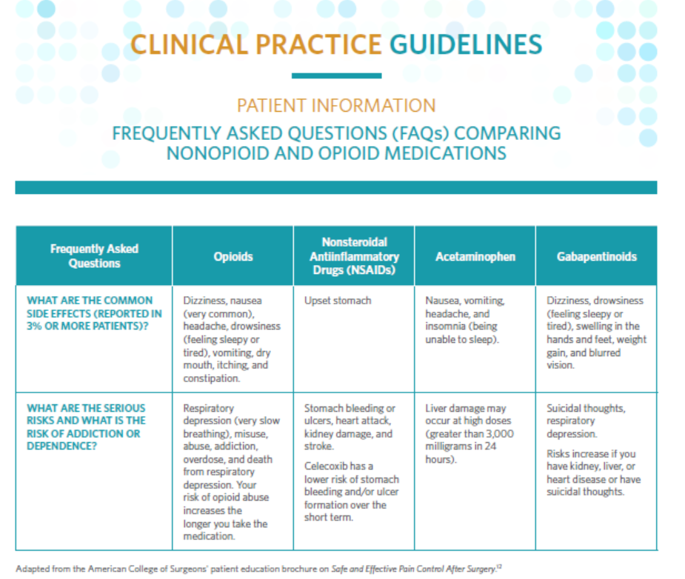
Patient Handouts available at www.entnet.org/opioidscpg

Slide 40
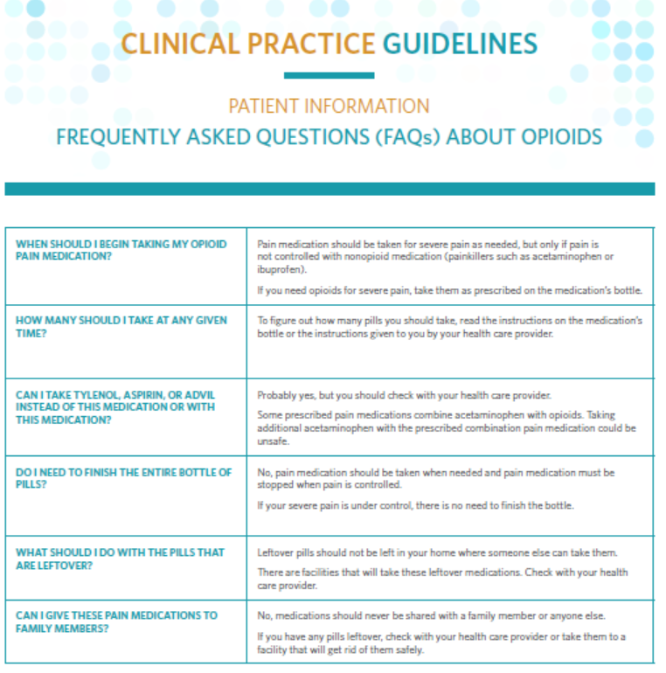
Patient Handouts available at www.entnet.org/opioidscpg

Slide 41

Video: Secure Storage and Disposal of Opioids
https://www.youtube.com/watch?v=08xuYGrvEYk

Slide 42
Research Needs
Development of this guideline was based on the current body of evidence regarding the opioid-prescribing practices for common otolaryngologic procedures. As determined by the GDG’s review of the literature, assessment of current clinical practices, and determination of evidence gaps, research needs were determined as follows:

Slide 43
Research Needs
What are the benefits of preoperative counseling on postoperative pain outcomes?
What is the duration and severity of pain for specific otolaryngology surgical procedures?
How do specific procedural and patient factors modify postoperative pain?
In patients at risk for increased postoperative pain, how is that effectively managed?
What is the optimal way to counsel patients preoperatively?
How have prescription-monitoring-programs influenced management of postoperative pain?
Are there specific predictors of OUD in otolaryngologic surgical patients?
How do opioid risk assessment and postoperative prescribing differ in the pediatric otolaryngologic population?
What interventions reduce risk of OUD for patients after surgery?
Is gabapentin helpful to control postoperative pain and reduce opioid use in otolaryngology patients?

Slide 44
Research Needs (Cont.)
Are some otolaryngology patients at higher risk for cardiovascular morbidity from COX-2 inhibitors?
Which otolaryngology surgical procedures are associated with prolonged opioid use and symptoms of postoperative opioid withdrawal?
What is the risk of bleeding after surgery, by procedure, when using ibuprofen postoperatively?
What specific combinations of medications optimally balance pain control, risks, and cost?
Are scheduled doses of acetaminophen and NSAIDs superior to as-needed regimens?
Does staggering the timing of acetaminophen and NSAIDs improve postoperative pain control?
What are the current trends in opioid prescribing for otolaryngologic surgery, and what are the key factors (eg, patient awareness, patient education, provider awareness, and provider education) that affect the trends?
When nonopioids are used as first-line therapy, what is the impact on opioid consumption?
What are the usual durations for opioid therapy after each of the most common otolaryngologic surgical procedures?
What is the best strategy to de-escalate postoperative pain treatment?

Slide 45
Research Needs (Cont.)
What percentage of patients dispose of unused opioids after recovery from otolaryngologic surgery?
What is the most effective educational approach to promote disposal of unused opioids?
Do the expectations of the duration and severity of surgical pain by providers correlate with postoperative assessments by patients?
What are optimal measurements/scales for pain and indicators for quality of recovery after otolaryngology surgery?
Are there racial or gender biases that impact the prescribing of opioids, the education about opioids, or risk of developing OUD after surgery?
The lists of research needs identified by guideline development groups can be found at https://www.entnet.org/content/research-gaps

Slide 46
The AAO-HNSF Maureen Hannley Research Grant
Mechanism of the CORE Grants Program
$50,000 over one year
Purpose:
  Designed to fill research needs identified by the AAO-HNSF clinical practice guideline panels.
  Support the career development of investigators who have made a commitment to focus their research endeavors on patient-oriented research.
If you are interested in applying for an AAO-HNSF Maureen Hannley Research Grant, visit www.entnet.org/core

Slide 47
References from CPG
18. Dowell D, Haegerich TM, Chou R. CDC Guideline for Prescribing Opioids for Chronic Pain--United States, 2016. JAMA. 2016;315(15):1624-1645.
19. Reinhart M, Scarpati LM, Kirson NY, Patton C, Shak N, Erensen JG. The Economic Burden of Abuse of Prescription Opioids: A Systematic Literature Review from 2012 to 2017. Appl Health Econ Health Policy. 2018;16(5):609-632.
20. Kaplovitch E, Gomes T, Camacho X, Dhalla IA, Mamdani MM, Juurlink DN. Sex Differences in Dose Escalation and Overdose Death during Chronic Opioid Therapy: A Population-Based Cohort Study. PLoS One. 2015;10(8):e0134550.
21. Washington State Agency Medical Directors' Group. AMDG 2015 Interagency Guideline on Prescribing Opioids for Pain. http://www.agencymeddirectors.wa.gov/guidelines.asp. Published 2015. Accessed November 14, 2019.
6. Svider PF, Arianpour K, Guo E, et al. Opioid prescribing patterns among otolaryngologists: Crucial insights among the medicare population. Laryngoscope. 2018;128(7):1576-1581.
7. Khalid SI, Kelly R, Khalid R, et al. The opioid prescribing practices of surgeons: A comprehensive review of the 2015 claims to Medicare Part D. Surgery Open Science. 2020;2(2):96-100.
9. Alam A, Gomes T, Zheng H, Mamdani MM, Juurlink DN, Bell CM. Long-term analgesic use after low-risk surgery: a retrospective cohort study. Arch Intern Med. 2012;172(5):425-430.
10. Center for Behavioral Health Statistics and Quality. Results from the 2014 National Survey on Drug Use and Health. Substance Abuse and Mental Health Services Administration (SAMHSA), US Department of Health and Human Services. https://www.samhsa.gov/data/sites/default/files/NSDUH-DetTabs2014/NSDUH-DetTabs2014.pdf. Published 2014. Accessed December 8, 2019.
23. Centers for Disease Control and Prevention. 2018 Annual Surveillance Report of Drug-Related Risks and Outcomes — United States. U.S. Department of Health and Human Services;2018.
28. Centers for Disease Control and Prevention. Wide-ranging online data for epidemiologic research (WONDER). In:2020.
29. Centers for Disease Control and Prevention. Multiple Cause of Death 1999-2017 2018.
36. Florence CS, Zhou C, Luo F, Xu L. The Economic Burden of Prescription Opioid Overdose, Abuse, and Dependence in the United States, 2013. Med Care. 2016;54(10):901-906.
37. Altarum. Economic Toll of Opioid Crisis in U.S. Exceeded $1 Trillion Since 2001. https://altarum.org/news/economic-toll-opioid-crisis-us-exceeded-1-trillion-2001. Published 2018. Accessed August 5, 2020.
38. Kirson NY, Scarpati LM, Enloe CJ, Dincer AP, Birnbaum HG, Mayne TJ. The Economic Burden of Opioid Abuse: Updated Findings. J Manag Care Spec Pharm. 2017;23(4):427-445.

Slide 48
For more information and additional resources, visit www.entnet.org/opioidscpg

